Slide 2
Changes – March 23, 2020
The changes made to the administration of the test will accommodate those impacted by the spread of the Coronavirus that has interrupted face-to-face learning and review.
45 minutes
Online and students can take on any device
Will be a written exam (no multiple choice)
Will cover partial course content to address units not covered by teachers by mid-March

Slide 3
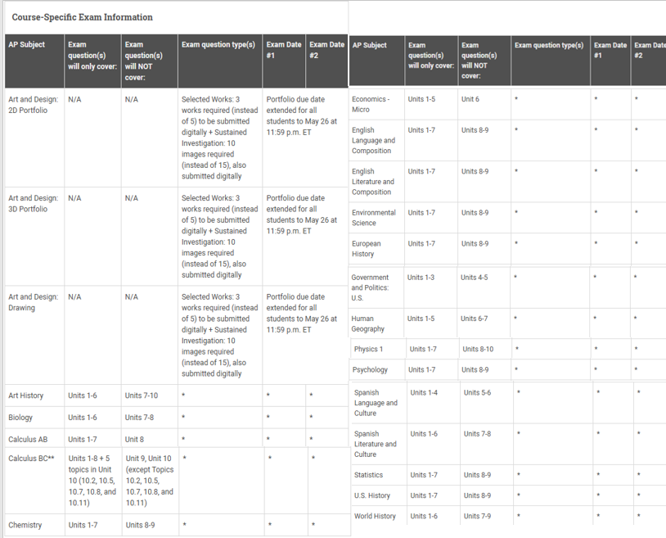
*CLARIFICATION: The units that will NOT be covered from OUR AP Bio course (at Wheeler) are: Unit 6 (Evol) & Unit 7 (Eco). Our Unit 8 WILL be covered on the Exam - it was an extension of Unit 4 (Communication)
→

Slide 4
When will we know more?
On April 3rd, the College Board will be announcing the type of writing assessment to be administered.
In addition, they will release more information regarding resources and options for students and teachers.
Please look for another video following April 3rd.

Slide 5
More information here:
https://apcentral.collegeboard.org/about-ap/news-changes/coronavirus-update

