Slide 1
Biology EOC Review
DNA, RNA, Protein Synthesis

Slide 2
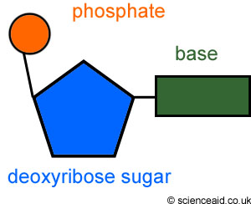
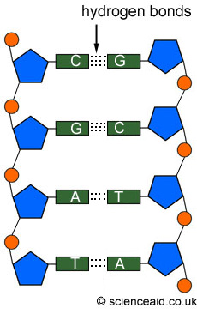
DNA
DNA is a polymer of nucleotides.
A nucleotide is made up of three parts: a sugar, a phosphate and one of four bases
In DNA, the bases are A, T, C, and G
DNA’s shape is a double helix
The two strands are held together by HYDROGEN bonds
A bonds to T
C bonds with G
*Pair up on computers, go to this site & do the questions: http://www.sciencegeek.net/Biology/review/U5DNA.htm

Slide 3
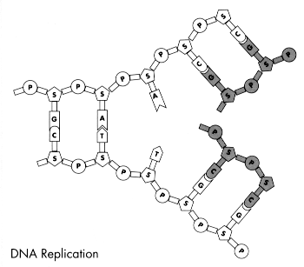
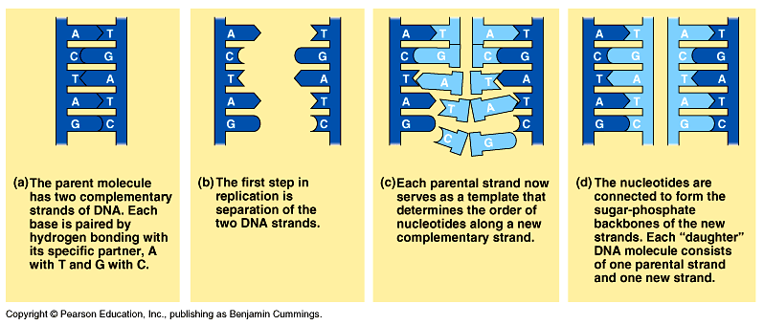
DNA Replication
Process of DNA copying itself
Steps
-DNA Unzips (Hydrogen bonds break)
-Each side acts as a template
-New DNA nucleotides are added according to base-pairing rules
-Two new molecules of DNA result – each with one old and one new strand.
Happens in INTERPHASE (before mitosis or meiosis)

Slide 4
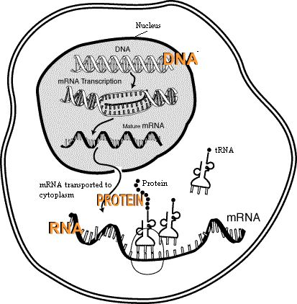
Protein Synthesis
Remember, genes are made of DNA and are in the nucleus
Genes (DNA) contain the instruction for making a protein
In transcription, DNA is used to make mRNA in the nucleus
mRNA then leaves the nucleus and goes to the ribosome
In translation, tRNA then brings amino acids in the proper order to make the protein on the ribosome.
DNA → mRNA → protein
Made of amino acids

Slide 5
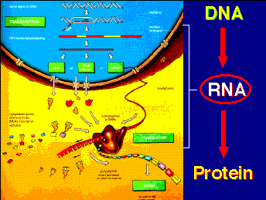
PROTEIN SYNTHESIS
DNA
DNA is in nucleus
GENES (made of DNA) hold code for protein
RNA
mRNA is made in nucleus
TRANSCRIPTION
PROTEIN
mRNA goes to ribosome
tRNA brings the right amino acid to the mRNA
Remember base pairing rules
3 bases on mRNA is a codon – each codon codes for one amino acid
Anticodon on tRNA base pairs with codon on mRNA

Slide 6
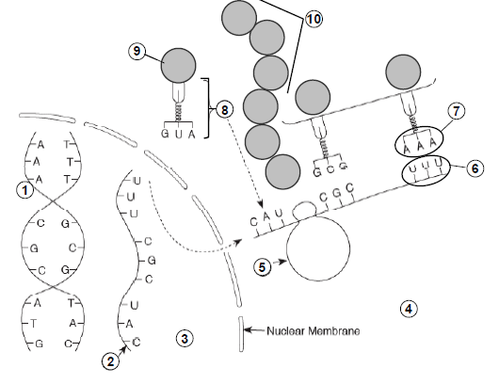
Can you IDENTIFY the parts?
DNA
mRNA
Nucleus
Cytoplasm
Ribosome
Codon
Anticodon
tRNA
Amino acid
Protein (polypeptide)

Slide 7
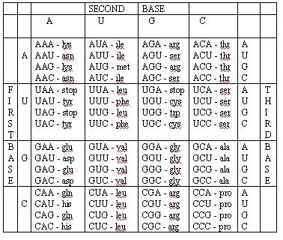
READING THE CODON CHART
Be sure to use mRNA
You won’t have to memorize this!
What amino acid is coded for by the DNA?
ATA GAG
First convert DNA to mRNA
ATA GAG UAU CUC
UAU = tyr
CUC = Leu

Slide 8
Mutations- changes in the dna code
Point (Base) Mutations: Substitution or Frameshift (insertion or deletion)
- Substitution Mutations- one base is substituted for another. It will only affect one amino acid (at the most)
- Frameshift Mutations- due to Insertion and Deletion of bases (will affect every amino acid there after)
*See the handout. We’ll go over it and work a few problems
Chromosomal Mutations
- Sometimes mutations happen to the entire chromosome. Parts may be broken off, duplicated and sometimes part of a chromosome may break off and reattach to a different chromosome.
- Five types exist:
Deletion, Inversion, Translocation, Nondisjunction, Duplication
*A few types are shown on the next few slides

Slide 9
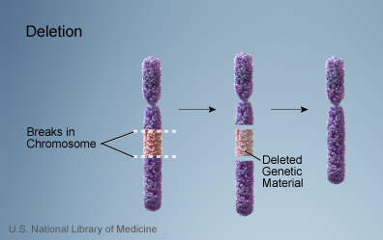
Deletion
Due to breakage
A piece of a chromosome is lost

Slide 10
Inversion
Chromosome segment breaks off
Segment flips around backwards
Segment reattaches

Slide 11
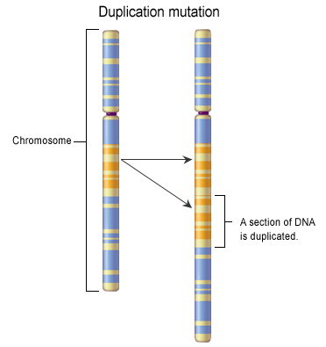
Duplication
Occurs when a gene sequence is repeated

