Slide 1
Cellular Division- Part 1- Mitosis MAGNET BIOLOGY

Slide 2
Cell Division
All cells are derived from pre-existing cells
New cells are produced for growth and to replace damaged or old cells
Differs in prokaryotes (bacteria and archaea) and eukaryotes (protists, fungi, plants, & animals)

Slide 3
Keeping Cells Identical
The instructions for making cell parts are encoded in the DNA, so each new cell must get a complete set of the DNA molecules

Slide 4
DNA Replication
DNA must be copied or replicated before cell division
Each new cell will then have an identical copy of the DNA
Original DNA strand
Two new, identical DNA strands

Slide 5
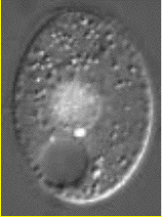
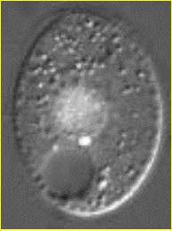
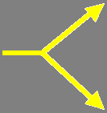
Identical Daughter Cells
Two identical daughter cells
Parent Cell

Slide 6
Chromosomes

Slide 7
Prokaryotic Chromosome
The DNA of prokaryotes (bacteria) is one, circular chromosome attached to the inside of the cell membrane

Slide 8
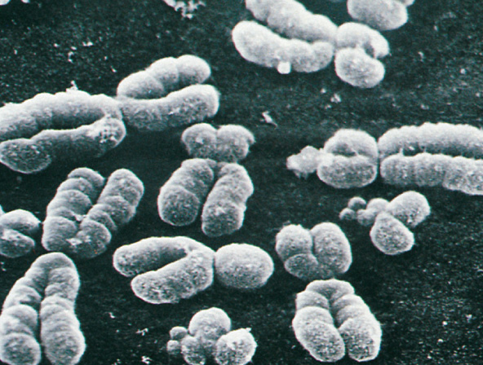
Eukaryotic Chromosomes
All eukaryotic cells store genetic information in chromosomes
Most eukaryotes have between 10 and 50 chromosomes in their body cells
Human body cells have 46 chromosomes or 23 homologous pairs

Slide 9
Eukaryotic Chromosomes
Each chromosome is composed of a single, tightly coiled DNA molecule
Chromosomes can’t be seen when cells aren’t dividing and are called chromatin

Slide 10
Compacting DNA into Chromosomes
DNA is tightly coiled around proteins called histones

Slide 11
Chromosomes in Dividing Cells
Duplicated chromosomes are called chromatids & are held together by the centromere
Called Sister Chromatids

Slide 12
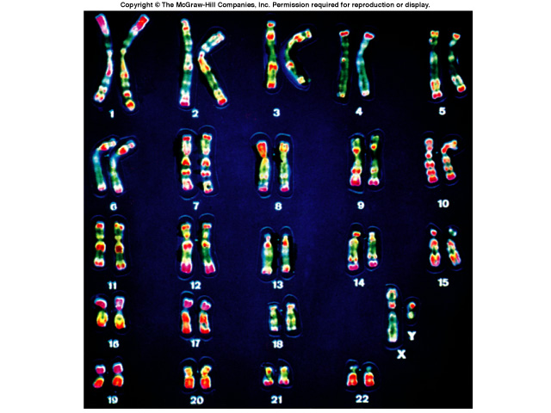
Karyotype
A picture of the chromosomes from a human cell arranged in pairs by size
First 22 pairs are called autosomes
Last pair are the sex chromosomes
XX female or XY male

Slide 13
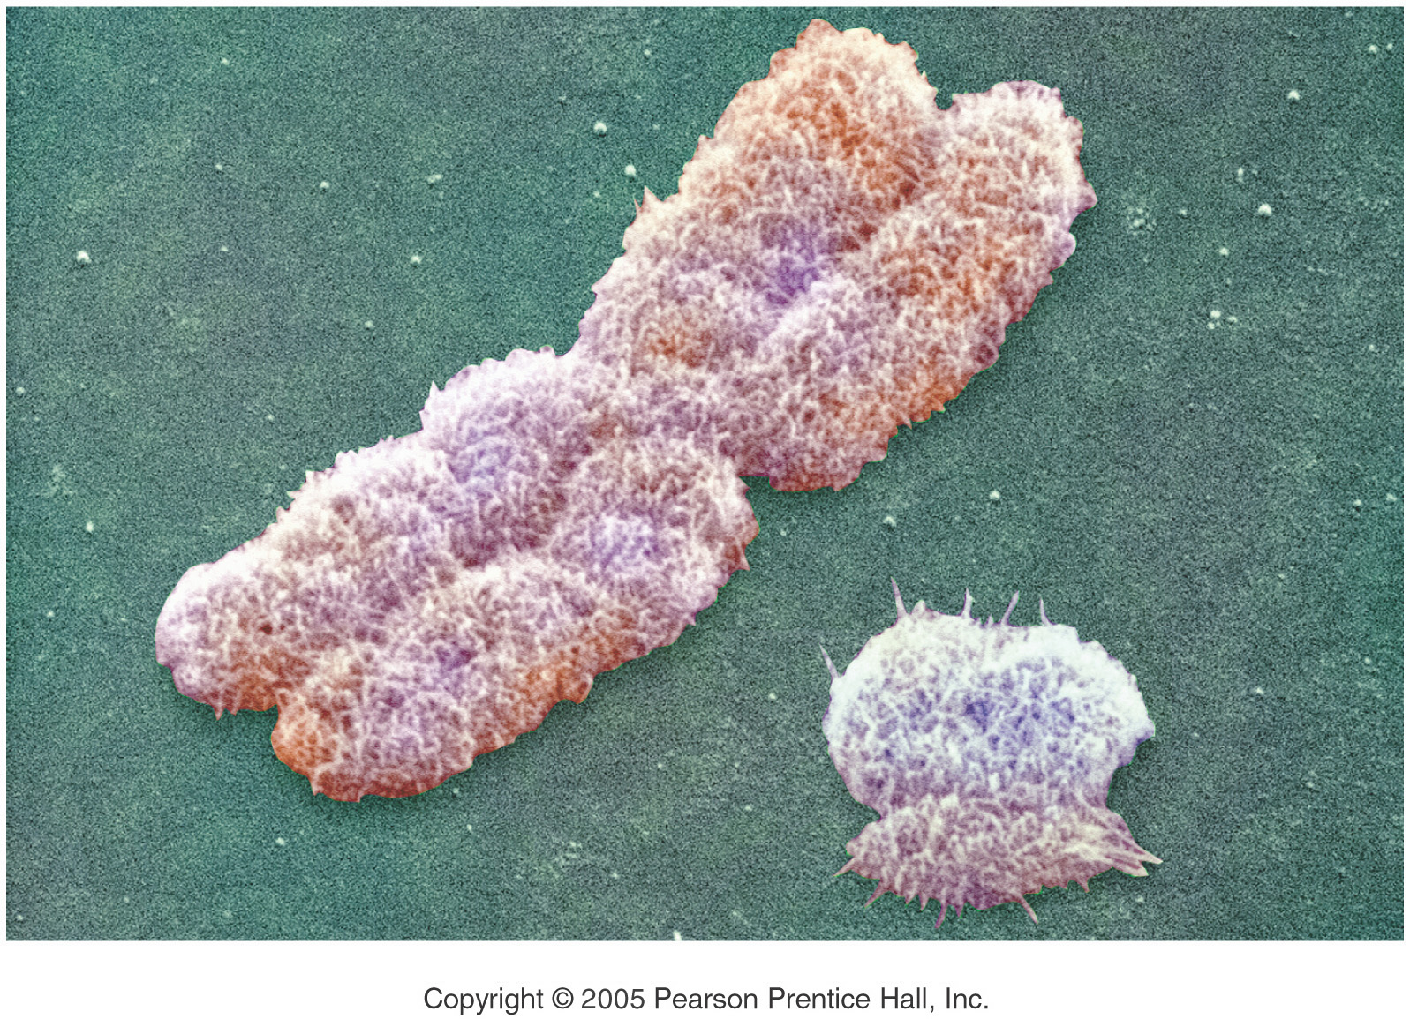
Boy or Girl?
The Y Chromosome Decides
Y - Chromosome
X - Chromosome

Slide 14
Cell Reproduction

Slide 15
Types of Cell Reproduction
Asexual reproduction involves a single cell dividing to make 2 new, identical daughter cells
Mitosis & binary fission are examples of asexual reproduction
Sexual reproduction involves two cells (egg & sperm) joining to make a new cell (zygote) that is NOT identical to the original cells
Meiosis is an example

Slide 16
Cell Division in Prokaryotes

Slide 17
Cell Division in Prokaryotes
Prokaryotes such as bacteria divide into 2 identical cells by the process of binary fission
Single chromosome makes a copy of itself
Cell wall forms between the chromosomes dividing the cell
Parent cell
Chromosome replicates
Cell splits
2 identical daughter cells

Slide 18
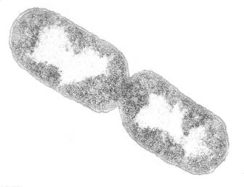
Prokaryotic Cell Undergoing Binary Fission

Slide 19
Animation of Binary Fission

Slide 20
The Cell Cycle

Slide 21
Five Phases of the Cell Cycle
G₁ - primary growth phase
S – synthesis; DNA replicated
G₂ - secondary growth phase
collectively these 3 stages are called interphase
M - mitosis
C - cytokinesis

Slide 22
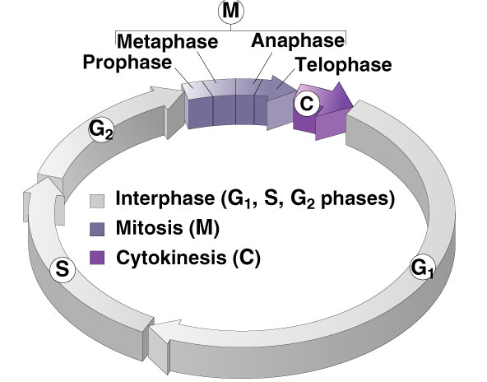
Cell Cycle

Slide 23
Interphase - G₁ Stage
1st growth stage after cell division
Cells mature by making more cytoplasm & organelles
Cell carries on its normal metabolic activities

Slide 24
Interphase – S Stage
Synthesis stage
DNA is copied or replicated
Two identical copies of DNA
Original DNA

Slide 25
Interphase – G₂ Stage
2nd Growth Stage
Occurs after DNA has been copied
All cell structures needed for division are made (e.g. centrioles)
Both organelles & proteins are synthesized

Slide 26
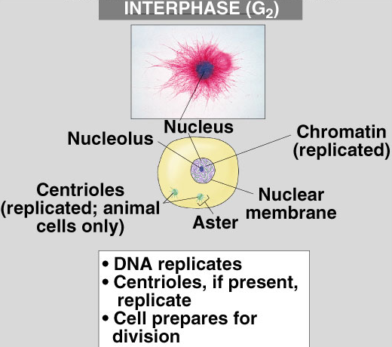
What’s Happening in Interphase?
What the cell looks like
Animal Cell
What’s occurring

Slide 27
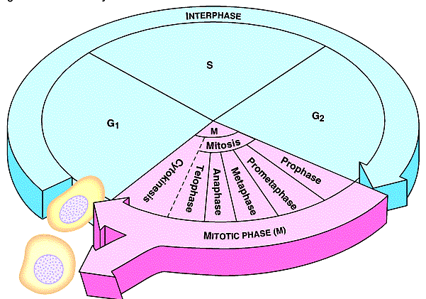
Sketch the Cell Cycle
DNA Copied
Cells prepare for Division
Cells Mature
Daughter Cells
Cell Divides into Identical cells

Slide 28
Mitosis

Slide 29
Mitosis
Division of the nucleus
Also called karyokinesis
Only occurs in eukaryotes
Has four stages
Doesn’t occur in some cells such as brain cells

Slide 30
Four Mitotic Stages
Prophase
Metaphase
Anaphase
Telophase

Slide 31
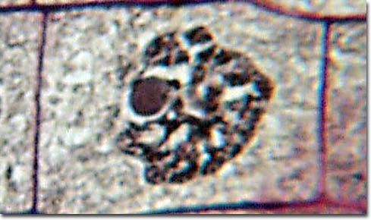
Early Prophase
Chromatin in nucleus condenses to form visible chromosomes
Mitotic spindle forms from fibers in cytoskeleton or centrioles (animal)
Nucleolus
Cytoplasm
Nuclear Membrane
Chromosomes

Slide 32
Late Prophase
Nuclear membrane & nucleolus are broken down
Chromosomes continue condensing & are clearly visible
Spindle fibers called kinetochores attach to the centromere of each chromosome
Spindle finishes forming between the poles of the cell

Slide 33
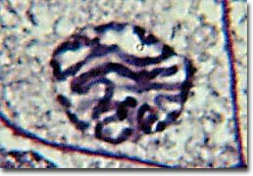
Late Prophase
Chromosomes
Nucleus & Nucleolus have disintegrated

Slide 34
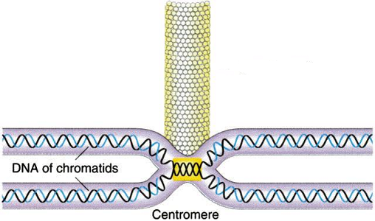
Spindle Fiber attached to Chromosome
Kinetochore Fiber
Chromosome

Slide 35
Review of Prophase
What the cell looks like
What’s happening

Slide 36
Spindle Fibers
The mitotic spindle form from the microtubules in plants and centrioles in animal cells
Polar fibers extend from one pole of the cell to the opposite pole
Kinetochore fibers extend from the pole to the centromere of the chromosome to which they attach
Asters are short fibers radiating from centrioles

Slide 37
Sketch The Spindle

Slide 38
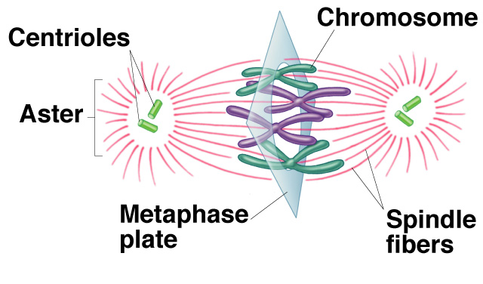
Metaphase
Chromosomes, attached to the kinetochore fibers, move to the center of the cell
Chromosomes are now lined up at the equator
Equator of Cell
Pole of the Cell

Slide 39
Metaphase
Asters at the poles
Spindle Fibers
Chromosomes lined at the Equator

Slide 40
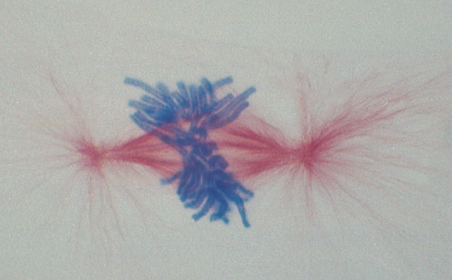
Metaphase
Aster
Chromosomes at Equator

Slide 41
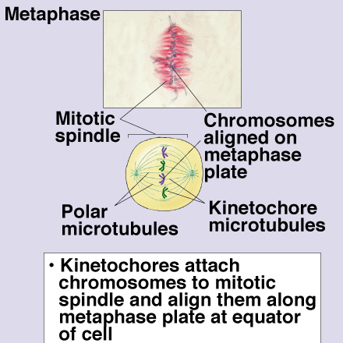
Review of Metaphase
What the cell looks like
What’s occurring

Slide 42
Anaphase
Occurs rapidly
Sister chromatids are pulled apart to opposite poles of the cell by kinetochore fibers

Slide 43
Anaphase
Sister Chromatids being separated

Slide 44
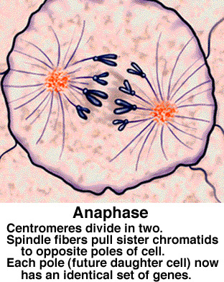
Anaphase Review
What the cell looks like
What’s occurring

Slide 45
Telophase
Sister chromatids at opposite poles
Spindle disassembles
Nuclear envelope forms around each set of sister chromatids
Nucleolus reappears
CYTOKINESIS occurs
Chromosomes reappear as chromatin

Slide 46
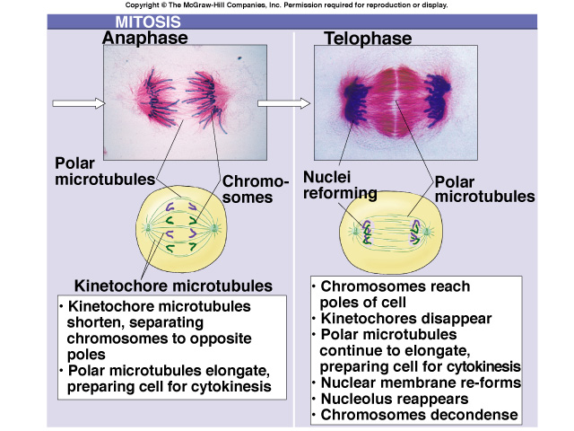
Comparison of Anaphase & Telophase

Slide 47
Cytokinesis
Means division of the cytoplasm
Division of cell into two, identical halves called daughter cells
In plant cells, cell plate forms at the equator to divide cell
In animal cells, cleavage furrow forms to split cell

Slide 48
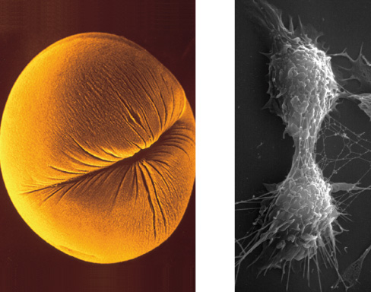
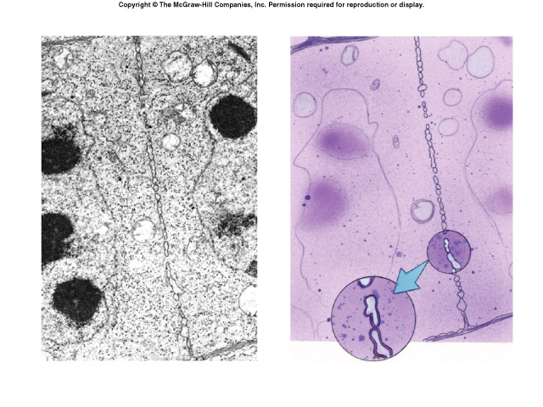
Cytokinesis
Cleavage furrow in animal cell
Cell plate in plant cell

Slide 49
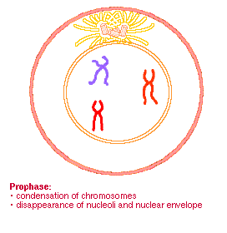
Mitotic Stages

Slide 50
Daughter Cells of Mitosis
Have the same number of chromosomes as each other and as the parent cell from which they were formed
Identical to each other, but smaller than parent cell
Must grow in size to become mature cells (G₁ of Interphase)
Watch this short video: http://iknow.net/player_window.html?url=media/prophase_video_auto.swf&width=360&height=285

Slide 51
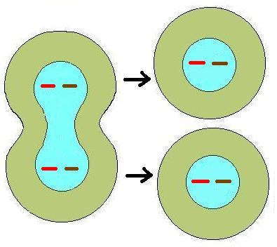
Identical Daughter Cells
What is the 2n or diploid number?
2
Chromosome number the same, but cells smaller than parent cell

Slide 52
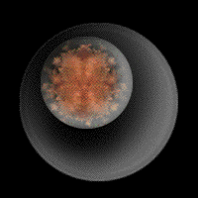
Review of Mitosis

Slide 53
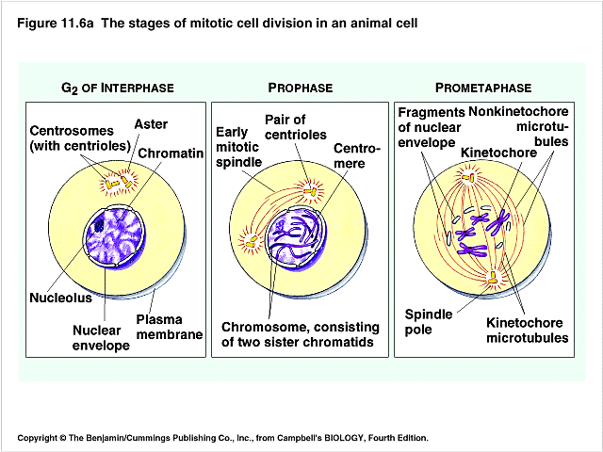
Draw & Learn these Stages

Slide 54
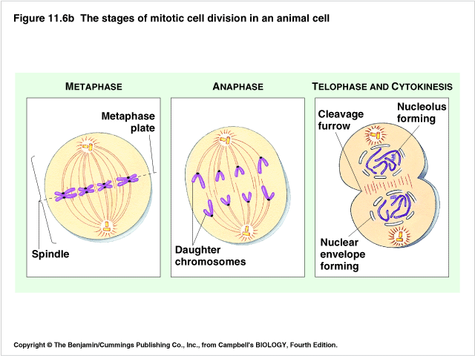
Draw & Learn these Stages

Slide 55
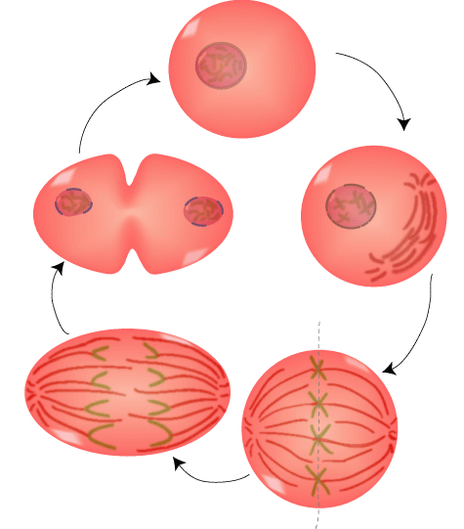
Name the Mitotic Stages:
Interphase
Name this?
Prophase
Telophase
Name this?
Metaphase
Anaphase

Slide 56
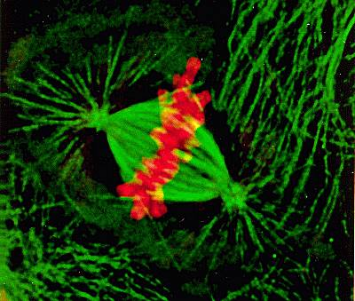
Eukaryotic Cell Division
Used for growth and repair
Produce two new cells identical to the original cell
Cells are diploid (2n)
Chromosomes during Metaphase of mitosis
Anaphase
Cytokinesis
Prophase
Metaphase
Telophase

Slide 57
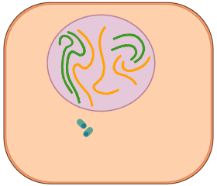
Mitosis Animation
Name each stage as you see it occur?

Slide 58
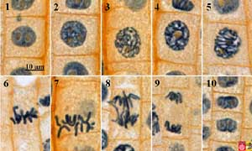
Mitosis in Onion Root Tips
Do you see any stages of mitosis?

Slide 59
Test Yourself over Mitosis

Slide 60
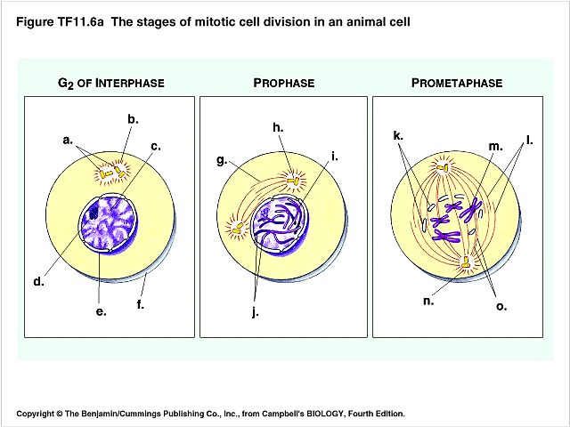
Mitosis Quiz

Slide 61
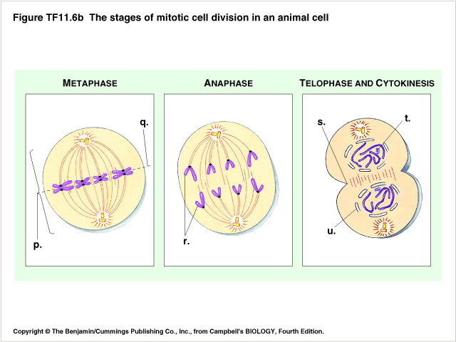
Mitosis Quiz

Slide 62
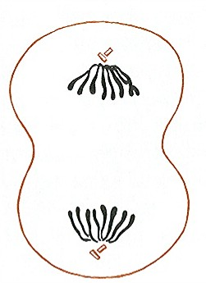
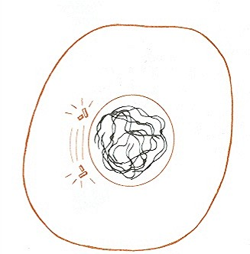
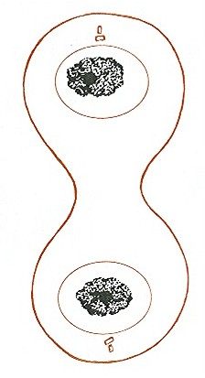
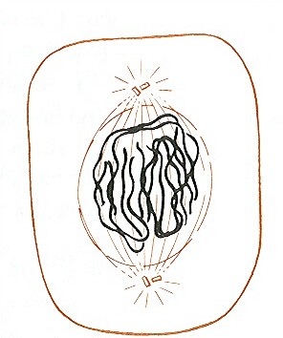
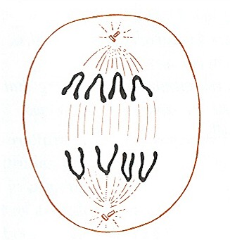
Name the Stages of Mitosis:
Early prophase
Early Anaphase
Metaphase
Interphase
Early Telophase,
Begin cytokinesis
Late Prophase
Late telophase,
Advanced cytokinesis
Mid-Prophase
Late Anaphase

Slide 63
Identify the Stages
?
Early, Middle, & Late Prophase
?
?
?
Metaphase
Anaphase
Late Prophase
?
?
?
Late Anaphase
Telophase
Telophase & Cytokinesis

Slide 64
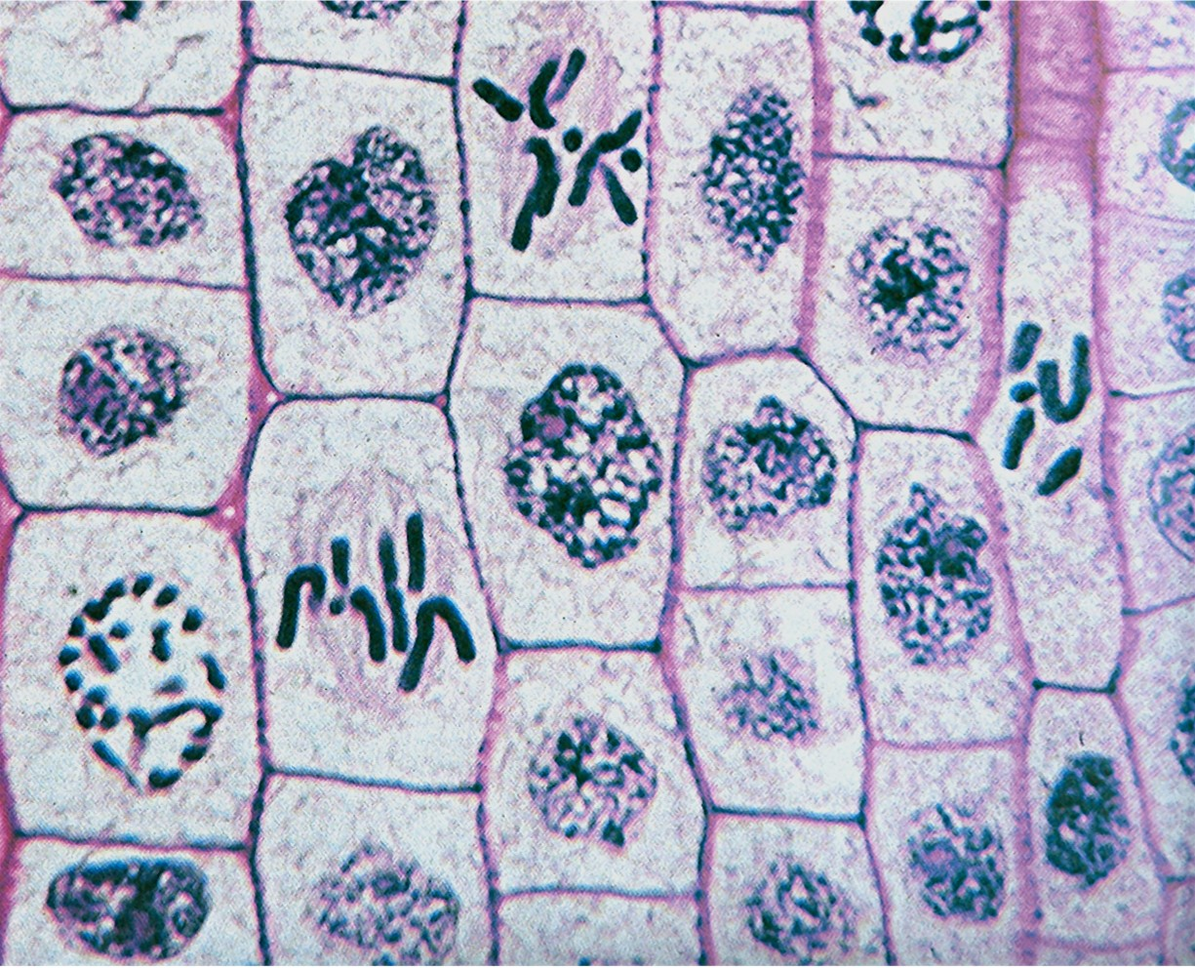
Locate the Four Mitotic Stages in Plants
Anaphase
Telophase
Metaphase
Prophase

Slide 65
Uncontrolled Mitosis
If mitosis is not controlled, unlimited cell growth & division occurs causing cancerous tumors
Oncogenes are mutated genes that increase the chance that a normal cell develops into a tumor cell
Abnormal proteins are synthesized
Checkpoints are ignored.
*See next PPt for more to know on cancer, if the slides weren’t added to this PPt
Cancer cells

Slide 66
Cancer and the Cell Cycle
Checkpoints in the cell cycle are ignored. The proteins that normally regulate the cycle are not synthesized ‘correctly’. So, even if a cell’s DNA is ‘damaged’ and the cycle should ‘stop’, the cycle proceeds anyway
Causes excessive cell division and accumulation of non-functioning cells
Carcinogen: anything that causes cancer (ex: cigarettes, UV light)
*See next slide

Slide 67
FYI: The 2 major proteins that control/regulate the cycle (and checkpoints) are Cyclin & Kinases. Since kinase ends in –ase, what kind of protein is it?

Slide 68
Question?
What is apoptosis?
What is density dependent inhibition? These questions will likely be on the test. Do some googling and be prepared to answer tomorrow!

