Slide 1
organism
population
community
ecosystem
biosphere
Population Ecology
Chapter 53

Slide 2
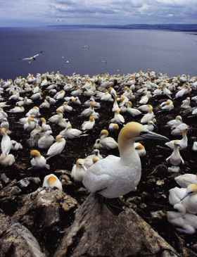
Life takes place in populations
Population
  group of individuals of same species in same area at same time
Watch: http://www.bozemanscience.com/046-communities
  Students- do video guide
rely on same resources
interact
interbreed
Population Ecology: What factors affect a population?

Slide 3
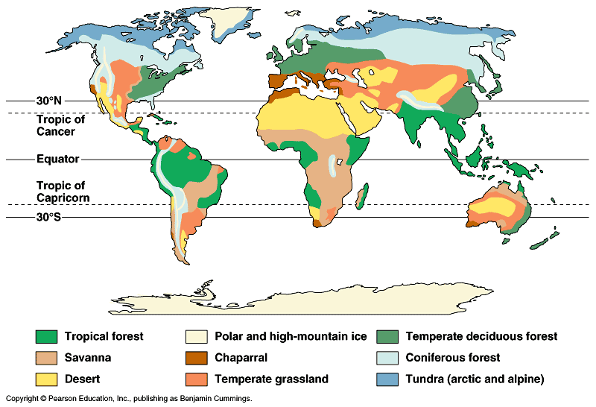
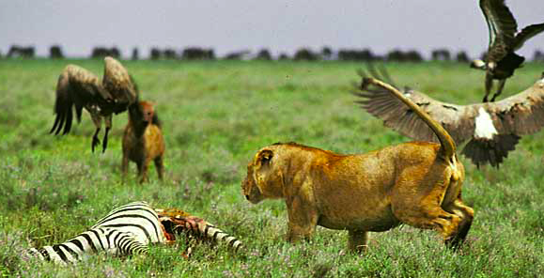
Factors that affect Population Size
Abiotic factors
  sunlight & temperature
  precipitation / water
  soil / nutrients
Biotic factors
  other living organisms
    prey (food)
    competitors
    predators, parasites,
    disease
Intrinsic factors
  adaptations

Slide 4
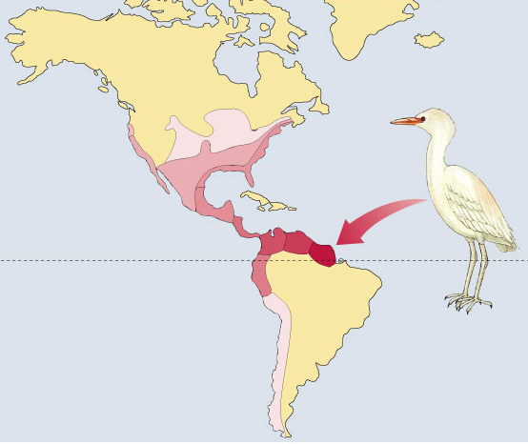
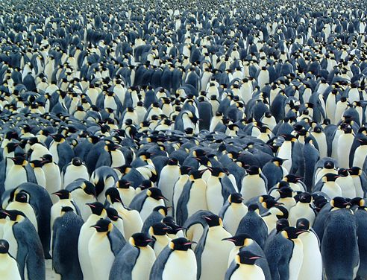
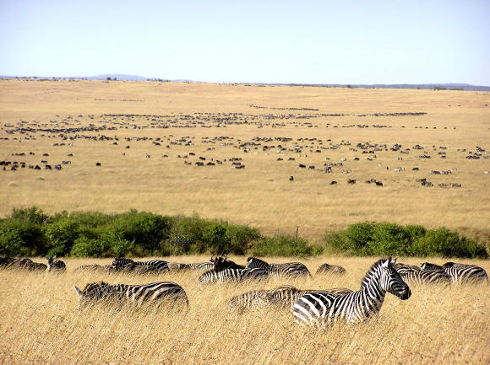
Characterizing a Population
Describing a population
  population range
  pattern of Dispersion
  Density of population
1966
1970
1964
1965
1960
1961
1951
1943
Equator
1958
1937
1956
Immigration
from Africa
~1900
1970
range

Slide 5
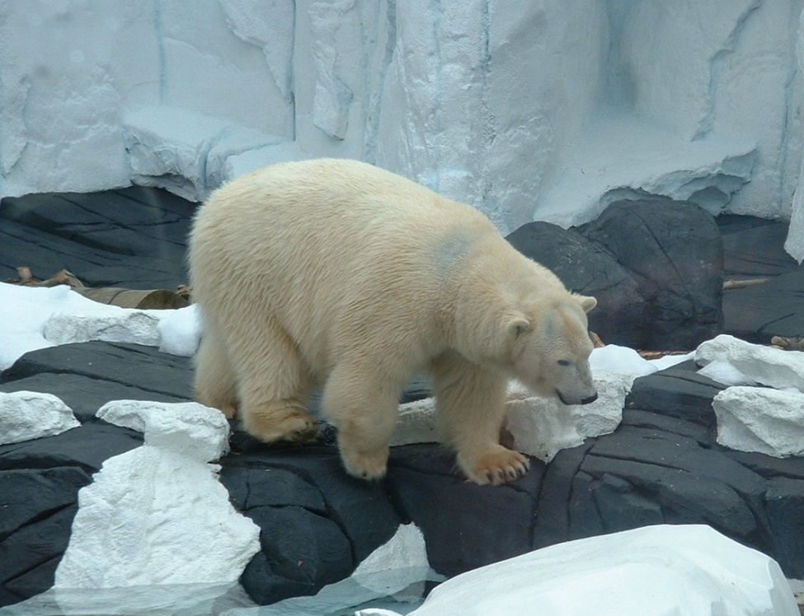
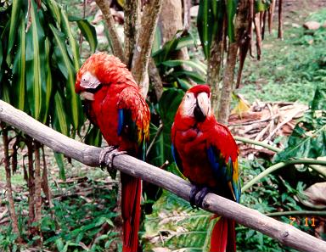
Population Range
Geographical limitations
  abiotic & biotic factors
    temperature, rainfall, food, predators, etc.
  habitat
adaptations to
polar biome
adaptations to
rainforest biome

Slide 6
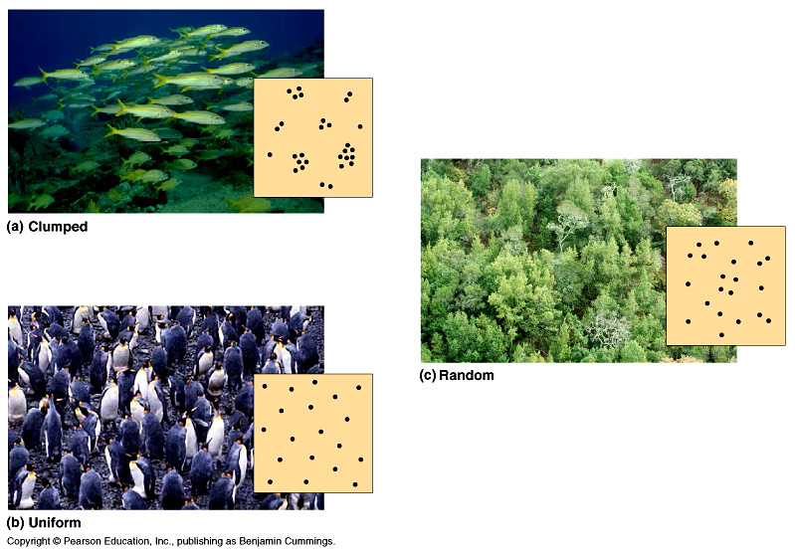
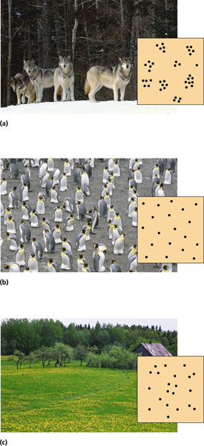
Population Dispersion
Spacing patterns within a population
Provides insight into the environmental associations
& social interactions of individuals in population
clumped
random
uniform
Notes:
Within a population’s geographic range, local densities may vary substantially. Variations in local density are among the most important characteristics that a population ecologist might study, since they provide insight into the environmental associations and social interactions of individuals in the population. Environmental differences—even at a local level—contribute to variation in population density; some habitat patches are simply more suitable for a species than are others. Social interactions between members of the population, which may maintain patterns of spacing between individuals, can also contribute to variation in population density.

Slide 7
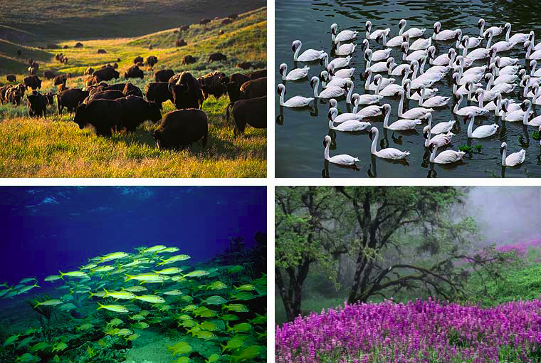
Clumped Pattern (most common)
Notes:
The most common pattern of dispersion is clumped, with the individuals aggregated in patches. Plants or fungi are often clumped where soil conditions and other environmental factors favor germination and growth. For example, mushrooms may be clumped on a rotting log. Many animals spend much of their time in a particular microenvironment that satisfies their requirements. Forest insects and salamanders, for instance, are frequently clumped under logs, where the humidity tends to be higher than in more exposed areas. Clumping of animals may also be associated with mating behavior. For example, mayflies often swarm in great numbers, a behavior that increases mating chances for these insects, which survive only a day or two as reproductive adults. Group living may also increase the effectiveness of certain predators; for example, a wolf pack is more likely than a single wolf to subdue a large prey animal, such as a moose

Slide 8
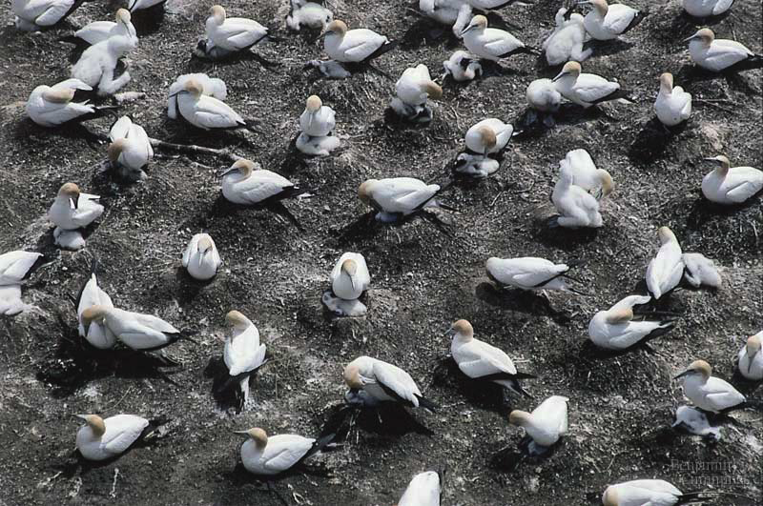
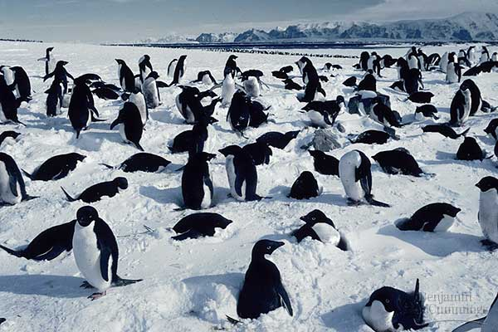
Uniform
May result from direct interactions between individuals in the population
→ territoriality
Clumped patterns
Notes:
A uniform, or evenly spaced, pattern of dispersion may result from direct interactions between individuals in the population. For example, some plants secrete chemicals that inhibit the germination and growth of nearby individuals that could compete for resources. Animals often exhibit uniform dispersion as a result of antagonistic social interactions, such as territoriality —the defense of a bounded physical space against encroachment by other individuals. Uniform patterns are not as common in populations as clumped patterns.

Slide 9
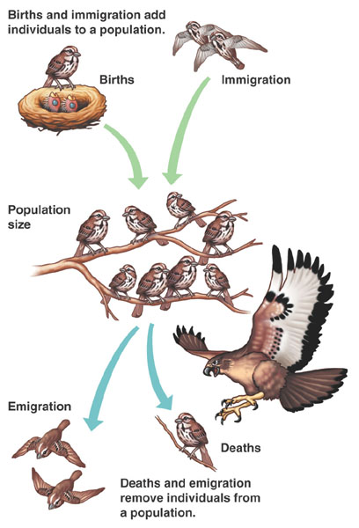
Population Size
Changes to population size
  adding & removing individuals from a population
    birth
    death
    immigration
    emigration
How can the change be measured? What to consider…..

Slide 10
Population growth rates
Factors affecting population growth rate
  sex ratio
    how many females vs. males?
  generation time
    at what age do females reproduce?
  age structure
    how females at reproductive age in cohort?
How do biologists find all these factors?
  They study: Life Tables, Survivorship curves,
  and Age Structure diagrams

Slide 11
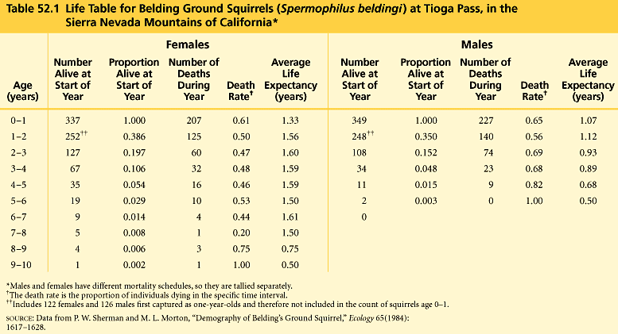
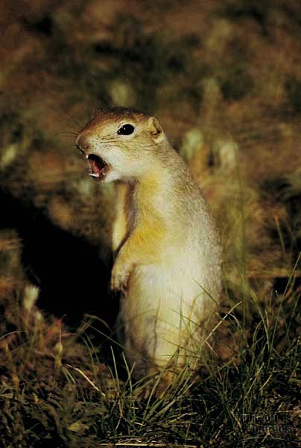
Life Tables
Why do teenage boys pay high car insurance rates?
Shows life expectancies for age groups
Demography: Study of a populations vital statistics and how they change over time
Life table
females
males
What adaptations have
led to this difference
in male vs. female
mortality?

Slide 12
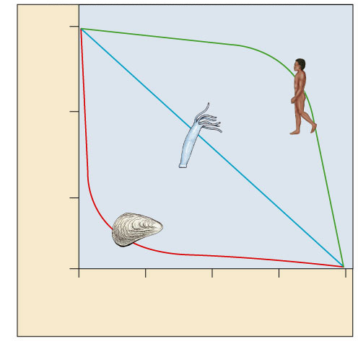
Survivorship curves
What do these graphs tell about survival &
strategy of a species?
Generalized life strategies
1000
Human
(type I)
I. High death rate in post-reproductive years
Hydra
(type II)
100
II. Constant mortality rate throughout life span
Survival per thousand
Oyster
(type III)
10
III. Very high early mortality but the few survivors then live long (stay reproductive)
1
0
25
50
75
100
Percent of maximum life span
Notes:
A Type I curve is flat at the start, reflecting low death rates during early and middle life, then drops steeply as death rates increase among older age groups. Humans and many other large mammals that produce few offspring but provide them with good care often exhibit this kind of curve. In contrast, a Type III curve drops sharply at the start, reflecting very high death rates for the young, but then flattens out as death rates decline for those few individuals that have survived to a certain critical age. This type of curve is usually associated with organisms that produce very large numbers of offspring but provide little or no care, such as long–lived plants, many fishes, and marine invertebrates. An oyster, for example, may release millions of eggs, but most offspring die as larvae from predation or other causes. Those few that survive long enough to attach to a suitable substrate and begin growing a hard shell will probably survive for a relatively long time. Type II curves are intermediate, with a constant death rate over the organism’s life span. This kind of survivorship occurs in Belding’s ground squirrels and some other rodents, various invertebrates, some lizards, and some annual plants.

Slide 13
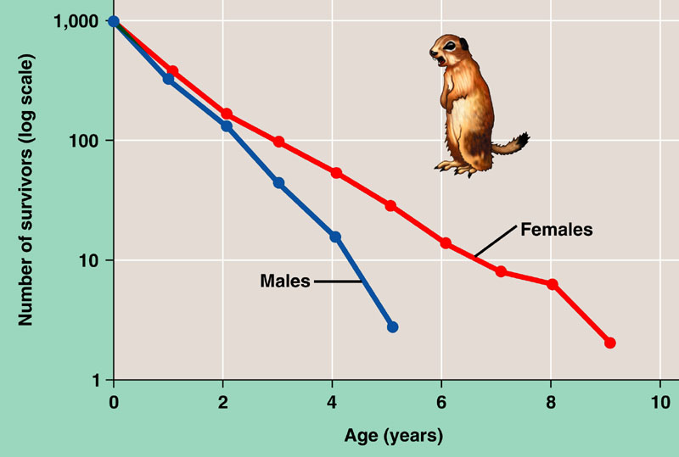
Survivorship curves
Graphic representation of life table
The relatively straight lines of the plots indicate relatively constant rates of death; however, males have a lower survival rate overall than females.
Belding ground squirrel

Slide 14
Survival vs. Reproduction
The cost of reproduction
  increase reproduction may decrease survival
    age at first reproduction
    investment per offspring
    number of reproductive cycles per lifetime
    parents not equally invested
    offspring mutations
Life History determined by
costs and benefits
of all adaptations
Natural selection favors a life history that maximizes lifetime reproductive success

Slide 15
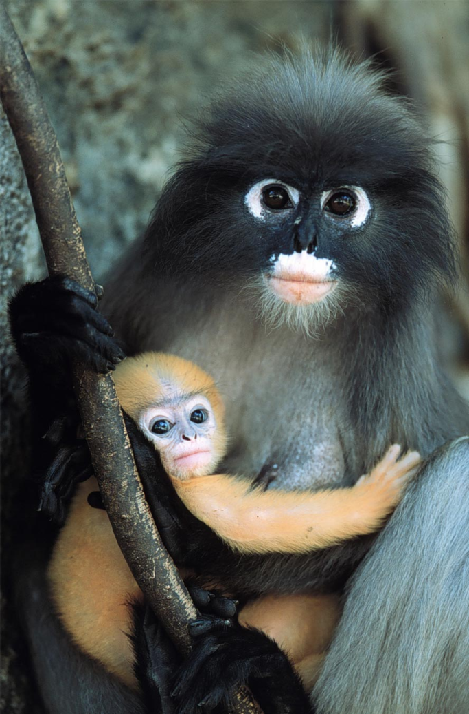
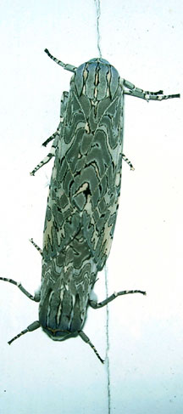
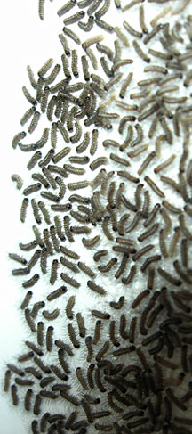
Reproductive strategies
K-selected
  late reproduction
  few offspring
  invest a lot in raising offspring
    primates
r-selected
  early reproduction
  many offspring
  little parental care
    insects
    many plants
K-selected
r-selected

Slide 16
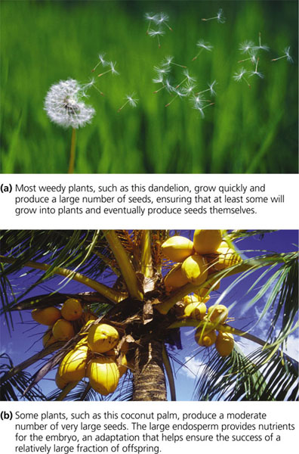
r-selected
Number & size of offspring
vs.
Survival of offspring or parent
K-selected

Slide 17
Reproductive strategies & survivorship
K-selection
1000
Human
(type I)
Hydra
(type II)
100
Survival per thousand
Oyster
(type III)
10
r-selection
1
0
25
50
75
100
Percent of maximum life span
Notes:
A Type I curve is flat at the start, reflecting low death rates during early and middle life, then drops steeply as death rates increase among older age groups. Humans and many other large mammals that produce few offspring but provide them with good care often exhibit this kind of curve. In contrast, a Type III curve drops sharply at the start, reflecting very high death rates for the young, but then flattens out as death rates decline for those few individuals that have survived to a certain critical age. This type of curve is usually associated with organisms that produce very large numbers of offspring but provide little or no care, such as long–lived plants, many fishes, and marine invertebrates. An oyster, for example, may release millions of eggs, but most offspring die as larvae from predation or other causes. Those few that survive long enough to attach to a suitable substrate and begin growing a hard shell will probably survive for a relatively long time. Type II curves are intermediate, with a constant death rate over the organism’s life span. This kind of survivorship occurs in Belding’s ground squirrels and some other rodents, various invertebrates, some lizards, and some annual plants.

Slide 18
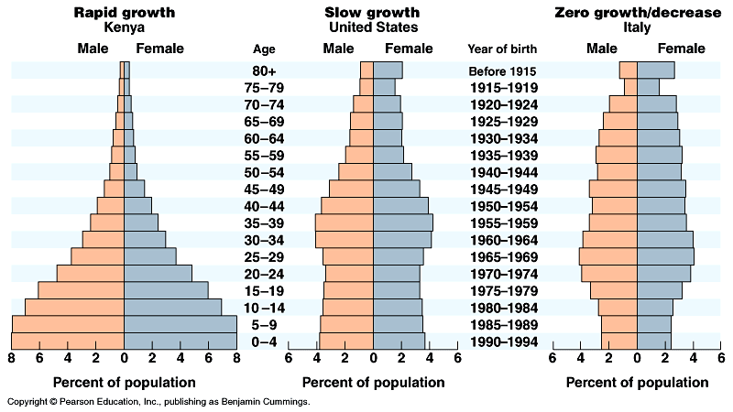
Age structure
Relative number of individuals of each age
What do these data imply about population growth in these countries?

Slide 19
Growth Rate Models
Population Growth =
Exponential growth
  Rapid growth
  No constraints
Logistic growth
  Environmental constraints
  Limited growth
change in population = births – deaths

Slide 20
Watch these and do ‘Population Growth’ handout & ‘AP Bio Population Practice Problems’
https://paul-andersen.squarespace.com/exponential-growth
http://www.bozemanscience.com/logistic-growth
Need more help with “Pop. Ecology Prac. Problems”? This should help: https://www.youtube.com/watch?v=vdlu1V68_JU&t=66s (MVHSAPBio)
In addition to AP formula sheet, you may need to use these formulas:
R = # births/total pop size
R= # deaths/total pop size

Slide 21

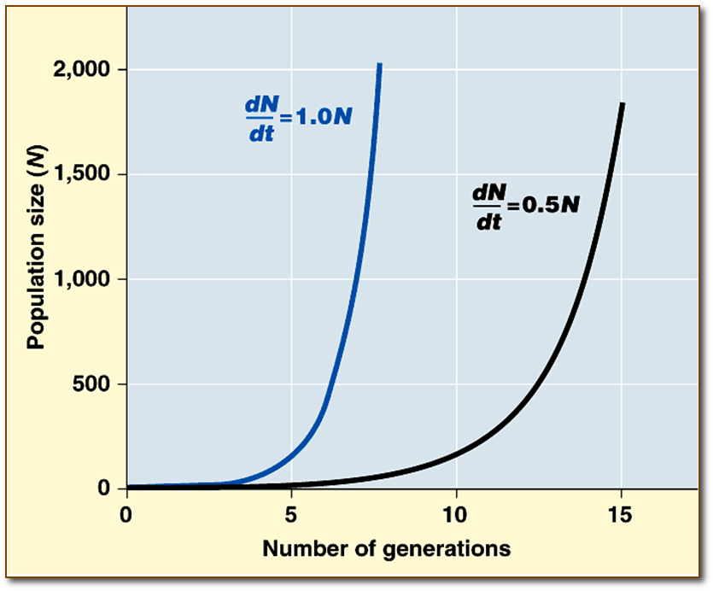
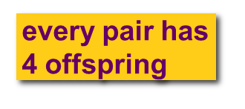
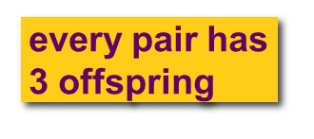
Exponential Growth (ideal conditions)
No environmental barriers
Growth is at maximum rate
dN/dt = r_{max}N
N = # individuals
r_{max} = growth rate

Slide 22
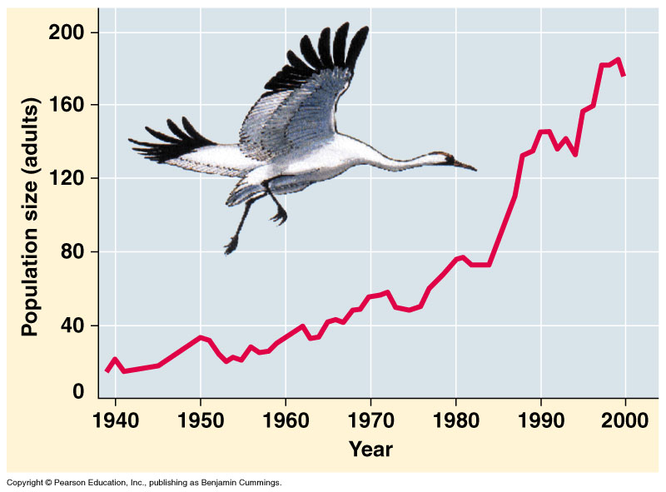
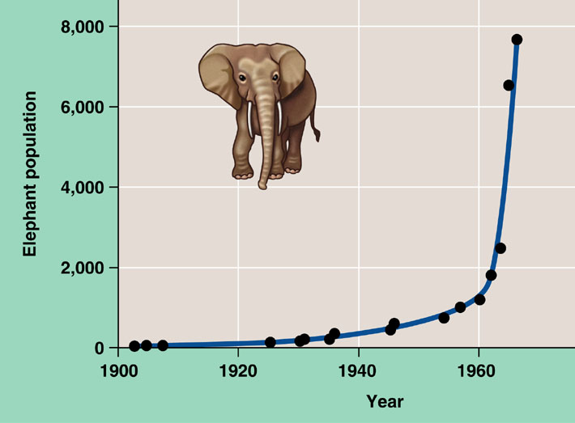
Exponential growth rate
Characteristic of populations without
limiting factors
  introduced to a new environment or rebounding from a catastrophe
Whooping crane
coming back from near extinction
African elephant
protected from hunting
Notes:
The J–shaped curve of exponential growth is characteristic of some populations that are introduced into a new or unfilled environment or whose numbers have been drastically reduced by a catastrophic event and are rebounding. The graph illustrates the exponential population growth that occurred in the population of elephants in Kruger National Park, South Africa, after they were protected from hunting. After approximately 60 years of exponential growth, the large number of elephants had caused enough damage to the park vegetation that a collapse in the elephant food supply was likely, leading to an end to population growth through starvation. To protect other species and the park ecosystem before that happened, park managers began limiting the elephant population by using birth control and exporting elephants to other countries.

Slide 23
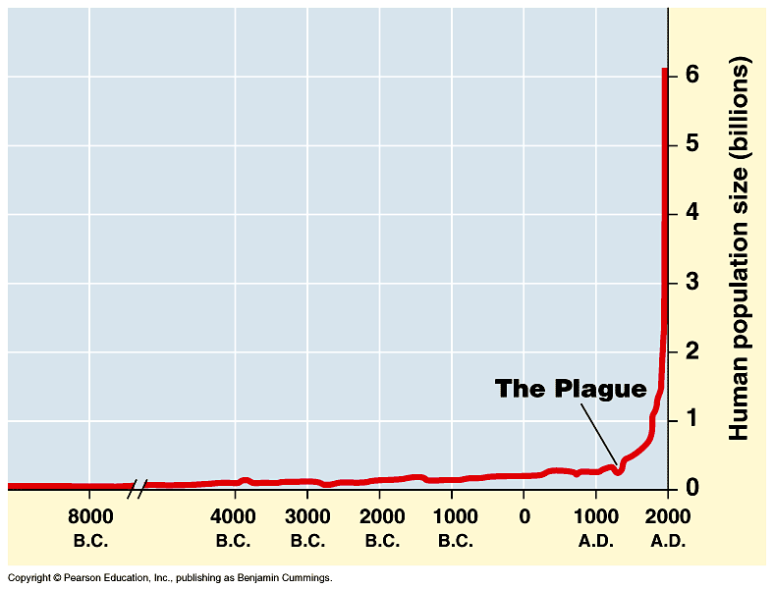
Human population growth
Population of…
China: 1.3 billion
India: 1.1 billion
Doubling times
250m → 500m = y ()
500m → 1b = y ()
1b → 2b = 80y (1850–1930)
2b → 4b = 75y (1930–1975)
adding 82 million/year
~ 200,000 per day!
2005→6 billion
Significant advances
in medicine through
science and technology
What factors have contributed to this exponential growth pattern?
Industrial Revolution
Is the human
population reaching
carrying capacity?
Bubonic plague "Black Death"
1650→500 million
Notes:
The population doubled to 1 billion within the next two centuries, doubled again to 2 billion between 1850 and 1930, and doubled still again by 1975 to more than 4 billion. The global population now numbers over 6 billion people and is increasing by about 73 million each year. The population grows by approximately 201,000 people each day, the equivalent of adding a city the size of Amarillo, Texas, or Madison, Wisconsin. Every week the population increases by the size of San Antonio, Milwaukee, or Indianapolis. It takes only four years for world population growth to add the equivalent of another United States. Population ecologists predict a population of 7.3–8.4 billion people on Earth by the year 2025.

Slide 24
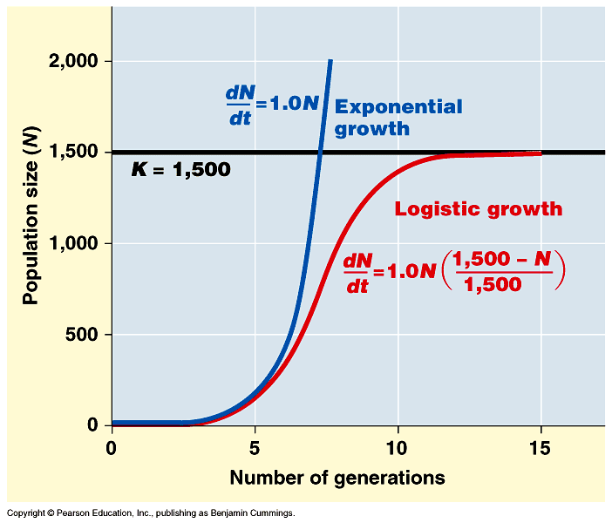
Logistic rate of growth
Can populations continue to grow exponentially?
Of course not!
no natural controls
K =
carrying
capacity
What happens as
N approaches K?
effect of
natural controls
Notes:
Decrease rate of growth as N reaches K

Slide 25
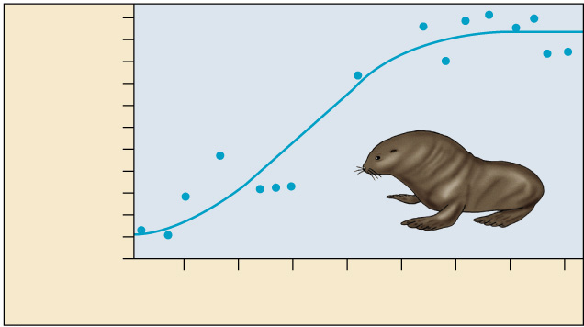
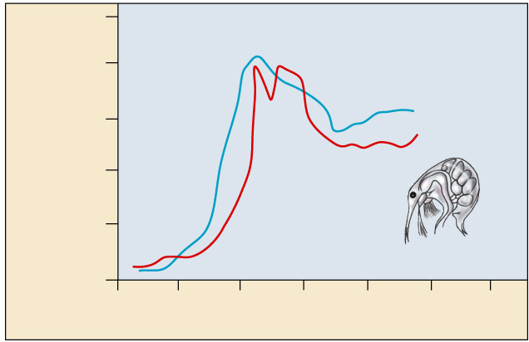
Carrying capacity
Maximum population size that environment can support with no degradation of habitat
  varies with changes in resources
10
8
Number of breeding male
fur seals (thousands)
6
4
2
0
1915
1925
1935
1945
Time (years)
500
400
Number of cladocerans
(per 200 ml)
300
What’s going
on with the
plankton?
200
100
0
0
10
20
30
40
50
60
Time (days)

Slide 26
Do ‘Population Ecology Practice Problems’ WS.
Do Interactive: https://ats.doit.wisc.edu/biology/ec/pd/pd.htm
Need help with problems? https://www.youtube.com/watch?v=vdlu1V68_JU (Part 1) https://www.youtube.com/watch?v=2UVpS5MMnOE (Part 2)

Slide 27
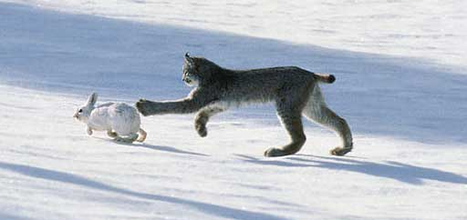
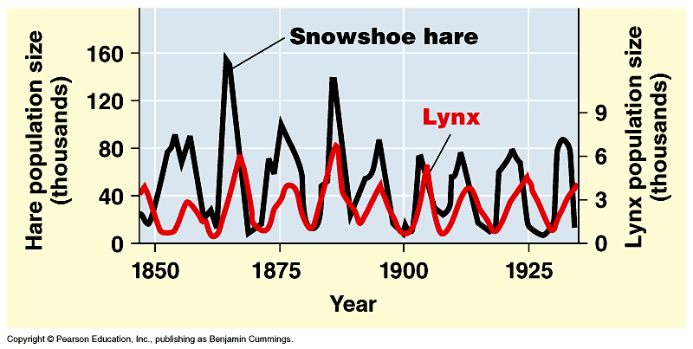
Changes in Carrying Capacity
Population cycles
  predator – prey interactions
At what
population level is the
carrying capacity?
K
K

Slide 28
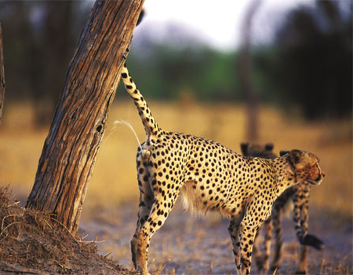
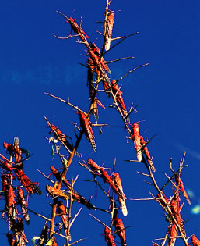
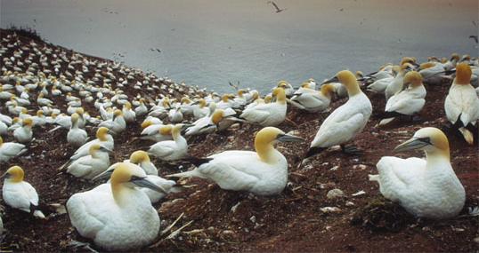
Regulation of population size
marking territory
= competition
Limiting factors
  density dependent
    competition: food, mates, nesting sites
    predators, parasites, pathogens
  density independent
    abiotic factors
      sunlight (energy)
      temperature
      rainfall
swarming locusts
competition for nesting sites

Slide 29
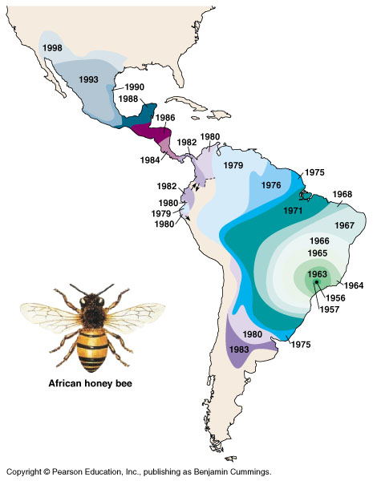
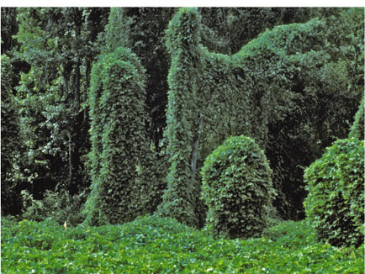
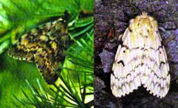
Introduced species
Non-native species (INVASIVE)
  transplanted populations grow exponentially in new area
  out-compete native species
    loss of natural controls
    lack of predators, parasites, competitors
  reduce diversity
  examples
    African honeybee
    gypsy moth
    zebra mussel
    purple loosestrife
gypsy moth
kudzu

Slide 30
Invasive species
From the ‘Washington Post”
The dirty dozen: 12 of the most destructive invasive animals in the United States
Burmese pythons.
Emerald ash borer.
Nutria.
Northern snakehead.
Brown marmorated stink bug.
Feral hogs.
Lionfish.
Asian citrus psyllid.

Slide 31
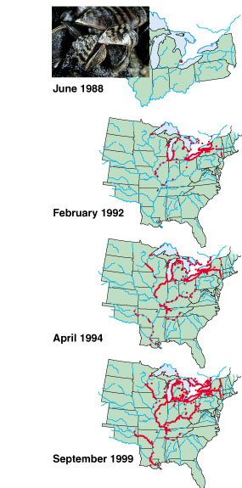
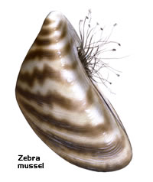
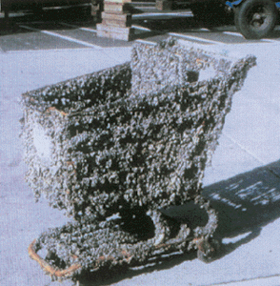
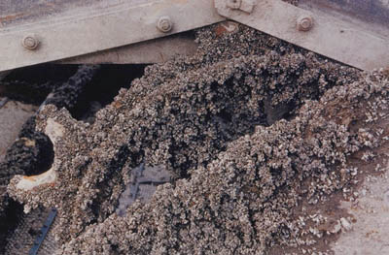
Zebra musselssel
~2 months
reduces diversity
loss of food & nesting sites for animals
economic damage
ecological & economic damage

Slide 32
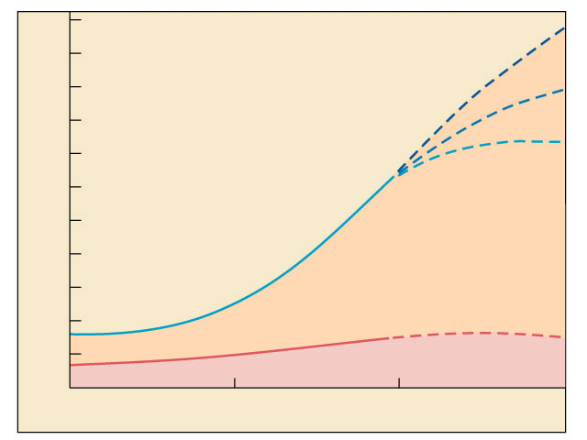
Distribution of population growth
11
uneven distribution of population:
90% of births are in developing countries
10
9
high fertility
uneven distribution of resources:
wealthiest 20% consumes ~90% of resources
increasing gap between rich & poor
8
medium fertility
7
low fertility
6
World total
World population in billions
What is K
for humans?
10-15 billion?
5
4
Developing countries
3
2
1
Developed countries
0
1900
1950
2000
2050
Time

Slide 33
What is….
An ecological footprint? Make sure you can tell me tomorrow
*If you need help solving Population Problems, there are links on my blog in the right column

