Slide 1
Chapter 6: Metabolism
Energy and enzymes

Slide 2
Cellular Metabolism- Ch 6
Metabolism = Anabolism (‘building’) + Catabolism (‘breaking down’). It’s the sum of all chemical reactions
Exergonic (exothermic) rxns: Release energy. Exp- Cellular Respiration
Endergonic (endothermic)-Absorb energy. Exp- Photosynthesis

Slide 3
Metabolism
Metabolism- the total of all chemical reactions done in an organism to store or release energy. (the number of molecules built vs. the amount of molecules broken down) ex. Digestion or building muscle.
A metabolic pathway begins with a specific molecule and ends with a product and is carried out by enzymes.

Slide 4
Catabolic Pathways
Catabolic pathways release energy by breaking down molecules into simpler compounds.
Ex. Cellular respiration, the breakdown of glucose to release energy in humans.
Copyright © 2008 Pearson Education, Inc., publishing as Pearson Benjamin Cummings

Slide 5
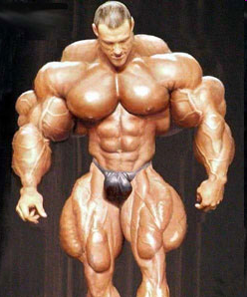
Anabolic Pathways
Anabolic pathways use energy to build molecules.
The synthesis of protein from amino acids to be used in muscles is an example of anabolism.
Copyright © 2008 Pearson Education, Inc., publishing as Pearson Benjamin Cummings

Slide 6
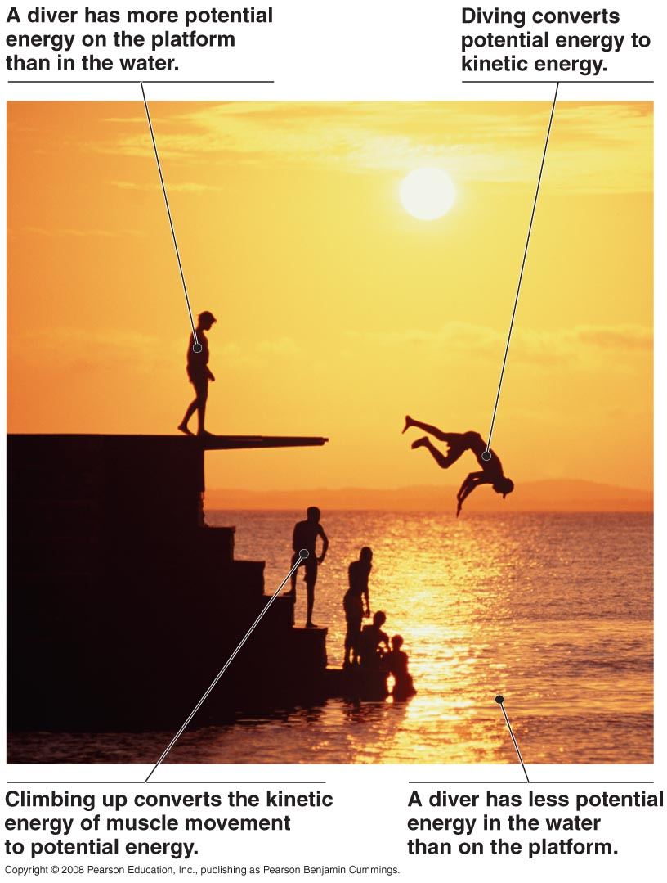
Thermodynamics
Thermodynamics is
the study of energy
transformations
Copyright © 2008 Pearson Education, Inc., publishing as Pearson Benjamin Cummings

Slide 7
The First Law of Thermodynamics
1st Law – energy cannot not by created or destroyed, just transformed.
Copyright © 2008 Pearson Education, Inc., publishing as Pearson Benjamin Cummings

Slide 8
The Second Law of Thermodynamics
2nd Law- Every energy transfer increases the entropy (disorder) of the universe and makes things unstable. (energy will seek to get back into a stable form or equilibrium)
Copyright © 2008 Pearson Education, Inc., publishing as Pearson Benjamin Cummings

Slide 9
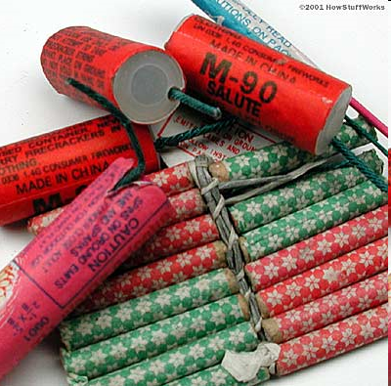
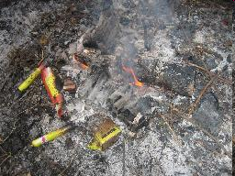
Free Energy
free energy - energy available to do work
∆G = change in free energy
If ∆G is negative, energy was released (becomes more stable)
If ∆G is positive, energy was stored (becomes less stable- requires more enthalpy)
Copyright © 2008 Pearson Education, Inc., publishing as Pearson Benjamin Cummings

Slide 10
Cellular respiration (next chapter) is spontaneous and ∆G < 0. Photosynthesis is not spontaneous & ∆G > 0

Slide 11
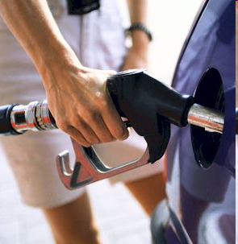
Spontaneous Change
Releasing free energy is known as a spontaneous change. The energy released in a spontaneous change can be harnessed to do work.
Copyright © 2008 Pearson Education, Inc., publishing as Pearson Benjamin Cummings

Slide 12
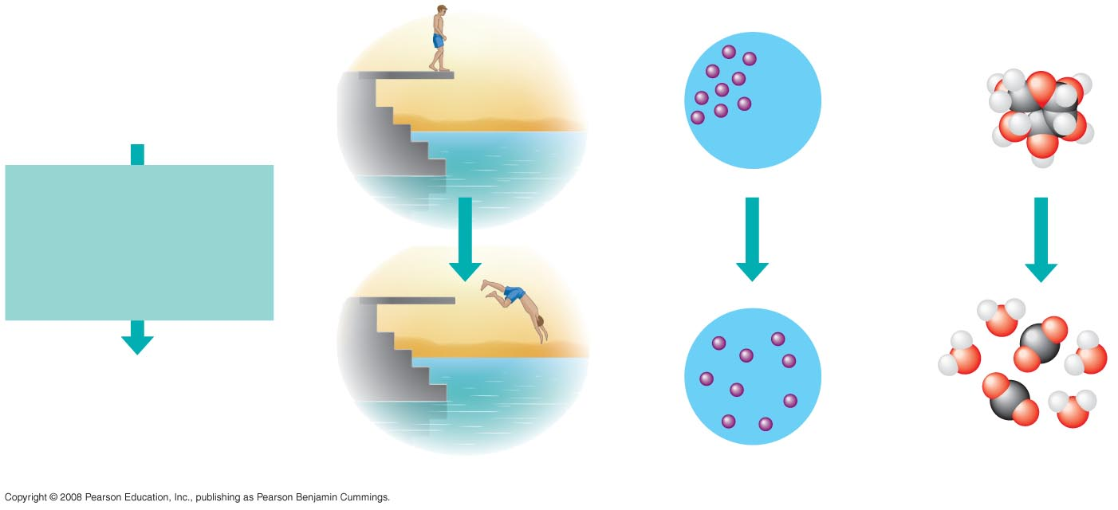
Fig. 8-5
More free energy (higher G)
Less stable
Greater work capacity
In a spontaneous change
The free energy of the system
decreases (∆G < 0)
The system becomes more
stable
The released free energy can
be harnessed to do work
Less free energy (lower G)
More stable
Less work capacity
(a) Gravitational motion
(b) Diffusion
(c) Chemical reaction
Notes:
Figure 8.5 The relationship of free energy to stability, work capacity, and spontaneous change

Slide 13
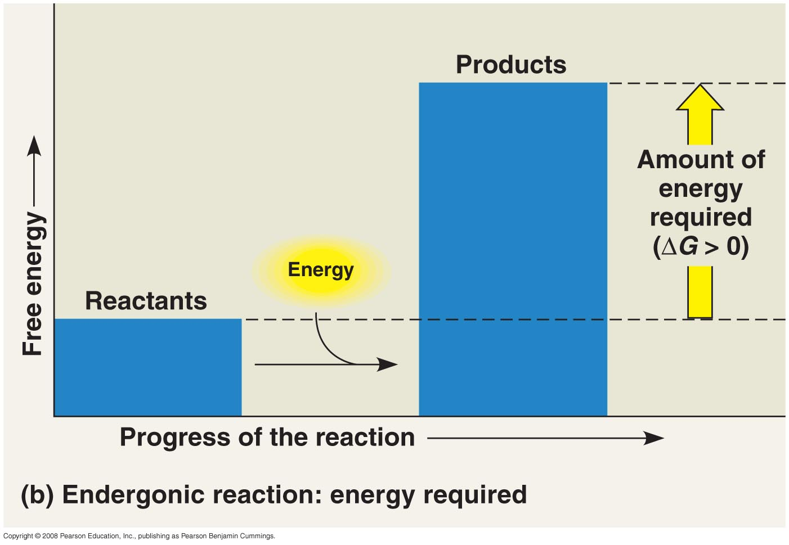
Energy in Cells
An endergonic reaction absorbs free energy from its surroundings and is nonspontaneous. (Anabolic)

Slide 14
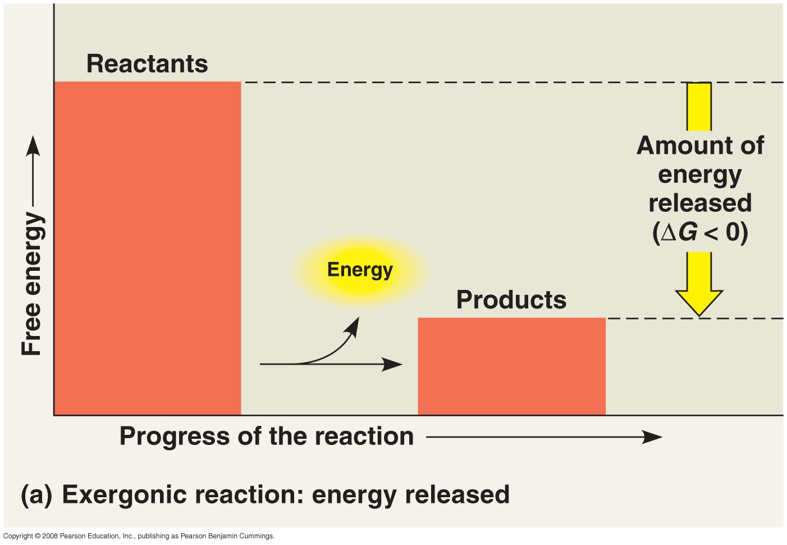
Energy in Cells
An exergonic reaction proceeds with a net release of free energy and is spontaneous. (Catabolic)
Copyright © 2008 Pearson Education, Inc., publishing as Pearson Benjamin Cummings

Slide 15
Energy Coupling
energy coupling - the use of an exergonic process to drive an endergonic one
Most energy coupling in cells is done by ATP (the cells energy molecule). Ex- ATP→ADP + P releases energy to the cell for endergonic (anabolic) reactions, like protein synthesis, to occur
Copyright © 2008 Pearson Education, Inc., publishing as Pearson Benjamin Cummings

Slide 16
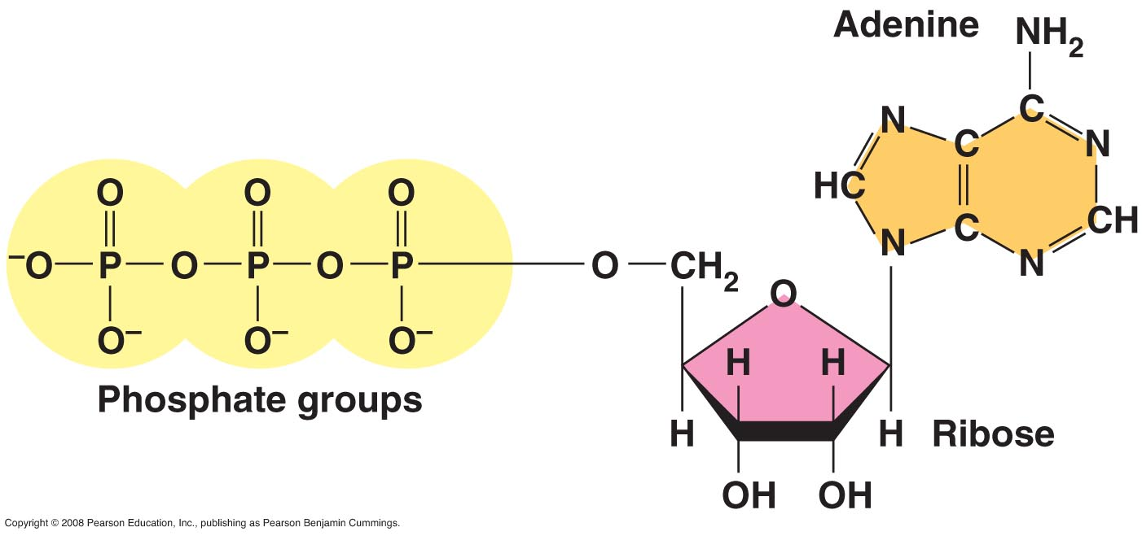
ATP
ATP (adenosine triphosphate) - ATP made of ribose (a sugar), adenine (a nitrogenous base), and three phosphate groups.
Copyright © 2008 Pearson Education, Inc., publishing as Pearson Benjamin Cummings
Notes:
For the Cell Biology Video Space Filling Model of ATP (Adenosine Triphosphate), go to Animation and Video Files.

Slide 17
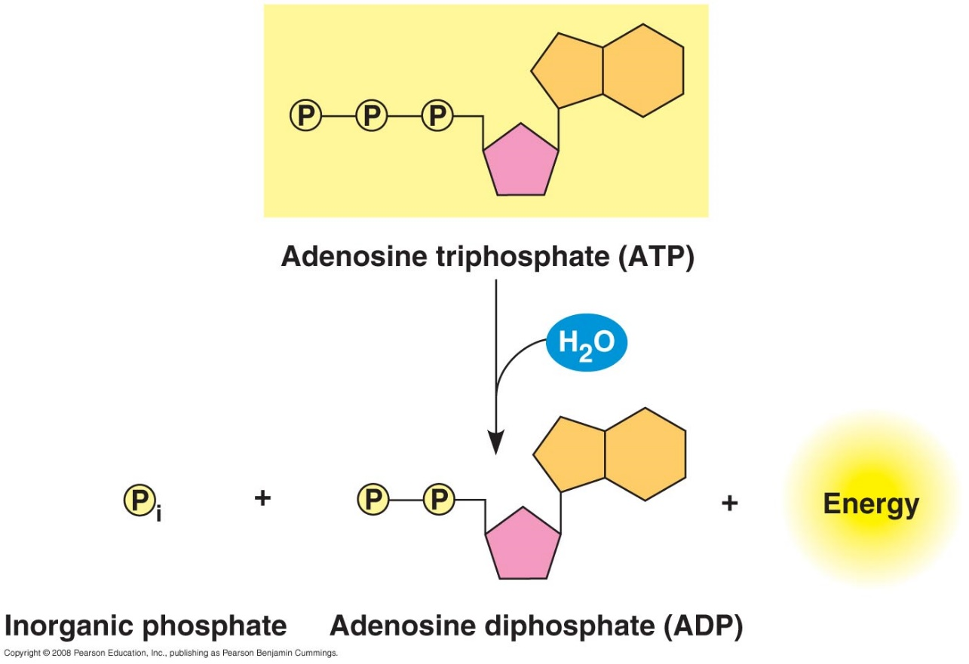
ATP at Work
ATP powers cells by breaking off a phosphate group. This releases energy. (exergonic)
ADP + P →ATP -this reaction occurs when we ‘burn’ (oxidize) glucose. The energy obtained from breaking the bonds of glucose makes many ATPs. We use the ATP energy to do work (ex- contracting a muscle)
Copyright © 2008 Pearson Education, Inc., publishing as Pearson Benjamin Cummings
Notes:
For the Cell Biology Video Stick Model of ATP (Adenosine Triphosphate), go to Animation and Video Files.

Slide 18
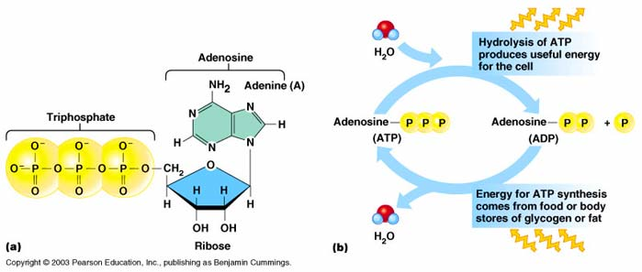

Slide 19
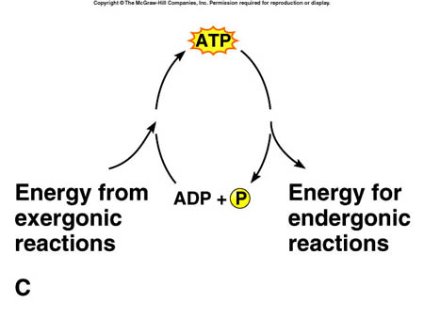
Endergonic
Exergonic

Slide 20
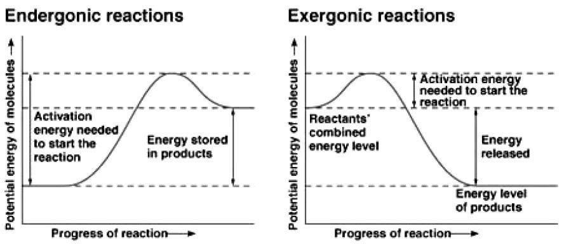

Slide 21
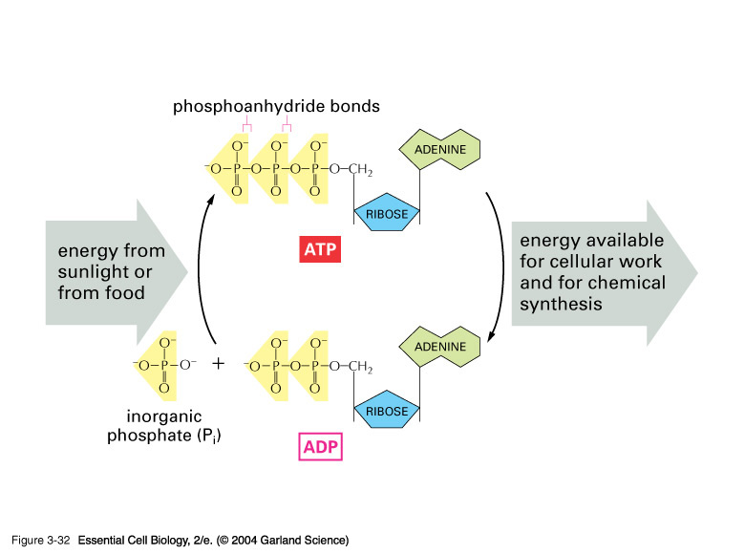

Slide 22
Enzymes- *Refer back to Unit 2, Part 2 PPt, if needed
Functional proteins used to catalyze chem. rxns.
Don’t get changed in the rxn and are recyclable
Work on highly specific substrates. Substrate(s) attaches to Active Site with of the enzyme and is converted to product(s)
Enzymes decrease the amount of activation energy needed for the rxn to occur

Slide 23
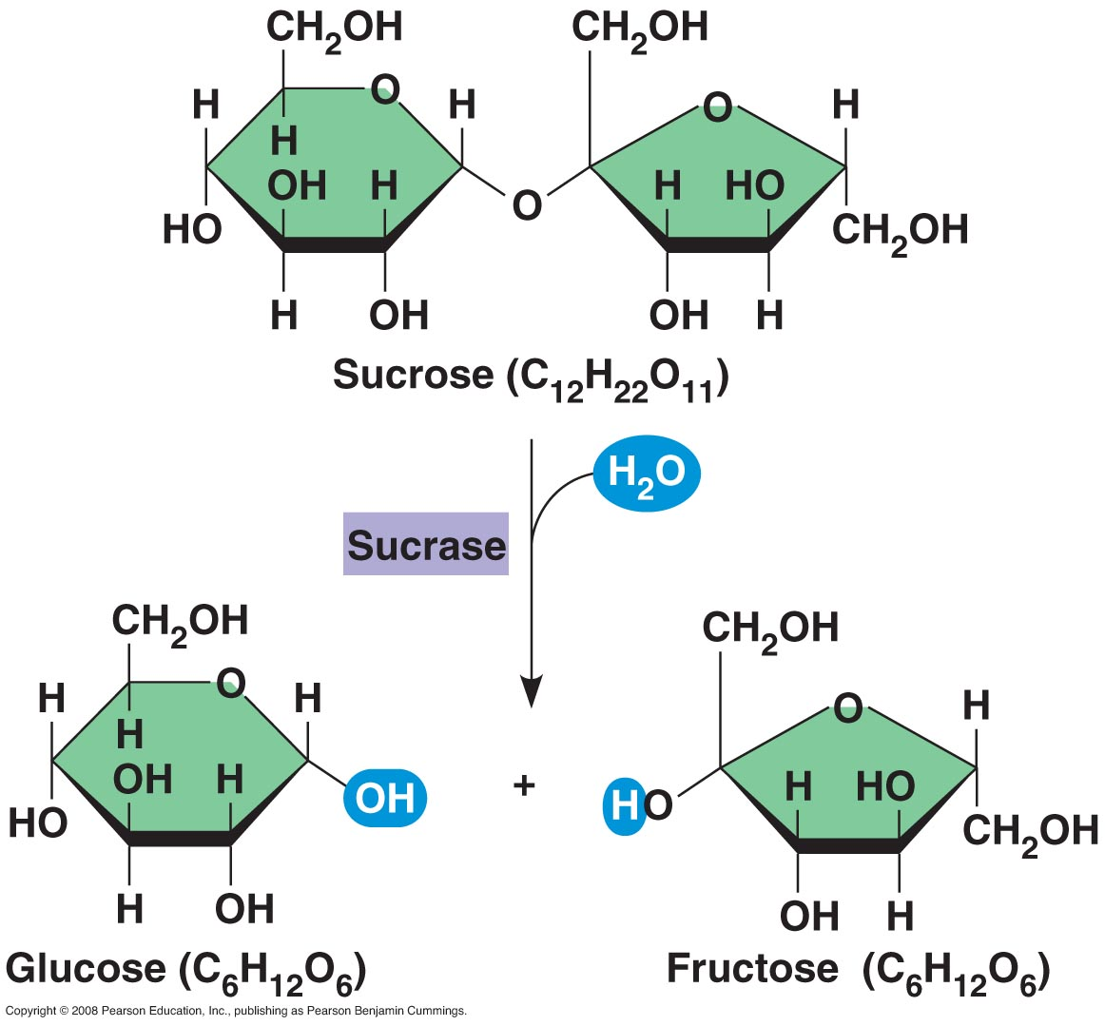
Enzymes
An enzyme is a catalytic protein
Ex. Hydrolysis of sucrose by the enzyme sucrase

Slide 24
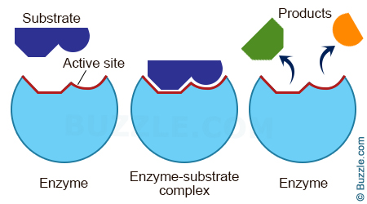

Slide 25
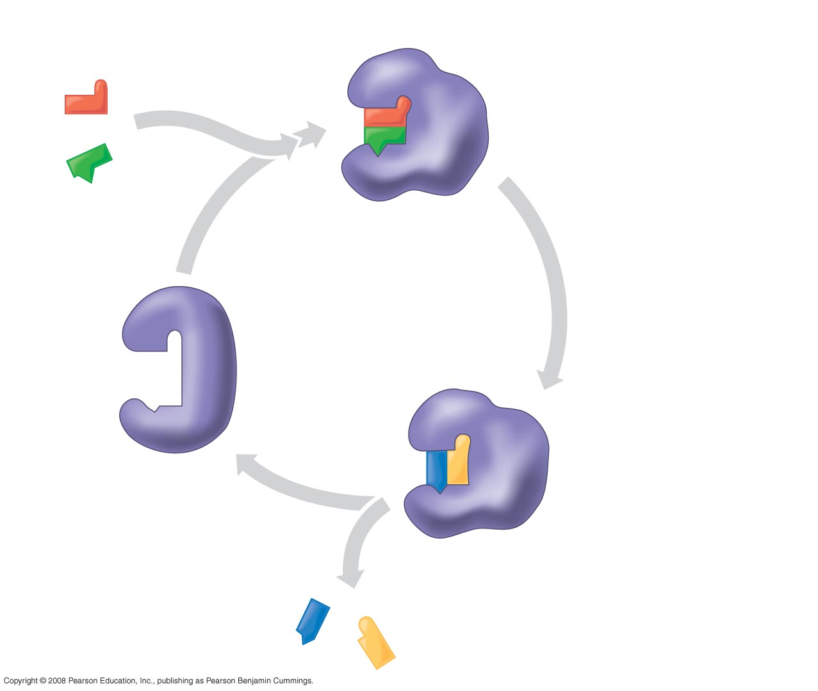
Fig. 8-17
Substrates enter active site; enzyme
changes shape such that its active site
enfolds the substrates (induced fit).
1
2
Substrates held in
active site by weak
interactions, such as
hydrogen bonds and
ionic bonds.
Substrates
Enzyme-substrate
complex
Active site can lower E_{A}
and speed up a reaction.
3
6
Active
site is
available
for two new
substrate
molecules.
Enzyme
5
Products are
released.
4
Substrates are
converted to
products.
Products
Notes:
Figure 8.17 The active site and catalytic cycle of an enzyme

Slide 26
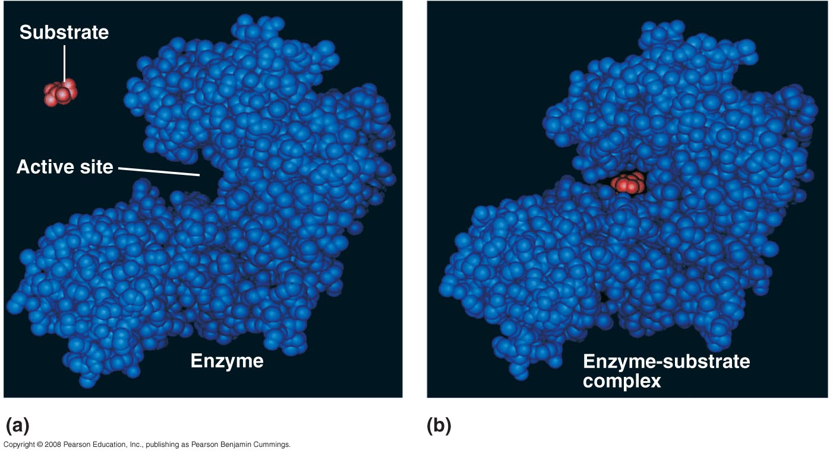
Substrate Specificity of Enzymes
substrate -reactant that an enzyme acts on enzyme-
substrate complex – enzyme and substrate together
active site – part of the enzyme the substrate binds to
Induced fit – “lock and key” matching shape of enzyme and substrate
Copyright © 2008 Pearson Education, Inc., publishing as Pearson Benjamin Cummings
Notes:
For the Cell Biology Video Closure of Hexokinase via Induced Fit, go to Animation and Video Files.

Slide 27
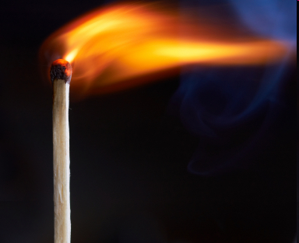
Activation Energy
activation energy (E_{A}) -The initial energy needed to start a chemical reaction
Activation energy can by supplied in the form of heat from the surroundings

Slide 28
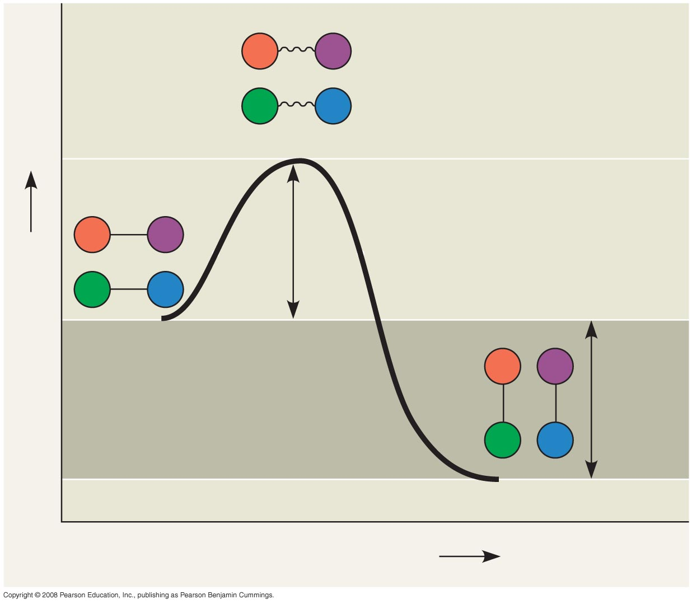
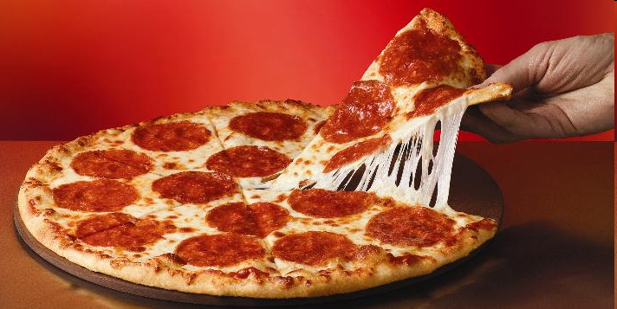
Fig. 8-14
A
B
C
D
Transition state
A
B
E_{A}
C
D
Free energy
Reactants
A
B
∆G < O
C
D
Products
Progress of the reaction
Notes:
Figure 8.14 Energy profile of an exergonic reaction

Slide 29
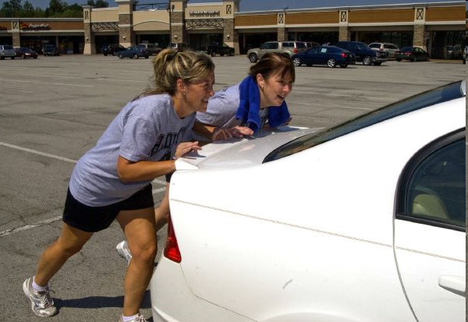
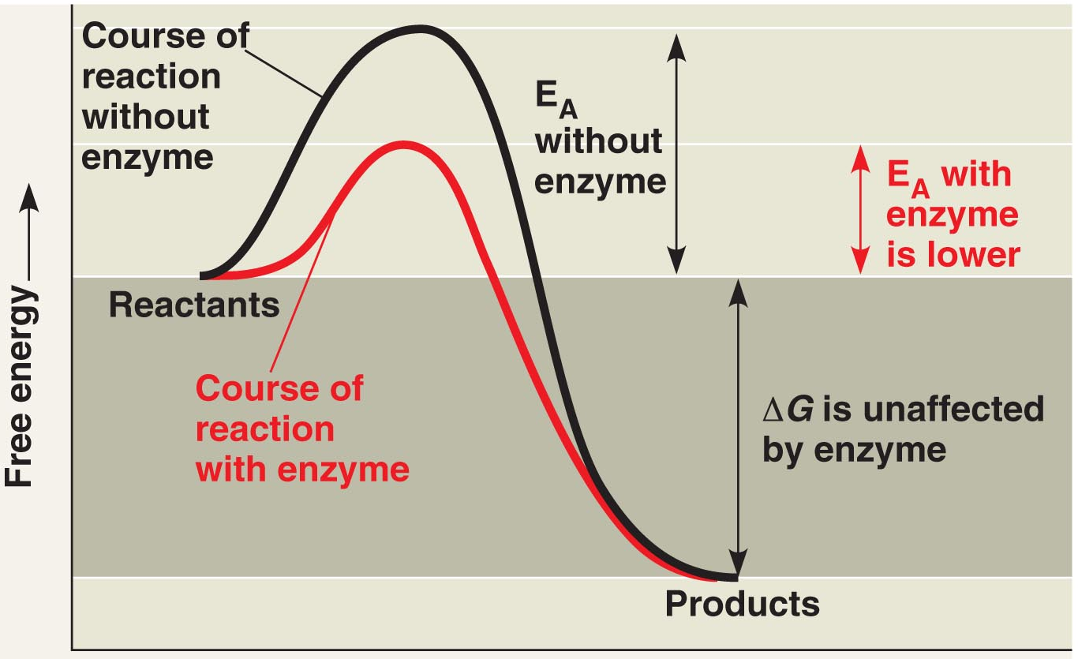
Enzymes Lower the E_{A}
Enzymes catalyze reactions by lowering the E_{A} barrier
Copyright © 2008 Pearson Education, Inc., publishing as Pearson Benjamin Cummings

Slide 30
How E_{A} is lowered
The active site can lower an E_{A} barrier by:
Orienting substrates correctly
Straining substrate bonds
Copyright © 2008 Pearson Education, Inc., publishing as Pearson Benjamin Cummings

Slide 31
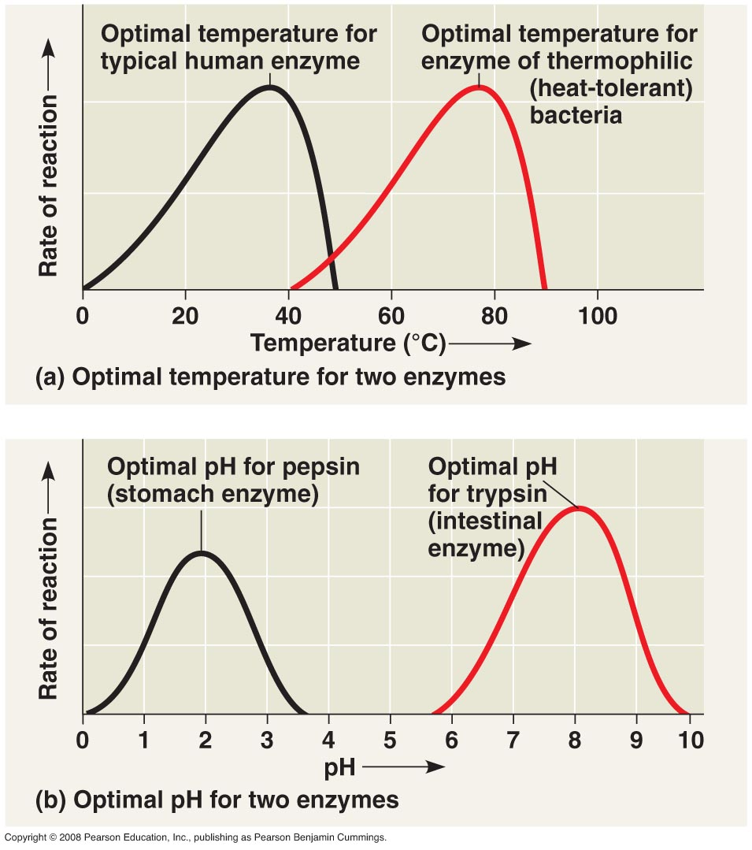
Enzyme Denaturation
An enzyme’s activity can be affected by general environmental factors, such as temperature, pH, salinity, and solute concentration.
Copyright © 2008 Pearson Education, Inc., publishing as Pearson Benjamin Cummings

Slide 32
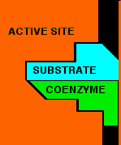
Cofactors
Cofactors - are nonprotein enzyme helpers. Ex- minerals (ex- Zinc, Iron)
Coenzyme - An organic cofactor (ex. Vitamins)
Both of these help maintain the integrity of the enzyme and the active site
Copyright © 2008 Pearson Education, Inc., publishing as Pearson Benjamin Cummings

Slide 33
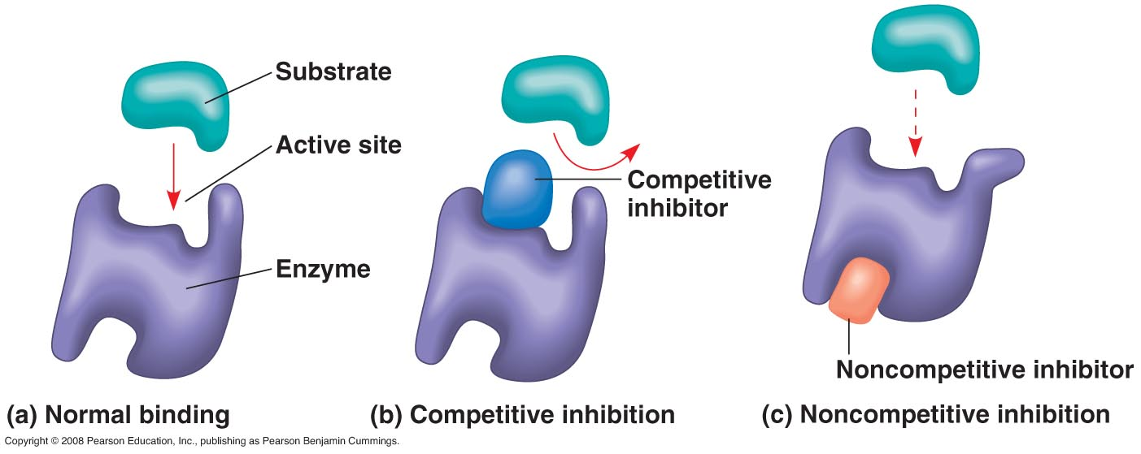
Enzyme Inhibitors
Competitive inhibitors bind to the active site of an enzyme, competing with the substrate
Noncompetitive inhibitors bind to another part of an enzyme, causing the enzyme to change shape and making the active site less effective
Examples of inhibitors include toxins, poisons, pesticides, and antibiotics
Copyright © 2008 Pearson Education, Inc., publishing as Pearson Benjamin Cummings=

Slide 34
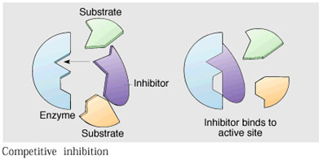
Enzymes
Competitive Inhibitor:
Takes the place of the normal substrate and does not change the ‘shape’ of the active site. Usually reversible

Slide 35
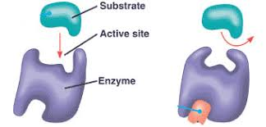
Enzymes
Non-Competitive Inhibitor
Attaches to the allosteric site (different than the active site) and thus changes the shape of the enzyme, and thereby the active site. Many are non reversible. Ex- DDT-pesticide that attaches to a central nervous system enzyme of insects. Results in death. Ex- Penicillin. Binds to bacterial enzyme that inhibits it from making cell wall

Slide 36
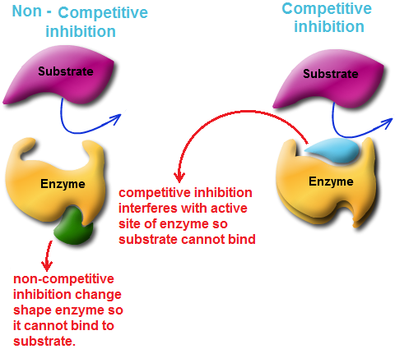

Slide 37
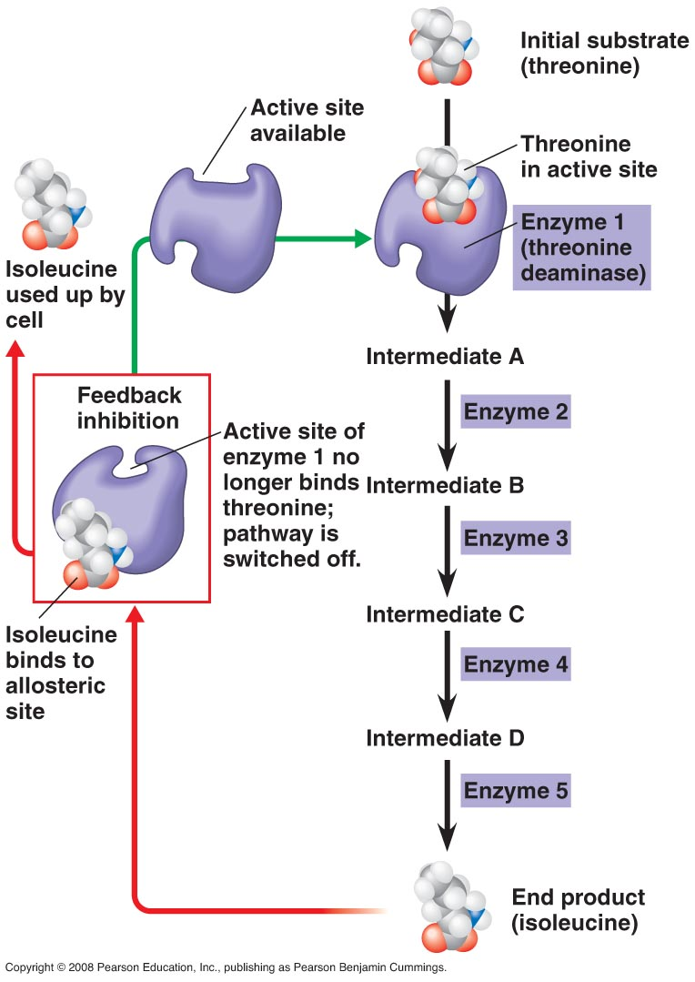
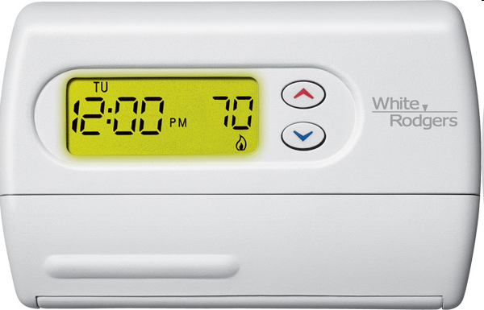
Feedback Inhibition
In feedback inhibition,
the end product of a
metabolic pathway shuts
down the pathway.
Ex. thermostat.
Copyright © 2008 Pearson Education, Inc., publishing as Pearson Benjamin Cummings

Slide 38
Homework: Look this up! What is Apoptosis? (Should have done this in last unit)

