Slide 1
Classification of Life
Biology Unit 7- Part 2

Slide 2
What’s the deal with Classification?
Life on Earth is constantly changing (evolution)
Scientists have currently identified around 1.5 million species (and estimate another 2-100 million species yet to be discovered)
Remember: A species is a population of organisms that share similar characteristics and can breed with one another and produce fertile offspring.
This diversity creates an organizational challenge.
To deal with this, Biologists name each organism and attempt to organize living things into groups that have biological meaning.

Slide 3
1.5 - 2 million known species…
Bacteria 4,000
Protozoa, algae, etc. 80,000
Fungi 70,000
Plants 321,000
Animals 1,320,000
insects 1,000,000
vertebrates 62,000

Slide 4
Taxonomy
Scientists classify organisms and assign each organism a universally accepted name based on a common criteria = taxonomy
Science requires both general and very specific categories to properly categorize all organisms.
Organisms placed into a particular group are more similar to each other that they are to organisms in other groups.

Slide 5
Scientific Names
There was confusion among scientists when they used common names.
In the eighteenth century, scientists created a scientific name for each species using Latin and Greek languages.
Originally, scientists named organisms according to their physical characteristics, but names were long and inefficient.
Then, Carolus Linnaeus, a Swedish botanist known as the ‘Father of Taxonomy’, developed a system of assigning each species a two-part scientific name = binomial nomenclature (Genus and species).
Today, scientists still use this binomial nomenclature based on Latin and Greek to name newly discovered species.

Slide 6
Binomial Nomenclature
2 part scientific name
Genus — larger group to which organism belongs
always capitalized
species — specific name for that organism
always lowercase
example: Linnaeus named humans Homo sapiens
means “wise man” — perhaps in a show of hope & optimism

Slide 7
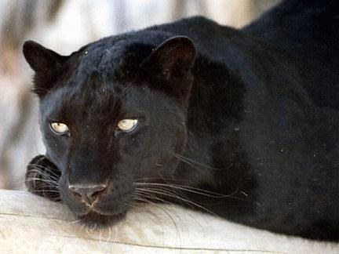
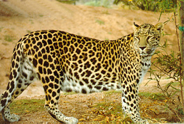
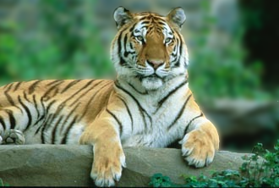
Genus groupings
Classify organisms into broader groups
Species that are closely related are grouped into the same genus
Leopard Panthera pardus
African lion Panthera leo
Tiger Panthera tigris

Slide 8
Grizzly Bear and Polar Bear
Ursus arctos
The genus Ursus indicates that it is a bear, but the species name describes either where the species lives or characteristics of the species.
What do you think maritimus means?
maritimus refers to the sea in Latin
How does this relate to polar bears?
Ursus maritimus

Slide 9
Linnaeus’s System of Classification
Uses seven taxonomic categories (largest to smallest):
Kingdom
Phylum
Class
Order
Family
Genus
species
“King Philip Came Over For Grape Soda”

Slide 10
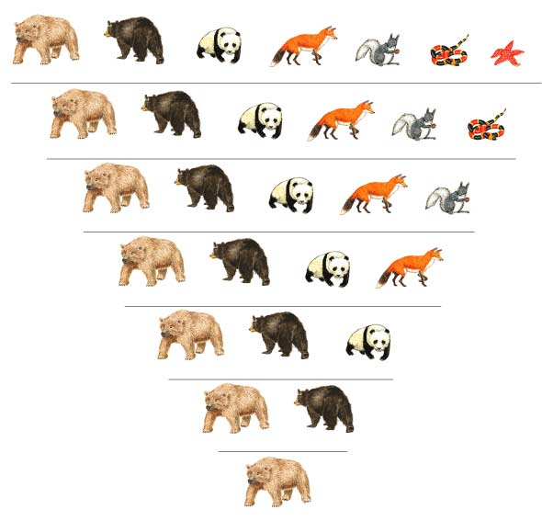
Figure 18-5 Classification of Ursus arctos
Section 18-1
Grizzly bear
Black bear
Giant panda
Red fox
Abert squirrel
Coral snake
Sea star
KINGDOM Animalia
PHYLUM Chordata
CLASS Mammalia
ORDER Carnivora
FAMILY Ursidae
GENUS Ursus
Go to Section:
SPECIES Ursus arctos

Slide 11
Modern Evolutionary Classification
Linnaeus focused on structures and anatomy.
Due to convergent (“coming together”) evolution, organisms that were quite different evolved similar body structures.
Bat and Bird wings
Whale and fish fins
Darwin’s theory of evolution changed how biologists classify organisms.
Biologists now group organisms into categories that represent lines of evolutionary descent (the evolutionary history they share), not just similar traits = Evolutionary Classification.

Slide 12
Cladograms
Cladogram = a diagram that shows the evolutionary relationships among a group of organisms (“evolution family tree”)
Cladistic analysis = using cladograms to map out evolutionary history
Based on derived characters = new characteristics that appear in recent parts of a lineage arising as lineages evolve over time

Slide 13
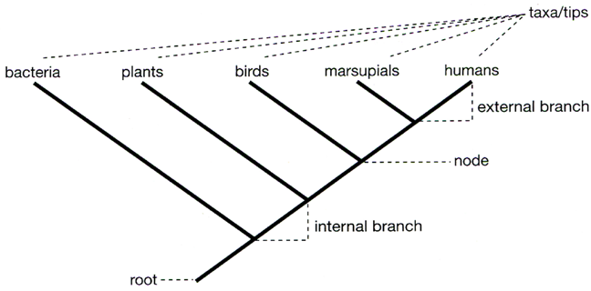
Some important terms used to describe phylogenetic trees and cladograms

Slide 14
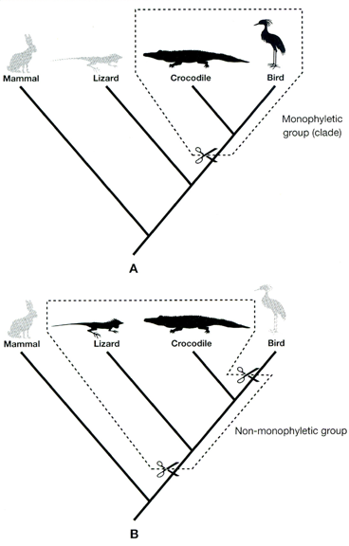
A clade includes all and only the descendants of a paticular ancestor

Slide 15
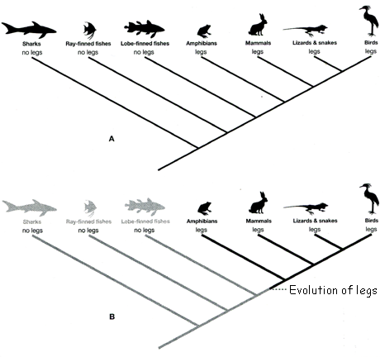
How trees show evolutionary history ←Derived character

Slide 16
Three trees, all depict the same evolutionary history (can ‘rotate’ the nodes)

Slide 17
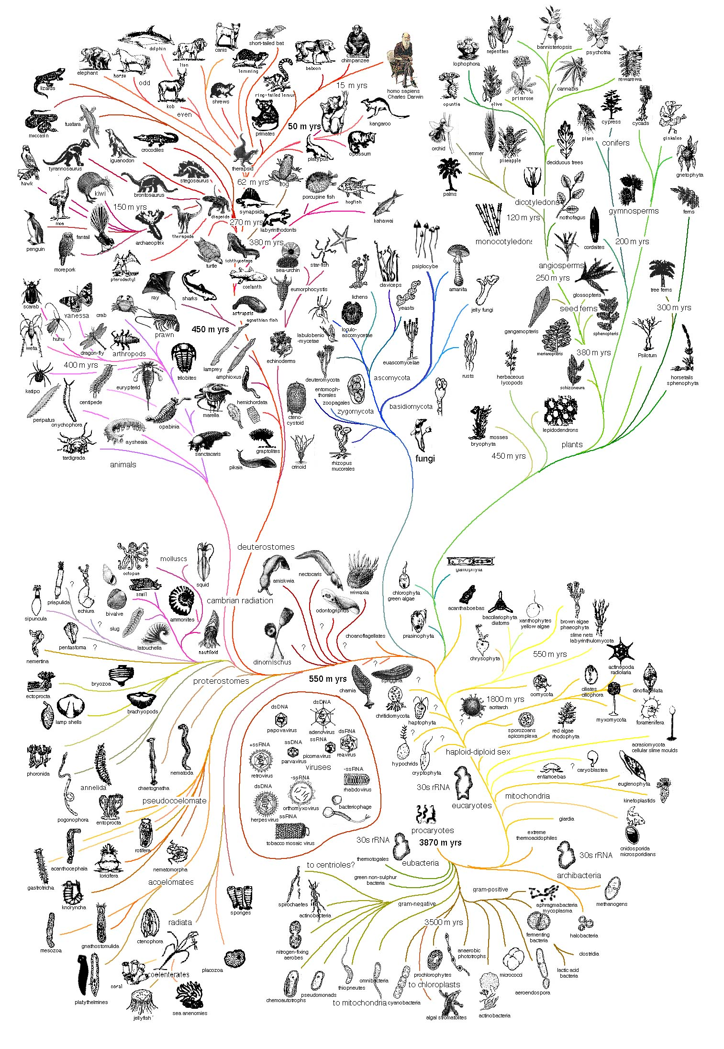

Slide 18
How would you group these organisms?
crabs
barnacles
limpets

Slide 19
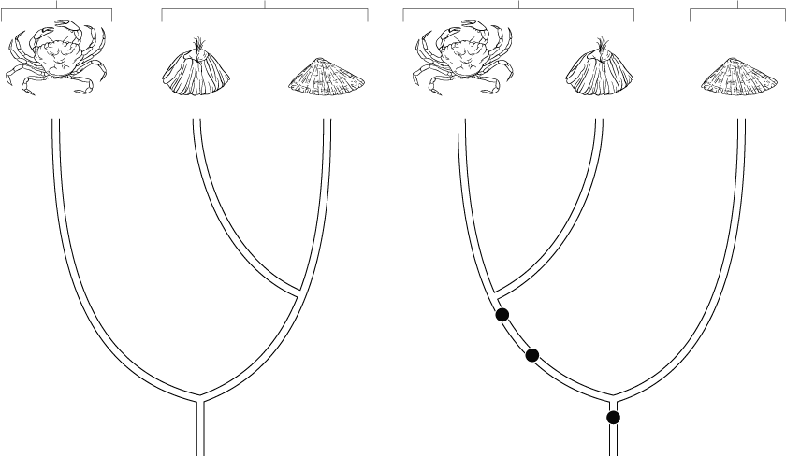
Traditional Classification Versus Cladogram
Appendages
Conical Shells
Crustaceans
Gastropod
Crab
Barnacle
Limpet
Crab
Barnacle
Limpet
Molted exoskeleton
Segmentation
Tiny free-swimming larva
TRADITIONAL CLASSIFICATION
CLADOGRAM
Go to Section:

Slide 20
Similarities in DNA & RNA
Other classification systems are based on anatomical similarities and differences, but how would you compare very different organisms?
All organisms use DNA & RNA to pass on information and control growth and development.
Since there are many similar genes in all forms of life suggesting a common ancestry, these molecules are an excellent way to compare organisms.
The genes of many organisms show important similarities at the molecular level. These molecular similarities can be used as criteria to help determine classification.

Slide 21
Vultures and Storks?
American vulture
African vulture
Traditionally, American vultures and African vultures were classified together in the falcon family. Recently, because the American vulture and stork share a common cooling behavior, scientists compared their DNA, and discovered that the American vulture and stork are more closely related than the American vulture and African vulture.
Stork

Slide 22
Molecular Clocks
Uses DNA comparisons to estimate the length of time that two species have been evolving independently.
Mutations occur all the time, causing slight changes in DNA.
Mutations build up with time and the more difference in mutations of specific genes, the less related they are with a common ancestor further back in history.

Slide 23
New Kingdoms
As evidence about different organisms continues to accumulate, biologists adjust the classification system.
The current classification system includes six kingdoms:
Eubacteria
Archaebacteria
Protista
Fungi
Plantae
Animalia
Formerly Monera

Slide 24
The Tree of Life Evolves
Changing Number of Kingdoms
Introduced
Names of Kingdoms
1700’s
Plantae
Animalia
Late 1800’s
Protista
Plantae
Animalia
1950’s
Monera
Protista
Fungi
Plantae
Animalia
1990’s
Eubacteria
Archaea-bacteria
Protista
Fungi
Plantae
Animalia
Notes:
This diagram shows some of the ways organisms have been classified into kingdoms over the years. The six-kingdom system includes the following kingdoms: Eubacteria, Archaebacteria, Protista, Fungi, Plantae, and Animalia.

Slide 25
Three-Domain System
Using molecular analyses, scientists group modern organisms into three, more general categories (domains) according to how long they have been evolving independently.
The three domains are:
Bacteria
Archaea
Eukarya

Slide 26
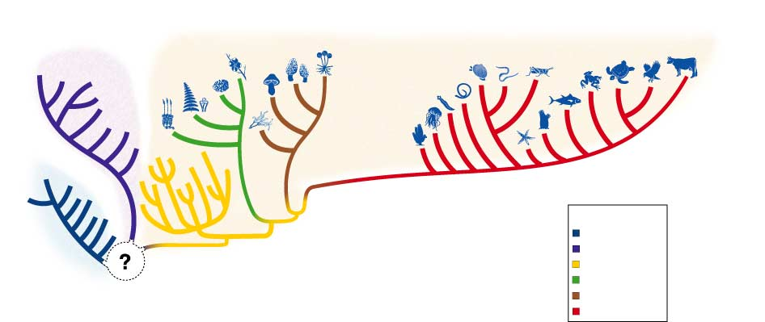
Figure 18-13 Cladogram of Six Kingdoms and Three Domains
Section 18-3
DOMAIN ARCHAEA
DOMAIN EUKARYA
Kingdoms
Eubacteria
Archaebacteria
Protista
Plantae
Fungi
Animalia
DOMAIN BACTERIA

Slide 27
Domain Bacteria
E. coli
Kingdom: Eubacteria
Unicellular
Prokaryotic
Cell wall with peptidoglycan
Range from free-living soil organisms to deadly parasites.
lactobacillus

Slide 28
Bacteria
Have nucleoid region (NO nuclear membrane)
Large circular chromosome; also has plasmids
Bacteria- Usually 1-10 um long
Many secrete sticky substance that forms capsule outside wall.
Cell wall prevents osmotic rupture.
Penicillin, the first successful antibiotic, was derived from the Penicillium mold. It is able to break down cell wall and allows osmotic rupture

Slide 29
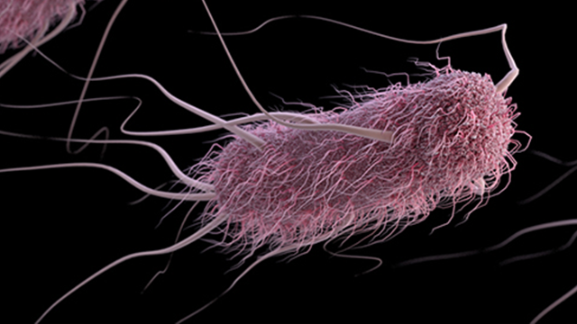
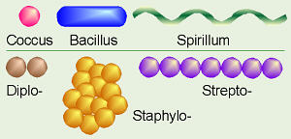
Bacteria
Some use O₂—others are anaerobes
Some are flagellated
Fimbriae (extensions) help bacteria to adhere to surfaces.
Pili used for conjugation (sexual reproduction)
Reproduce asexually by binary fission
Shapes:
Cocci-spheres
Spirillum (spirochete)-spiral (helical)
Bacillum-rod shaped

Slide 30
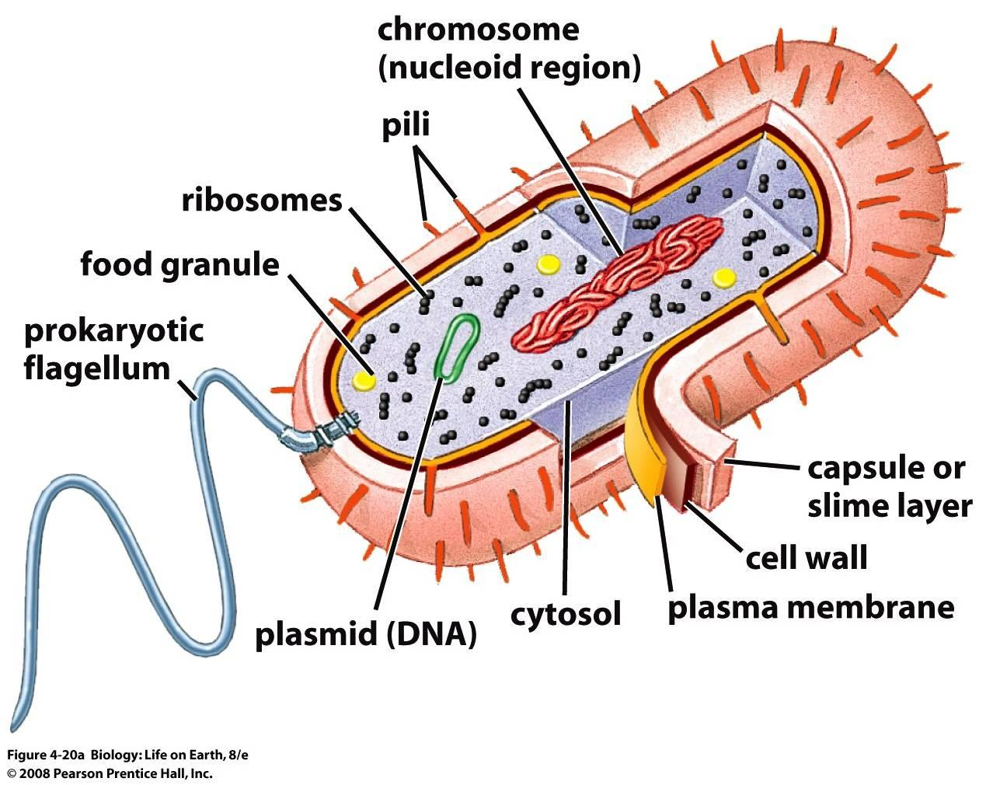
‘Typical’ Bacterial Cell

Slide 31
Prokaryotes are the foundation of life on earth
Most Bacteria are beneficial
Decompose dead organisms
Decomposers, saprobes, saprophytes
Perform nitrogen fixation
Live in our digestive system and are also used in the food industry
Cheese, yogurt, etc
Used to decompose waste in sewage
However, some bacteria cause disease – Usually produce toxins. Ex- bacteria that causes botulism (paralyzes nerve cells). Other diseases: Lyme disease; strep throat; syphilis; gonorrhea

Slide 32
Some Prokaryotes Cause Disease
Usually produce toxins. Ex- bacteria that causes botulism (paralyzes nerve cells). Other diseases: Lyme disease; strep throat; syphilis; gonorrhea
Antibiotics are the most effective means of fighting bacterial infections
**No known Archaea cause disease

Slide 33
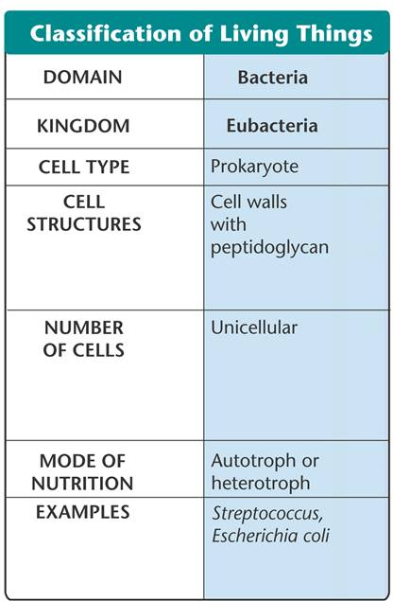
Domain Bacteria
The domain Bacteria corresponds to the kingdom Eubacteria.

Slide 34
Domain Archaea
Living in methane
Kingdom: Archaebacteria
Unicellular
Prokaryotic
Live in the most extreme environments (volcanic hot springs, brine pools, black organic mud without oxygen)
Live in absence of oxygen
Cell wall lacks peptidoglycan
Cell membranes contain unusual lipids not found in any other organism
No known archaea cause disease
Living in a hot spring

Slide 35
Major Groups of Archaea
Extremophiles-3 types
Methanogens- are poisoned by oxygen;use CO2 as the electron acceptor in respiration; produces methane as a waste product
Halophiles- lives in very saline places
Thermophiles (aka hyperthermophiles)

Slide 36
Archaea

Slide 37
Archaeabacteria
Used to be grouped with bacteria and called monerans
Now believed eukaryotes evolved from archaeal line of descent
Archaea and Eukarya share some of the same rRNA sequences and ribosomal proteins; also, similar tRNA
Archaea have “unusual” diverse lipids in membrane that allow them to live under extreme conditions
Cell walls are not peptidoglycan
**Some Archaea have introns; bacteria do not

Slide 38
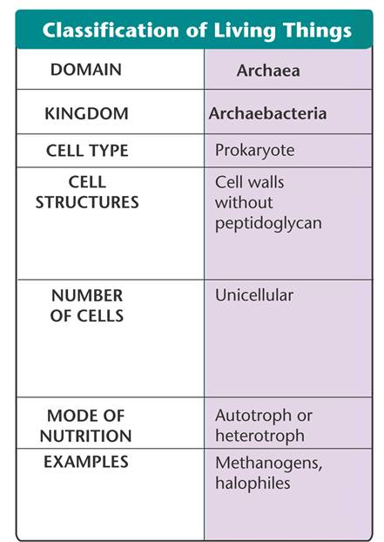
Domain Archaea
The domain Archaea corresponds to the kingdom Archaeabacteria

Slide 39
The Origin of the Eukaryotic Cell
Eukaryotic cells arose through a combination of 2 processes:
- membrane infolding- produced all the membrane-bound organelles except the mitochondrion and the choloroplasts.
Endosymbiosis-Mitochondria and chloroplasts believed to once be prokaryotic cells that were ingested or absorbed by another prokaryotic cell.

Slide 40
Endosymbiotic Theory

Slide 41
Domain Eukarya
All of the organisms that have a true nucleus
Kingdoms:
Protista
Fungi
Plantae
Animalia

Slide 42
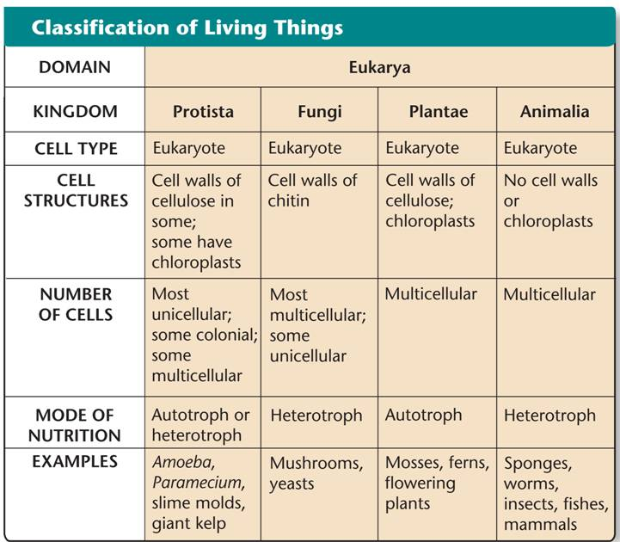
Domain Eukarya

Slide 43
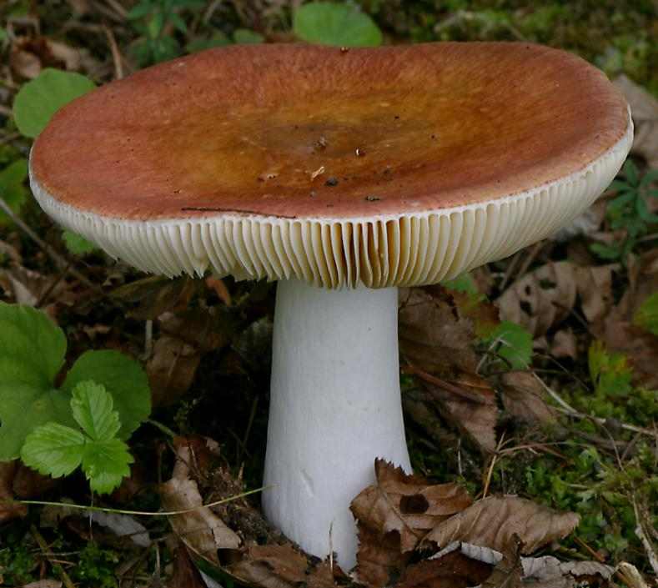
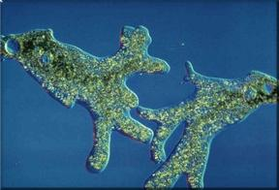
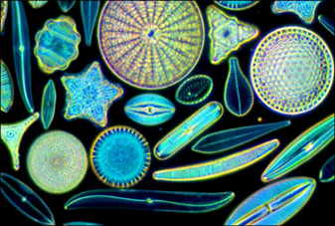
Domain Eukarya
Kingdom Protista
Most diverse kingdom
Most are unicellular, but some are multicellular
Some are autotrophic (Algae), while other are heterotrophic (Protozoans)
Some share characteristics with plants, others with fungi, and others with animals
Ex- Amoeba; Diatoms
Kingdom Fungi
Heterotrophs (digest food extracellularly & then absorb it)
Multicellular (except yeast)
Important decomposers
Cell walls: made of chitin
some cause disease (ex- athlete’s foot)
Ex- mushrooms; mold

Slide 44
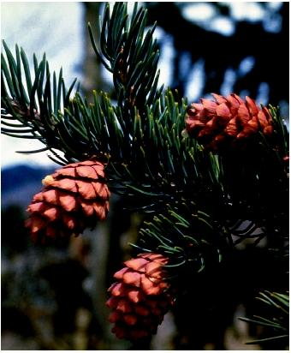
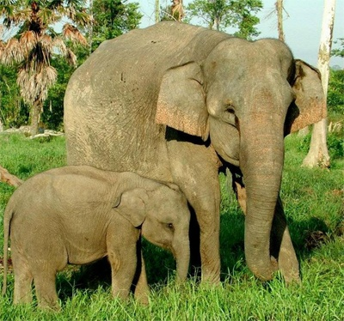
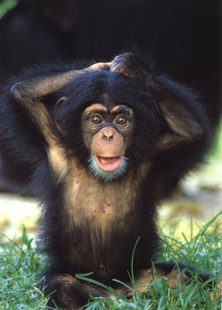
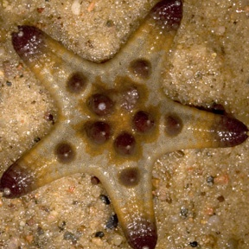
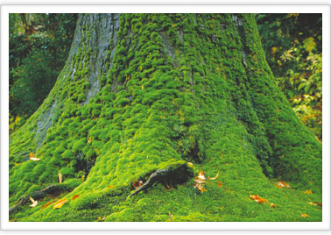
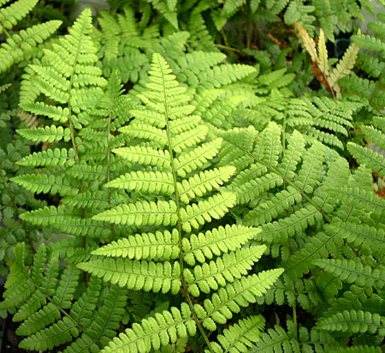
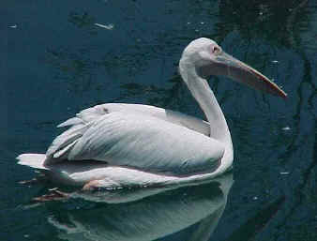
Domain Eukarya
Kingdom Animalia
Multicellular
Heterotrophic (eat food)
No cell walls
Motile (can move)
*More in next unit
Kingdom Plantae
Multicellular
Photosynthetic autotrophs (make food)
Nonmotile (can’t move from place to place)
Cell walls with cellulose
Cone-bearing, flowering-plants, mosses, & ferns
*More in next unit

Slide 45
Figure 18-12 Key Characteristics of Kingdoms and Domains
Classification of Living Things
DOMAINS and Kingdoms:
DOMAIN
KINGDOM
CELL TYPE
CELL STRUCTURES
NUMBER OF CELLS
MODE OF NUTRITION
EXAMPLES
Archaea
Archaebacteria
Prokaryote
Cell walls without peptidoglycan
Unicellular
Autotroph or heterotroph
Methanogens, halophiles
Protista
Eukaryote
Cell walls of cellulose in some; some have chloroplasts
Most unicellular; some colonial; some multicellular
Autotroph or heterotroph
Amoeba, Paramecium, slime molds, giant kelp
Fungi
Eukaryote
Cell walls of chitin
Most multicellular; some unicellular
Heterotroph
Mushrooms, yeasts
Bacteria
Eubacteria
Prokaryote
Cell walls with peptidoglycan
Unicellular
Autotroph or heterotroph
Streptococcus, Escherichia coli
Eukarya
Plantae
Eukaryote
Cell walls of cellulose; chloroplasts
Multicellular
Autotroph
Mosses, ferns, flowering plants
Animalia
Eukaryote
No cell walls or chloroplasts
Multicellular
Heterotroph
Sponges, worms, insects, fishes, mammals
Go to Section:

Slide 46
Concept Map
Section 18-3
Living Things
Prokaryotic cells
are characterized by
Eukaryotic cells
Important characteristics
and differing
which place them in
Cell wall structures
Domain Eukarya
such as
which place them in
which is subdivided into
Domain Bacteria
Domain Archaea
Kingdom Plantae
Kingdom Protista
which coincides with
which coincides with
Kingdom Fungi
Kingdom Animalia
Kingdom Eubacteria
Kingdom Archaebacteria
Go to Section:

Slide 47
Dichotomous Key
Dichotomous keys are tools used to identify organisms.
Dichotomous means “divided into two parts”
It includes a series of paired statements based on physical characteristics that are chosen and lead the user to the correct name of the organism.
Let’s make one together!

Slide 48
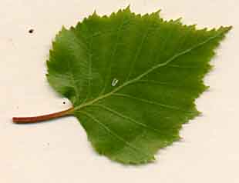
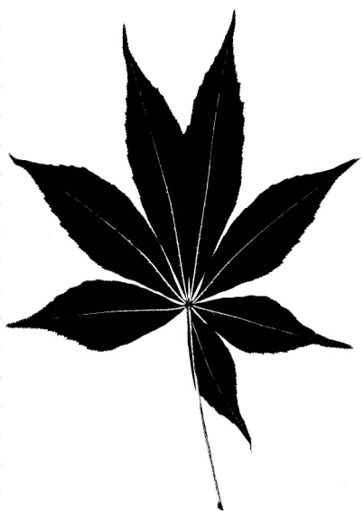
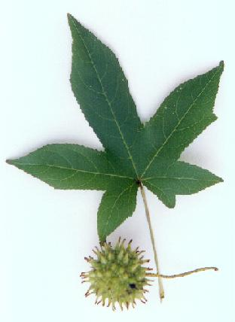
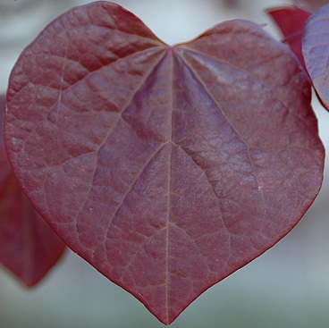
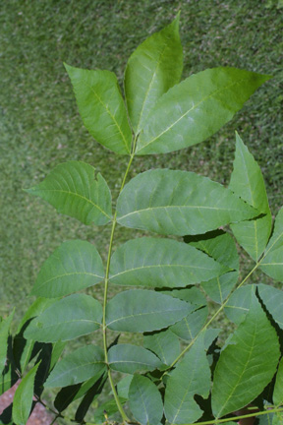
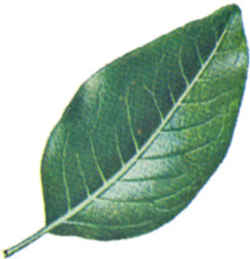
IV
I
II
V
III
VI
VII

Slide 49
The Tree of Life Evolves
Changing Number of Kingdoms
Introduced
Names of Kingdoms
1700’s
Plantae
Animalia
Late 1800’s
Protista
Plantae
Animalia
1950’s
Monera
Protista
Fungi
Plantae
Animalia
1990’s
Eubacteria
Archae-bacteria
Protista
Fungi
Plantae
Animalia
Notes:
This diagram shows some of the ways organisms have been classified into kingdoms over the years. The six-kingdom system includes the following kingdoms: Eubacteria, Archaebacteria, Protista, Fungi, Plantae, and Animalia.

Slide 50
Viruses
Not classified. Why aren’t they considered “living”?
Made of protein coat (capsid) and nucleic acid
5-300 nm (nm is a billionth of a meter)
No “cure”. Some can be prevented by vaccination (NOT antibiotics!)
Ex- influenza, cold, measles, mumps, HIV, hepatitis, chicken pox, herpes

Slide 51
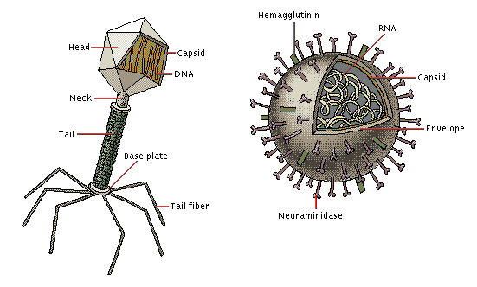
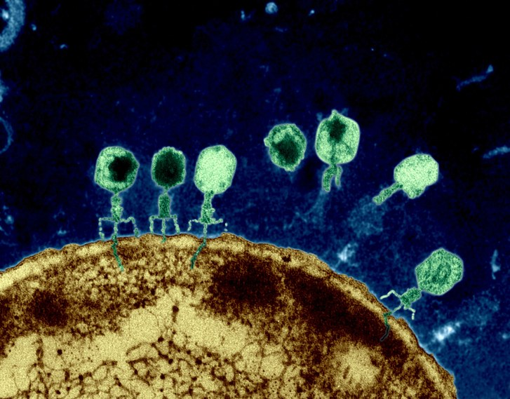
Bacteriophage infecting E. coli
Viral Structure

Slide 52
Viral Reproduction
Intracellular parasites
Virus attaches to host cell using their coat’s proteins and the host’s cell membrane receptors. Viral genome then enters host cell
Viruses can be made of DNA or RNA---HIV is a retrovirus made of RNA (*Does not follow ‘Central Dogma’: instead RNA→DNA)
Lytic cycle (active-lysis) vs. Lysogenic (inactive-virus ‘hides’ in host’s DNA as a prophage- ex: both Herpes Simplex types I & II).
*See next page

Slide 53
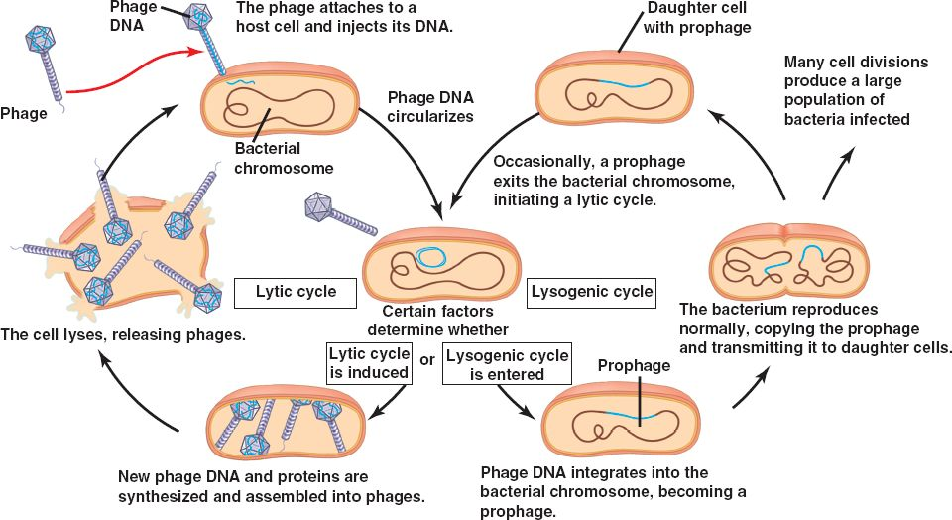

Slide 54
Important Symbiotic Relationships between Organisms of Different Kingdoms:

Slide 55
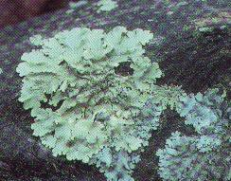
Lichens- (Know!)
Look similar to some species of moss, but are not!
Lichens are symbiotic associations between a fungus (often an ascomycete) and green algae or cyanobacteria
The fungus usually give lichens “shelter” (optimal environment) which gives rise to their shape
Alga provides the fungus with food
Fungus provides a suitable physical environment for growth

Slide 56
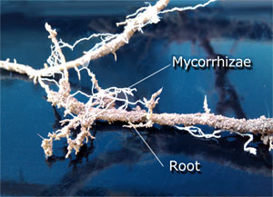
Mycorrhizae (“fungus roots”)- Know!
Mutualistic associations of plant roots and fungi
Almost all vascular plants have mycorrhizae

Slide 57
Review:
Organisms whose cell walls contain peptidoglycan belong in the kingdom
Fungi.
Eubacteria.
Plantae.
Archaebacteria.

Slide 58
Multicellular organisms with no cell walls or chloroplasts are members of the kingdom
Animalia.
Protista.
Plantae.
Fungi.

Slide 59
Organisms that have cell walls containing cellulose are found in
Eubacteria and Plantae.
Fungi and Plantae.
Plantae and Protista.
Plantae only.

Slide 60
Molecular analyses have given rise to a new taxonomic classification that includes
three domains.
seven kingdoms.
two domains.
five kingdoms.

Slide 61
Which of the following contain more than one kingdom?
only Archaea
only Bacteria
only Eukarya
both Eukarya and Archaea

