Slide 1
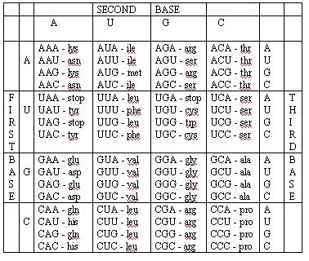
Codon Chart (mRNA codes)

