Slide 1
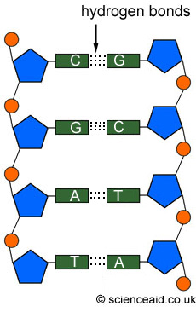
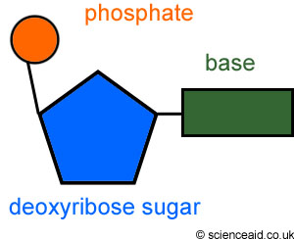
DNA in a ‘nutshell’
DNA is a polymer of nucleotides.
A nucleotide is made up of three parts: a sugar, a phosphate and one of four bases
In DNA, the bases are A, T, C, and G
DNA’s shape is a double helix
The two strands are held together by HYDROGEN bonds
A binds to T
C binds with G

Slide 2
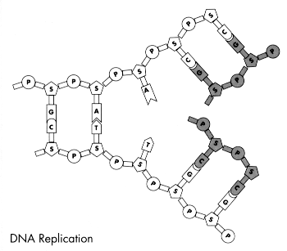
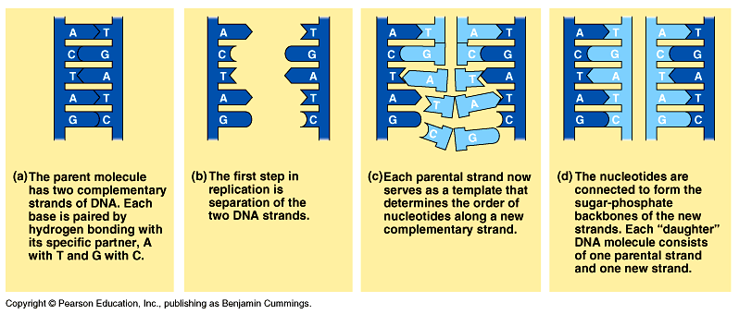
DNA Replication
Process of DNA copying itself
Steps
-DNA Unzips (Hydrogen bonds break)
-Each side acts as a template
-New DNA nucleotides are added according to base-pairing rules
-Two new molecules of DNA result – each with one old and one new strand.
Happens in INTERPHASE (before mitosis or meiosis)

Slide 3
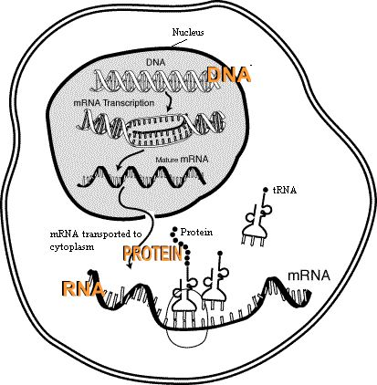
Protein Synthesis
*Fyi: All living things are primarily made of water, which is inorganic (no carbon). Other than water, organisms are primarily made of protein, which is organic (has carbon)
Remember, genes are made of DNA and are in the nucleus
Genes (DNA) contain the instruction for making a protein
In transcription, DNA is used to make mRNA in the nucleus
mRNA then leaves the nucleus and goes to the ribosome
In translation, tRNA then brings amino acids in the proper order to make the protein on the ribosome.
DNA → mRNA → protein
Made of amino acids

Slide 4
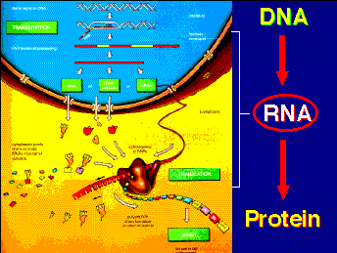
PROTEIN SYNTHESIS
DNA
DNA is in the nucleus
GENES (made of DNA) contain codes for making proteins
RNA
Answer: by using a messenger called mRNA
Called TRANSCRIPTION
PROTEIN
mRNA goes to ribosome
tRNA brings the right amino acid to the mRNA, which is now on the ribosome
Remember base pairing rules. *There’s no thymine (T) in RNA. Instead it has uracil (U)
3 bases on mRNA is a called codon – each codon codes for one amino acid
Anticodon on tRNA pairs with mRNA codon and releases its amino acid. Called TRANSLATION
DNA cannot leave the nucleus. Question: So how does it get it’s coded messages to the ribosomes?
mRNA is made in the nucleus (but instead of being double stranded, it’s single stranded)

Slide 5
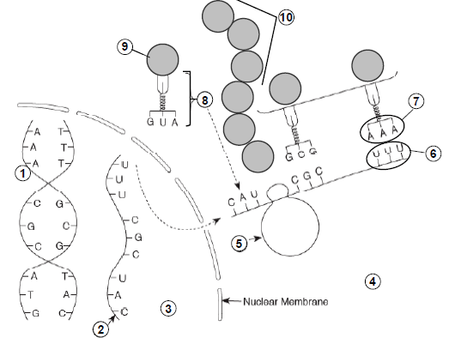
Can you IDENTIFY the parts?
DNA
mRNA
Nucleus
Cytoplasm
Ribosome
Codon
Anticodon
tRNA
Amino acid
Protein (polypeptide)

Slide 6
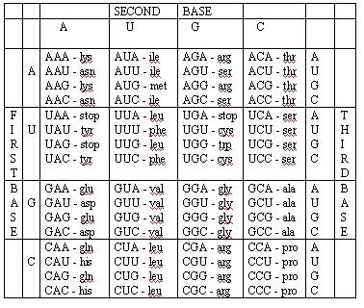
READING THE CODON CHART
Be sure to use mRNA
You won’t have to memorize this!
What amino acid is coded for by the DNA
ATA GAG
First convert DNA to mRNA
ATA GAG UAU CUC
UAU = tyr
CUC = Leu

