Slide 1
Chem UNIT 4
Lesson: Intermolecular Forces

Slide 2
Learning Target
SWBAT explain the effects of the intermolecular forces on the different phases of matter

Slide 3
What forces exist in compounds?
There are 2 types of attraction in molecules
Intramolecular & Intermolecular
We’ve already learned about intramolecular bonds
Ionic, polar, non-polar
Intermolecular forces (IMFs) have to do with the attraction between MOLECULES (rather than the attraction between ATOMS in a molecule)
Intramolecular forces are stronger than intermolecular forces

Slide 4
What are Intermolecular Forces?
Forces of attraction or repulsion which act between neighboring molecules
IMFS you are responsible for knowing:
Dipole – dipole attractions
Hydrogen bonding
London dispersion forces
Ionic
Covalent
Metallic

Slide 5
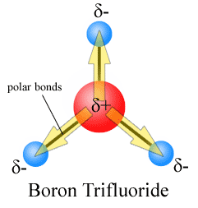
Define Dipole
A molecule that has a positive charge at one end and a negative charge at the other
Caused by the movement of electrons and the electronegativity of an element

Slide 6
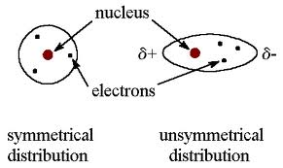
What is a London Dispersion Force?
Forces of attraction that exist between SMALL dipoles in non-polar molecules
Small dipoles are created by the movement of electrons in the atom

Slide 7
What is Dipole – Dipole Attraction?
Attractive forces between polar molecules
Orientation of Polar Molecules in a Solid

Slide 8
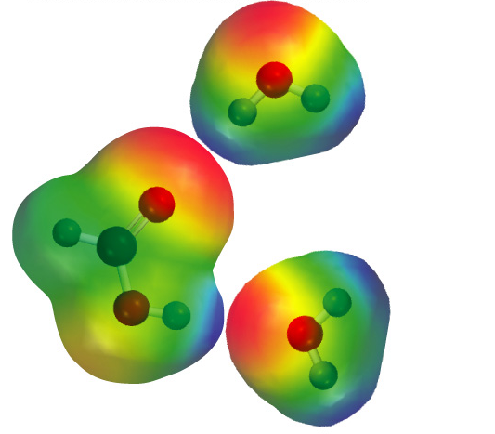
What is Hydrogen Bonding?
Special type of dipole – dipole
VERY STRONG
Occurs when F, O, or N are bonded to H
“H bonding is FON”

Slide 9
Strength of Forces
London dispersion << Dipole – Dipole < Hydrogen

Slide 10
Big Idea: Measuring IMFs
Boiling point and melting point are a way to measure the strength of intermolecular forces
Stronger intermolecular forces = higher boiling point and melting point
Think about it – the forces are STRONGER so it takes MORE energy to break the bonds to cause melting or boiling

