Slide 1
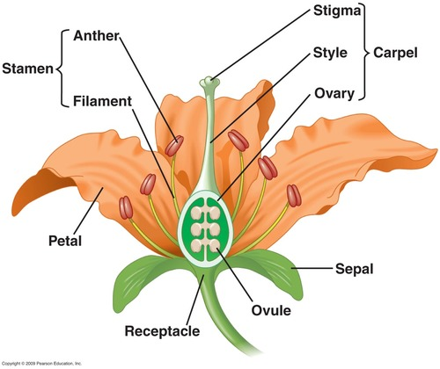
KINGDOM PLANTAE- Plants in a ‘Nutshell’
General Characteristics | Eukaryotic, multicellular, cell walls w/cellulose, autotrophic
TWO MAIN GROUPS OF PLANTS:
1. Nonvascular- no xylem or phloem; typically small/low to ground; no true roots, stems, leaves; need moisture for reproduction (ex- mosses). Pioneer species-important: rock weathering (soil). | 2. Vascular- have xylem (carries water) and phloem (carries sugar) vessels for movement of material thru plant (trees, flowers, pine trees, grass, etc.)
-Bryophytes- Nonvascular; need water to transport sperm to egg (sexual) so found in moist, shady areas -Can also release haploid spores (asexual) -Use ‘alternation of generations’ for reproduction (oscillate between sexual & asexual reproduction) | Main groups of Vascular Plants: 1. Pteridophytes (tracheophytes)- Ferns (no seeds, produce spores) 2. Gymnosperm- produces seeds in cones (ex: pine tree) 3. Angiosperm- produces seeds in flower (ex: deciduous trees, roses)
 | Roots- take up nutrients & water from soil. Store sugar during the winter.
 | Stems- contain xylem (water) & phloem (food-sugar)
 | Leaves- Main organ for photosynthesis & contain chloroplasts to collect sunlight for photosynthesis. Can be modified into spines & needles to prevent water loss
 | Flowers (only Angiosperms)- contain reproductive organs that make pollen (sperm) & ovule (egg);. Seeds are the result of fertilization (variation). Flowers color/smell- attract pollinators. Fruit-protects seeds.
Angiosperm Flower: Carpel/Pistil- ‘female’ (ovules/eggs)
Stamen- ‘male’ (pollen/sperm)
Plant TROPISMS (responses):
1) Phototropism: + leaves/stems toward light; - roots away
2) Gravitropism (or geotropism): + roots toward gravity; - leaves/stems grow away from gravity
3) Thigmotropism: + toward ‘touch’ stimulus (vine on fence); - away from touch (mimosa leaf ‘curls’ up)

