Slide 1
Week 1 resources
Mrs. Phillips

Slide 2
1st Period seating chart
1 | 2 | 3 | 4 | 5 | 6 | 7 | 8
9 | 10 | 11 | 12 | 13 | 14 | 15 | 16
17 | 18 | 19 | 20 | 21 | 22 | 23 | 24
25 | 26 | 27 | 28 | 29 | 30 | 31 | 32

Slide 3
3rd Period seating chart
1 | 2 | 3 | 4 | 5 | 6 | 7 | 8
9 | 10 | 11 | 12 | 13 | 14 | 15 | 16
17 | 18 | 19 | 20 | 21 | 22 | 23 | 24
25 | 26 | 27 | 28 | 29 | 30 | 31 | 32

Slide 4
4th Period seating chart
1 | 2 | 3 | 4 | 5 | 6 | 7 | 8
9 | 10 | 11 | 12 | 13 | 14 | 15 | 16
17 | 18 | 19 | 20 | 21 | 22 | 23 | 24
25 | 26 | 27 | 28 | 29 | 30 | 31 | 32

Slide 5
Fill in the following on your notecard: (*or fill in form)
1. Your Name (Last, First) Class Period
2. Parent/Guardian Name Phone Number
3. Do you have internet access at home?
4. What is your favorite thing about science?
5. What is something you are REALLY good at doing?
6. How would your past teachers describe you?
7. What do you normally do after school?

Slide 6
Agenda
Introductions
Procedures
Supporting Claims
Exit Ticket

Slide 7
Norms
Raise your hand to speak / ask a question
100% participation
Fill in your guided notes, if applicable

Slide 8
Ms. PHILLIPS
susan.phillips@cobbk12.org
Room 515
(770) 578-3266
www.phillipsscientificmethods.weebly.com (click ‘more’ at top of page)
Tutoring:
Learning Links: Tuesday’s and Thursday’s until 4:30 (or by appointment)
Science Honor Society- students can help if given 2+ days notice

Slide 9
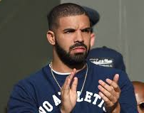
Attention Getter
If you can hear my voice clap once…
If you can hear by voice clap twice…
After 2 claps, students should
NOT be moving
Be silent
Be tracking the teacher
*I also sometimes use the bell on teacher counter

Slide 10
Classroom procedures
Entry:
Pick up papers from your class’s table
Sit in YOUR assigned seat (will be assigned tomorrow)
Write down due dates from Daily Agenda (will NOT be posted on blog). Begin QUIETLY working on any Warm Up questions given.
Tardy – If the door is closed and locked, you are tardy. If there is not a hall pass from a teacher or admin, you will either lose SAP points (discussed later today) OR given a detention OR receive a referral (my discretion!)
3rd block- Wait outside the door after A lunch until I unlock the door

Slide 11
WARM-UP/Do now – Today!
Write the statements and fill in the blanks.
Raise your hand when you have finished.
This semester I will _____________
I am looking forward to ________ in this class
My education is important to me because __________________

Slide 12
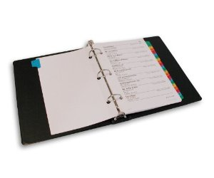
Materials
Scientific calculator
3 ring binder
ALWAYS have:
General resources
Notes, labs, & quizzes form previous unit
Notes labs, & quizzes from current unit
Optional: Markers, highlighters, color pencils, etc.
*I do not check HW every day. It will NOT be announced! You must ALWAYS have the current unit’s assignments with you each and every day!

Slide 13
Classroom procedures
Restroom policies
You should use the restroom BEFORE class
NO ONE may leave the room during the first or last 10 minutes of the class period OR during instruction time, so DON’T ASK!
Disclaimer: You may only use the restroom 9 times per semester. You must fill out your bathroom card and have it signed by the teacher

Slide 14
Classroom procedures
Exiting:
DO NOT pack up before instructed to do so
Make sure your area is clean! Leave the classroom better than you found it
Sit SILENTLY and wait to be dismissed
Exit Tickets:
Will be done some of the days
~5 minutes to answer questions from the day’s lesson; go over answers; share scores
*Discuss usatestprep.com and/or webassign

Slide 15
Important Dates To remember
1/5 – Completed & signed parent Syllabus; Safety contract; info forms
1/9 – Deductions on SAP passes begin
So….what is a SAP (Safety and Procedure Pass)?

Slide 16
Kid President
https://www.youtube.com/watch?v=l-gQLqv9f4o

Slide 17
What is Chemistry?
Essential study of matter and its interactions
Includes physical change, chemical changes, and the energy flow associated with them

Slide 18
Supporting Claims
How do scientists communicate?
How do you know whether or now a scientists’ work is credible?
YOU are scientists!
Must learn how to explain and defend knowledge

Slide 19
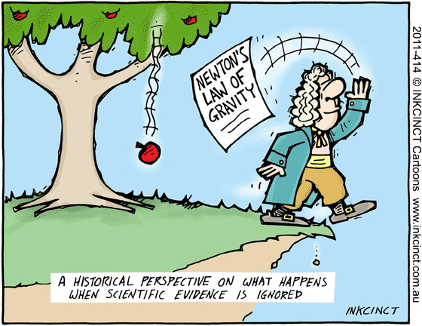
Supporting Claims
Answer questions with evidence and reasoning
CER Method:
Claim – answer to the question
Evidence – collected data
Reasoning – logical connection between the claim and the evidence
Example: Alien?
Notes:
https://www.youtube.com/watch?v=WQTsue0lKBk

Slide 20
Supporting Claims – Using CER
Question: Are you born with a defined intelligence level?
Task: Use the CER method and the video provided to answer the question
Be sure to do the following:
Answer the question
Use MORE THAN ONE piece of scientific data to support YOUR answer
Justify your answer with evidence; explain why the data counts as evidence using scientific language

Slide 21
Lab Safety- Today and ½ of tomorrow
Room Diagram
Safety Video
Safety Rules and Symbols
Safety Questions
*We will get books from the bookroom on Friday and begin Unit 1
NOW IT’S YOUR TURN…ANY QUESTIONS?

Slide 22
IF APPLICABLE: Pre SLO
45 minutes, 28 questions
Clear your desk of everything except a calculator
Will be provided with a scratch sheet of paper + resource sheet
Submitted via iRespond remotes
Log in; answer ALL questions
If you get logged out, simply log back in using your ID number
Finished?
Turn OFF the iRespond remote; return ALL supplies to the front
Pick up the worksheet for today’s lesson
Once your SLO has been turned in, you may listen to music while you work silently until everyone is finished

