Slide 1
Chem: Unit 3-Part 3
Lesson: Valence Electrons & Orbital Diagrams

Slide 2
Learning Target
SWBAT identify, draw electron dot diagrams, and write the orbital diagram of valence electrons in an element.
Importance?

Slide 3
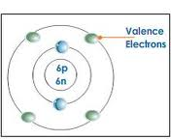
What are valence electrons?
Electrons found in the OUTERMOST energy level of the electron cloud
(Almost) ALL atoms want 8 valence electrons for stability
Exceptions: H, He, Li, Be, B

Slide 4
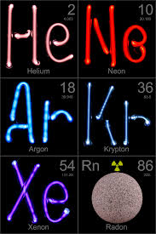
When are atoms chemically stable?
Noble gases (Group 18; aka 8A) – Only chemically stable group due to having full outer energy levels
All others that do not already have full outer energy levels in the neutral state will gain, lose, or share electrons in order to achieve stability

Slide 5
Periodic trends

Slide 6
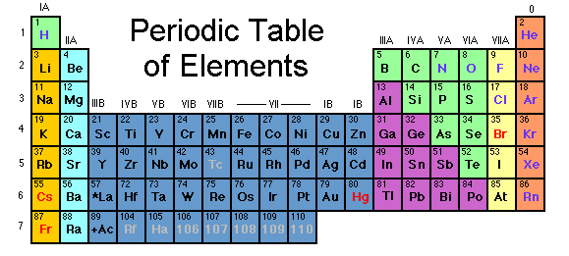
CFU – How many valence electrons?
P
C
Ba
Kr
Li

Slide 7
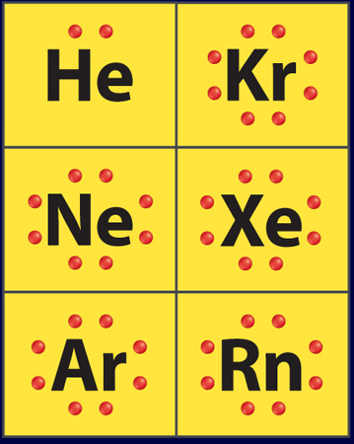
Electron Dot Diagrams
Shows valence electrons around an atom
To draw:
Write the chemical symbol of the element
In most cases, pair up ‘s’ electrons, then put one dot around the symbol for each valence electron. Go back & pair e- up, if needed (up to 8e-)
Everything else (meaning the nucleus and all the inner e-) is represented by the symbol

Slide 8
Electron Dot Diagram Practice
Carbon
Nitrogen
Phosphorus
Helium
Hydrogen

Slide 9
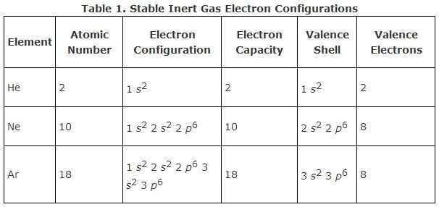
Valence Electron Orbital Diagrams
Only write the electron configuration for valence electrons
Generally only includes “s” and “p” orbitals
Elements with “d” block valence electrons can’t be determined just by looking at the periodic table

Slide 10
Valence Electron Orbital Diagram Practice
Boron
Silicon
Sulfur
Calcium
Arsenic

