Slide 1
Chem – unit 3: part 5
Lesson: Periodic Trends

Slide 2
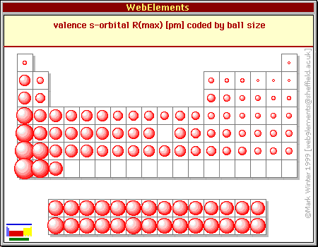
What is atomic radius?
Size of the atom
Decreases along a period
Increases down a group
Why?
L—R: Stronger pull on electrons = smaller
Down: Add new orbitals = bigger

Slide 3
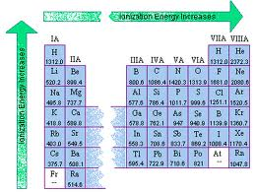
What is ionization energy?
The energy needed to remove an electron
Increases along a period
Decreases down a group
Why?

Slide 4
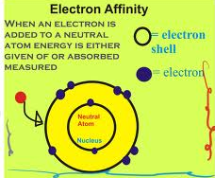
What is electron affinity?
Amount of energy released when an electron is added to a neutral atom
Increases along a period
Decreases down a group
Why?

Slide 5
What is electronegativity?
An atom’s ability to attract electrons
Increases across a period
Decreases down a group
Why?

Slide 6
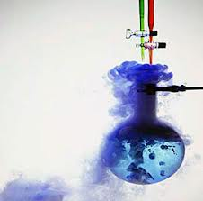
What is chemical reactivity?
Describes how easily an element reacts
Decreases across a period
Increases down a group
Why?

Slide 7
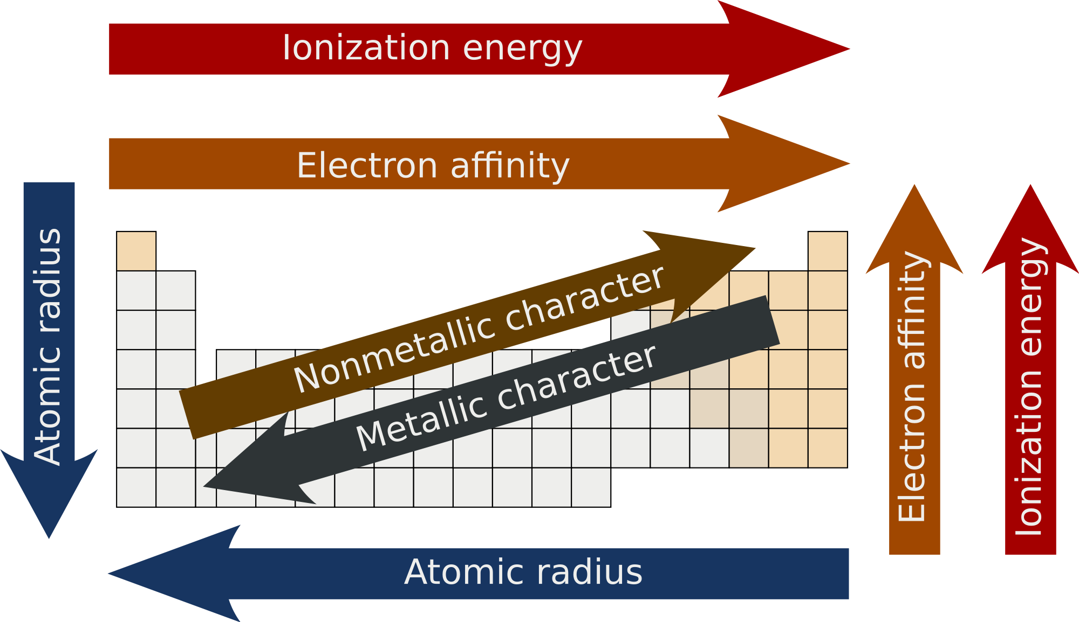
Periodic trends

Slide 8
Comparing Elements CFU
Circle the atom with the…
Largest atomic radii: Al or B
Smallest electronegativity: S or O
Largest electron affinity: Li or Be
Smallest ionization energy: Ca or Ga
Most chemical reactivity: Ba or Sr

