Slide 1
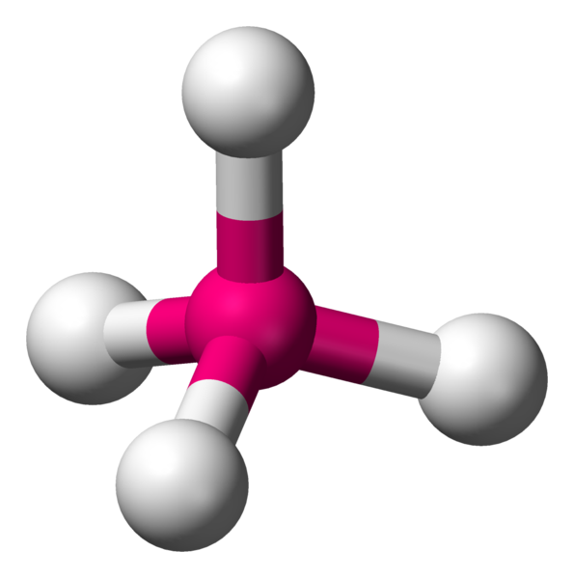
0
Molecular Geometry
The SHAPES of molecules

Slide 2
Why the shape of a molecule is important
0
The shape of a molecule may determine its properties and uses
Properties such as smell, taste, and proper targeting (of drugs) are all possible because of the shapes of molecules

Slide 3
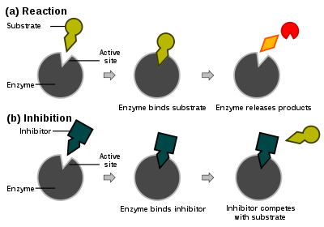
Aspirin works because of its shape!
0
Prostaglandin which causes inflammation (swelling) is produced by the
COX-1 and COX-2 enzymes
Aspirin can block the substrate from bonding to the COX-1 or COX-2 enzyme thus preventing the production of prostaglandin

Slide 4
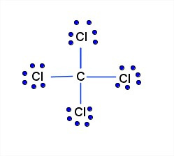
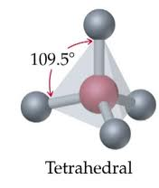
Determining the Shape of a molecule
0
Lewis structures don’t give us a 3-dimensional view of how the atoms are bonded together
The Lewis structure implies a cross shape with 90º angles
Would you have predicted this arrangement of atoms from just seeing it’s Lewis structure?

Slide 5
So how do we find the shape of a molecule?
0
By using the VSEPR Theory
(pronounced Vess Purr)

Slide 6

VSEPR Theory
0
Valence Shell Electron Pair Repulsion Theory
Main Premise: Molecules will adopt a shape that is lowest in energy by minimizing the valence shell electron pair repulsion (VSEPR) between adjacent atoms

Slide 7

0
Huh???
Atoms in a molecule try to spread out from one another as much as possible to reduce the “like charge repulsion” between their outer electrons

Slide 8
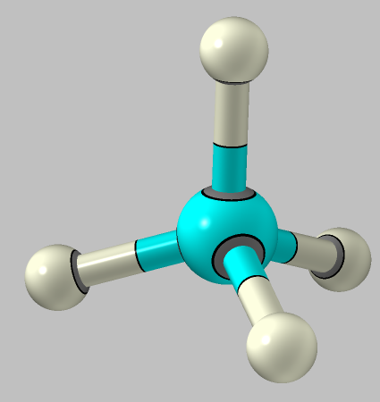
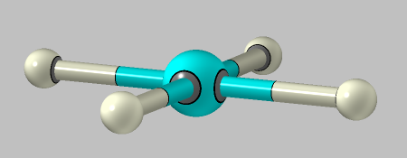
methane, CH₄
0
You might think this is the farthest that the hydrogens can get away from each other
90°
109.5°
But if you think in 3 dimensions, the hydrogens can actually get farther away from each other and minimize adjacent electron cloud repulsions

Slide 9
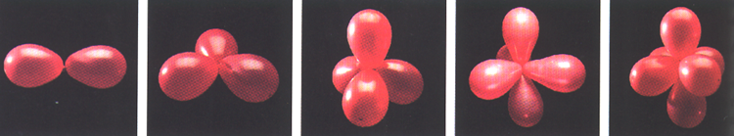
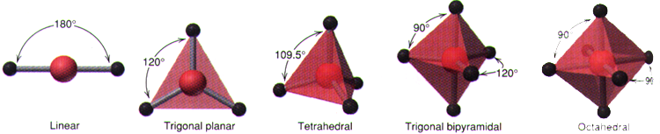
The 5 Main VSEPR Shapes
0
These shapes minimize the like charge repulsion between adjacent electron clouds

Slide 10
From Lewis to VSEPR Shape
0
1. Draw a Lewis structure
2. Count the number of “electron domains”
around the central atom
  -Each single, double and triple bond counts as ONE domain
  -Each lone pair counts as ONE domain
3. Use VSEPR Chart to determine the shape
based on how many bonding and nonbonding
domains are around the central atom

Slide 11
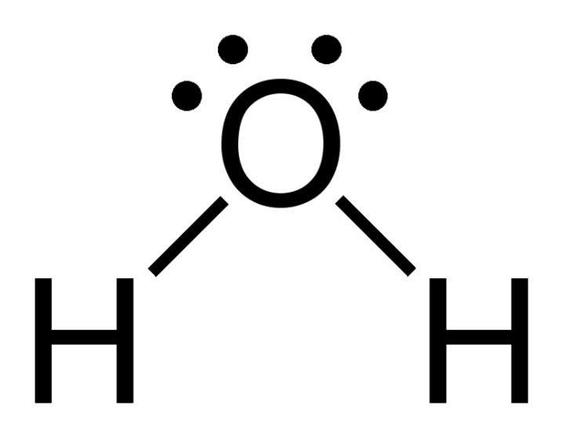
Electron domains
Regions in a molecule where there are high concentrations of electrons
Lone pairs= (non-bonding domains)
This Lewis structure shows
2 bonding domains
and
2 non bonding domains
Bonds = (bonding domains)

Slide 12
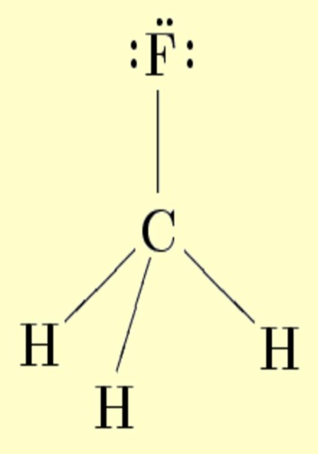
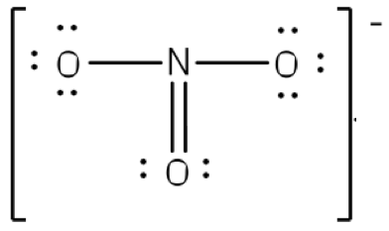

How many “domains” around the central atom?
3 around nitrogen
4 around carbon
Remember: single, double and triple bonds count as ONE domain
2 around each atom

Slide 13
Remember the BIG PICTURE?
Electron “domains” are all negatively charged so they want to spread out from each other as much as possible to minimize like-charge-repulsion within a molecule
Doing this allows the molecule to be
more stable (low energy)

Slide 14
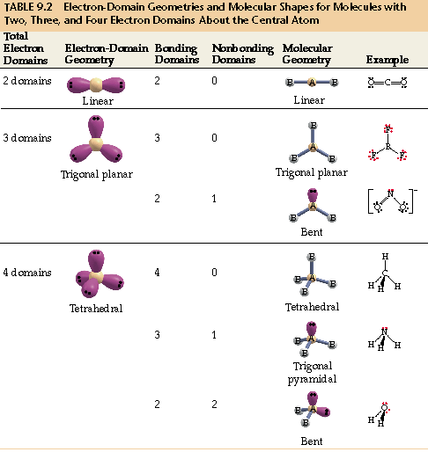
The vsepr chart
0
You need to memorize this

Slide 15

Let’s look at some Examples

Slide 16
great website for learning VSEPR!!!
0
www.chem.purdue.edu/gchelp/vsepr/cmp2.html

Slide 17
VSEPR Example 1
0
How many bonding and non-bonding electron domains are there around the central atom?
  2 bonding
  0 non-bonding

Slide 18
VSEPR Example 1
0
2 bonding, 0 nonbonding
Use the VSEPR chart…
  Electron geometry (how the electron domains are arranged around the central atom) is “linear”
  Molecular geometry (how the atoms bonded to the central atom are arranged) is “linear” also

Slide 19
VSEPR Example 2
0
How many bonding and non-bonding electron domains are there around the central atom?
  3 bonding
  0 non-bonding

Slide 20
VSEPR Example 2
0
3 bonding, 0 nonbonding
Use the VSEPR chart…
  Electron geometry (how the electron domains are arranged around the central atom) is “trigonal planar”
  Molecular geometry (how the atoms bonded to the central atom are arranged) is “trigonal planar” also

Slide 21
VSEPR Example 3
0
How many bonding and non-bonding electron domains are there around the central atom?
  2 bonding
  1 non-bonding

Slide 22
VSEPR Example 3
0
2 bonding, 1 nonbonding
Use the VSEPR chart…
  Electron geometry (how the electron domains are arranged around the central atom) is “trigonal planar”
  Molecular geometry (how the atoms bonded to the central atom are arranged) is “bent”

Slide 23
VSEPR Example 4
0
How many bonding and non-bonding electron domains are there around the central atom?
  4 bonding
  0 non-bonding

Slide 24
VSEPR Example 4
0
4 bonding, 0 nonbonding
Use the VSEPR chart…
  Electron geometry (how the electron domains are arranged around the central atom) is “tetrahedral”
  Molecular geometry (how the atoms bonded to the central atom are arranged) is “tetrahedral”

Slide 25
VSEPR Example 5
0
How many bonding and non-bonding electron domains are there around the central atom?
  3 bonding
  1 non-bonding

Slide 26
VSEPR Example 5
0
3 bonding, 1 nonbonding
Use the VSEPR chart…
  Electron geometry (how the electron domains are arranged around the central atom) is “tetrahedral”
  Molecular geometry (how the atoms bonded to the central atom are arranged) is “trigonal pyramidal”

Slide 27
VSEPR Example 6
0
How many bonding and non-bonding electron domains are there around the central atom?
  2 bonding
  2 non-bonding

Slide 28
VSEPR Example 6
0
2 bonding, 2 nonbonding
Use the VSEPR chart…
  Electron geometry (how the electron domains are arranged around the central atom) is “tetrahedral”
  Molecular geometry (how the atoms bonded to the central atom are arranged) is “bent”

Slide 29

0
Lone pairs (non-bonding domains) create a larger region of negative charge than bonding domains and thus push the adjacently bonded atoms even farther away from each other than normal

Slide 30
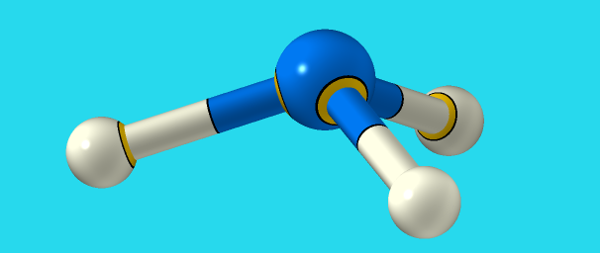
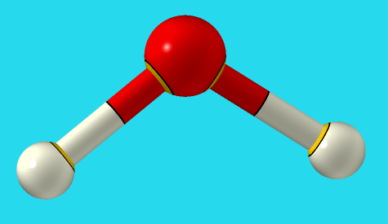
Lone pairs decrease the
expected bond angle
0
..
..
..
107°
104.5°
109.5°

Slide 31
For tetrahedral Shapes
0
Number of lone pairs around central atom | 0 | 1 | 2
Approximate bond angle | 109.5 | 107 | 104.5

Slide 32
VSEPR Notation
0
Also known as “AXE” notation
It is just a shorthand way to communicate VSEPR information

Slide 33
Examples of using axe notation
0
AX₃E₁
This subscript tells how many atoms are bonded to the central atom
This subscript tells how many lone pairs are on the central atom
AX₃E₁ is always trigonal pyramidal

Slide 34

Examples of using axe notation
0
AX₂E₂
This subscript tells how many atoms are bonded to the central atom
This subscript tells how many lone pairs are on the central atom
AX₂E₂ is always bent

Slide 35
Examples of using axe notation
0
AX₄
This subscript tells how many atoms are bonded to the central atom
Don’t put the “E” if there aren’t any lone pairs
AX₄ is always tetrahedral

Slide 36
Fisher Projections
A way to make your Lewis structures indicate their three dimensional VSEPR shape on paper

Slide 37
..

Slide 39
Fisher Projections
Bonds in the plane of the paper are shown as lines
Bonds projecting in front of the plane of the paper are shown as triangles
Bonds projecting behind the plane of the paper are shown as stacked lines

