Slide 1
Chem – 2 – Go
Lesson: Bohr Model

Slide 2
Learning Target
SWBAT understand the Bohr model of atoms and how electrons relate to the electromagnetic energy spectrum.
Importance?

Slide 3
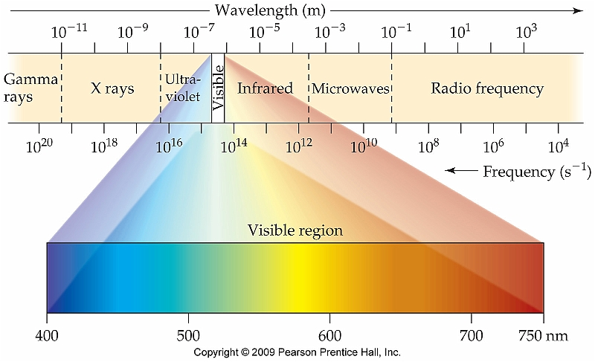
Wave Nature of Light
Visible light accounts for 1 form of electromagnetic energy
c = λv
Inverse relationship between frequency (v) & wavelength (λ)

Slide 4
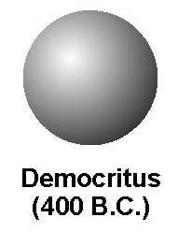
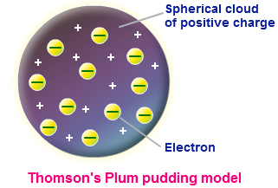
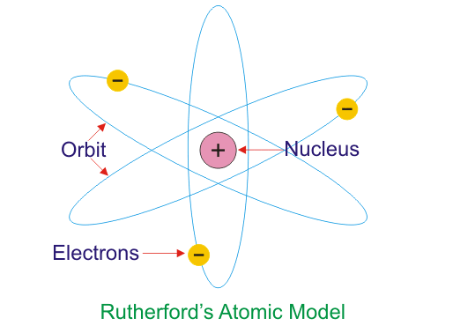
Evolution of the Atomic Model
Democritus Model
Sphere that can’t be broken down
Thompson “Plum Pudding” Model
Electrons, no nucleus
Rutherford Model
Electrons + Nucleus
Proton & neutron not discovered
Why doesn’t the electron fall into the nucleus?

Slide 5
Quantum Mechanics
Max Planck – introduced idea of “quantized energy”
Energy is released and absorbed in discreet intervals known as quanta
E = hv
E = energy
h = Planck’s constant
v = frequency
Replace v to give
h = 6.626 x 10⁻³⁴ J / s

Slide 6
CFU: Wave/Light Application
The threshold frequency that can dislodge an electron from metallic sodium is 5.51 × 10¹⁴ Hz. What is the energy of this photon?
What is the energy, in Joules, of a photon with a wavelength of 430.0 nm?
c = λv
E = hv

Slide 7
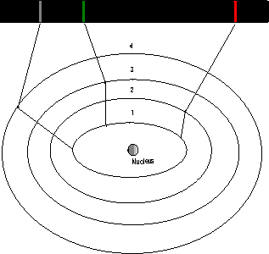
What is the Bohr Model?
Based on quantized energy
Only orbits of exact radii are permitted
An “allowed state” is one in which an electron has a specific energy
As electrons move between “allowed states,” a photon of energy is absorbed or emitted

Slide 8
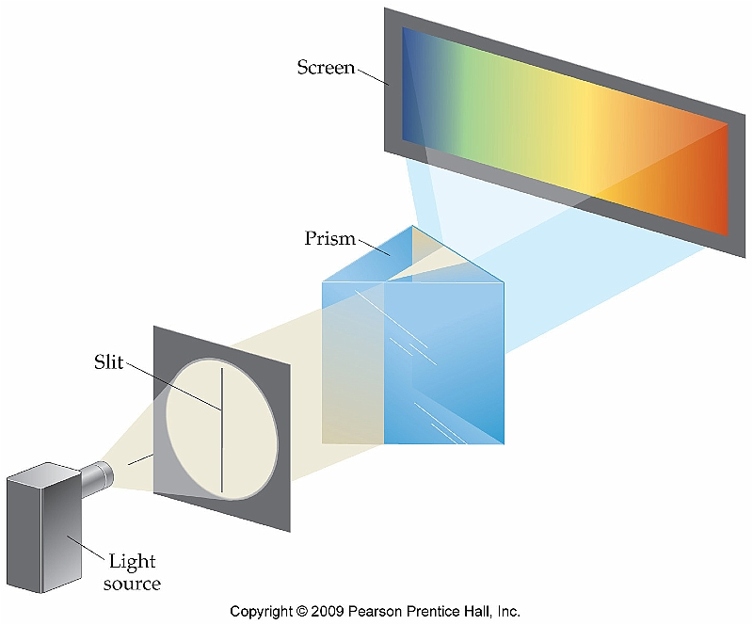
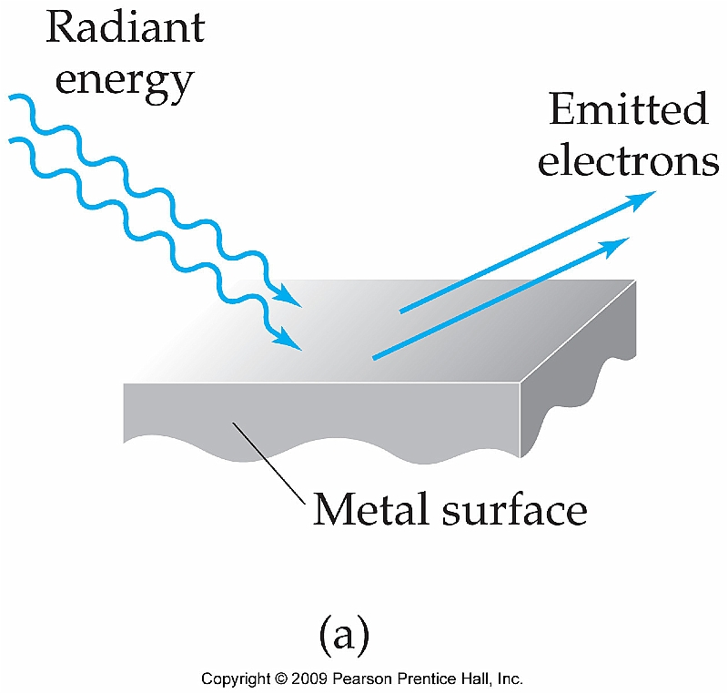
What is Line Spectra?
Scientists studied emission spectra of individual elements
Elements emit unique wavelengths of light
When light strikes the surface of metals, electrons are ejected with a specific frequency
Intensity of the light does not matter

Slide 9
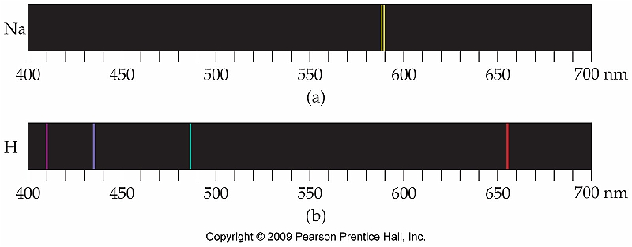
Emission Spectrum of Hydrogen

Slide 10
What is the Photoelectric Effect?
Increasing intensity of light has no effect on the emission spectra of elements
Led to idea that light exists as both a wave and discreet packet of energy (photon)
Wave particle duality

Slide 11
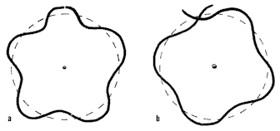
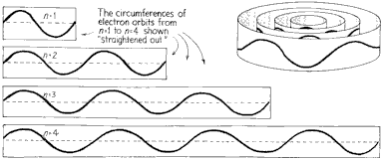
What is the Photoelectric Effect?
Waves must fit perfectly around the nucleus because there can be no constructive or destructive interference
Would otherwise cancel themselves out which is impossible

