Slide 1
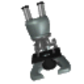
Introduction to the Microscope
Types of Microscopes
Care
Parts
Focusing
Notes:
Students will have their microscopes out, for reference as we go through each of the steps. As an introduction, students will be asked what kinds of things they can do with this tool.

Slide 2
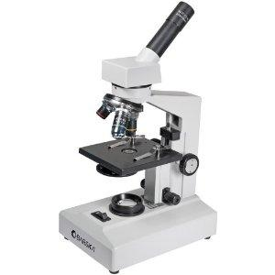
Types of Microscopes
Light Microscope - the models found in most schools, use compound lenses to magnify objects. The lenses bend or refract light to make the object beneath them appear closer.
Common magnifications: 40x, 100x, 400x
(*multiply ocular x objective)
*Oil Immersion lenses can improve quality of focus and magnification (1000x)

Slide 3
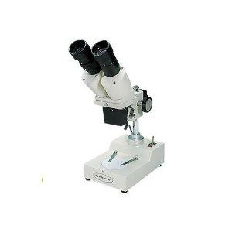
Stereoscope
This microscope allows for binocular (two eyes) viewing of larger specimens.
Usually magnifies 2 → 20x
Can be used for thicker specimens
Creates a 3D view of specimen

Slide 4
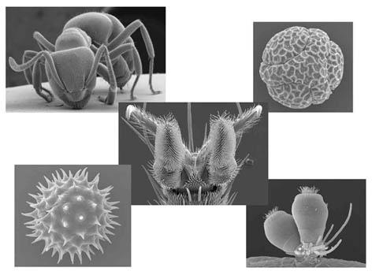
Scanning Electron Microscope - allows scientists to view a universe too small to be seen with a light microscope. SEMs do not use light waves; they use electrons (negatively charged electrical particles) to magnify objects up to two million times.
SEM creates a 3D view of specimen, but cannot view living specimens (process kills them)

Slide 5
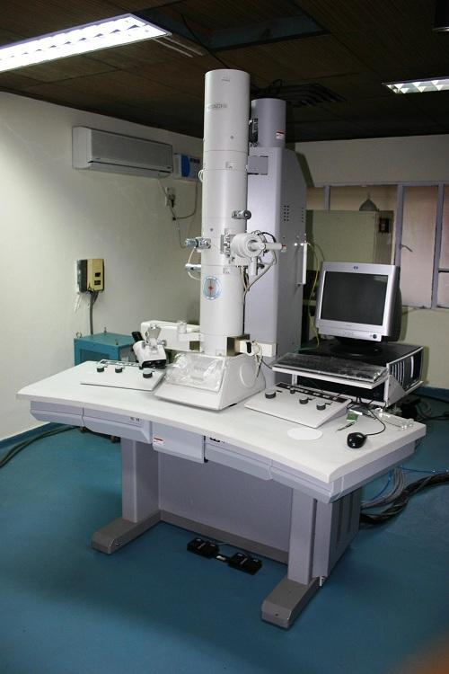
Transmission Electron Microscope - also uses electrons, but instead of scanning the surface (as with SEM's) electrons are passed through very thin specimens.
TEM = "thin"

Slide 6
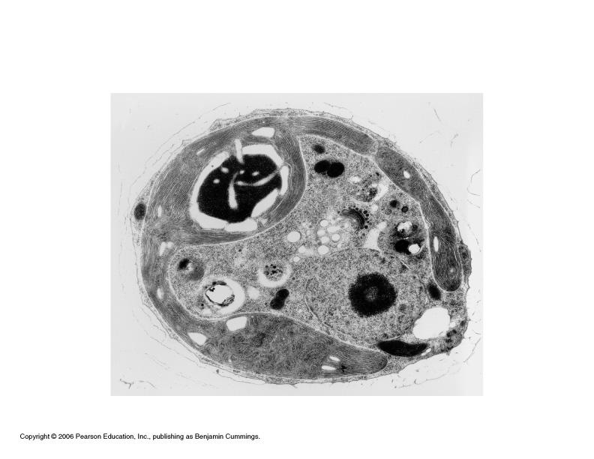
TEM of a cell, notice you see the inside of the cell and not the surface.

Slide 7
Microscope Resources
Virtual Microscopes (Phase Contrast, Fluorescence, TEM, STM) at
http://nobelprize.org/educational/physics/microscopes/1.html
Nanoworld Image Gallery
Microworld Images

Slide 8
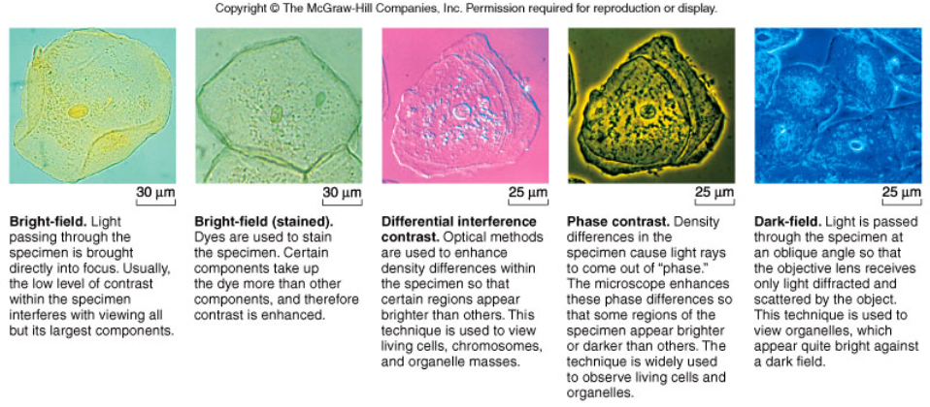
Types of Illumination in Microscopes
How light passes through a specimen changes the view of the specimen, making some parts more distinct.
Notes:
Figure 4B

Slide 9
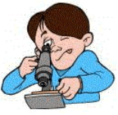
The Light Microscope
Guidelines for Use
Always carry with 2 hands
Only use lens paper for cleaning
Do not force knobs
Always store covered
Keep objects clear of desk and cords
Notes:
Teacher demonstrates how to hold the microscope, where the lens paper is located and how to use it. Students will be invited to turn the knobs and observe the stage as it moves up and down. Teacher will demonstrate how to store the microscope.

Slide 10
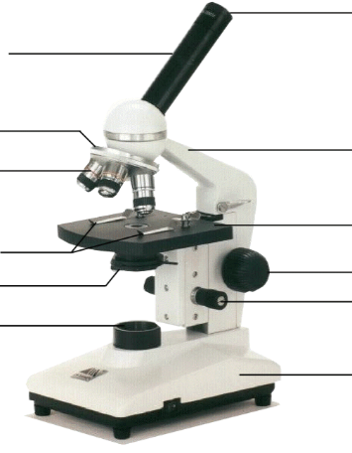
Eyepiece
Body Tube
Revolving Nosepiece
Arm
Objective Lens
Stage
Stage Clips
Coarse Focus
Diaphragm
Fine Focus
Light
Base
Notes:
This is the exact version of the microscope used in class. Students will be identifying the parts on the microscopes at their desks as we go along and what their functions are.

Slide 11
Magnification
Your microscope has 3 magnifications: Scanning, Low and High. Each objective will have the magnification. In addition to this, the ocular lens (eyepiece) has a magnification. The total magnification is the ocular x objective. Some of our scopes have a 4th objective (oil immersion). Magnification is 100x.

Slide 12
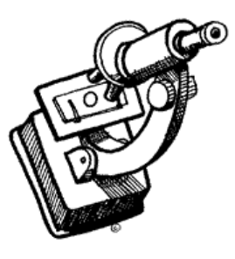
General Procedures
1. Make sure all backpacks and other items are out of the aisles and off the tops of desks.
2. Plug in your microscope (do not have cord near sinks!).
3. Store with cord LOOSELY wrapped around microscope and the scanning objective clicked into place. Make sure it is covered when it is stored on the shelf.
4. Carry by the base and arm with both hands.
Notes:
Give students a slide from the “common things” set, each student will practice focusing and changing objectives.

Slide 13
Focusing Specimens
1. Always start with the scanning objective.
Odds are, you will be able to see something on this setting. Use the Coarse Knob to focus, image may be small at this magnification, but you won't be able to find it on the higher powers without this first step.
These are PARFOCAL microscopes. Do NOT use the coarse objective knob on any other objectives…only use on SCAN! Once the scope is in “rough” focus on scan, it will be in rough focus on ALL other magnifications.
Notes:
Give students a slide from the “common things” set, each student will practice focusing and changing objectives.

Slide 14
2. Once you've focused on Scanning, switch to Low Power. Use the Fine Knob to refocus. Again, if you haven't focused on this level, you will not be able to move to the next level.
3. Now switch to High Power. (If you have a thick slide, or a slide without a cover, do NOT use the high power objective). ONLY use the Fine Adjustment Knob to focus specimens.
NEVER USE COARSE ADJUSTMENT ON HIGHER POWERS!
Recap
1. Scanning --> use coarse knob
2. Low power --> use fine knob
3. High power --> use fine knob
DO NOT SKIP STEPS!!!!

Slide 15
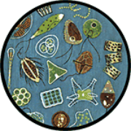
Your slide MUST be focused on low power before attempting this step
Click the nosepiece to the longest objective
Do NOT use the Coarse Focusing Knob, this could crack the slide or the lens
Use the Fine Focus Knob to bring the slide in view
Notes:
Have students exchange slides so they can look at different things, walk them through using the high power objective to focus slides. Emphasize not using the coarse objective during this process, as it will crack the slides.

Slide 16
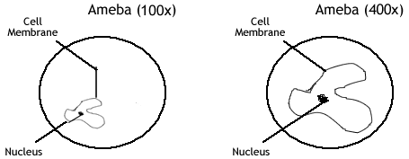
Drawing Specimens
1. Use pencil - you can erase and shade areas
2. All drawings should include clear and proper labels (and be large enough to view details). Drawings should be labeled with the specimen name and magnification.
3. Labels should be written on the outside of the circle. The circle indicates the viewing field as seen through the eyepiece, specimens should be drawn to scale - ie..if your specimen takes up the whole viewing field, make sure your drawing reflects that.
4. You MUST use a RULER to draw your lines! NO FREE HANDED LINES, or there will be a deduction! Write words at the END of the line!. The title and magnification must be written.

Slide 17
Making a Wet Mount
1. Gather a thin slice/peice of whatever your specimen is. If your specimen is too thick, then the coverslip will wobble on top of the sample like a see-saw, and you will not be able to view it under High Power.
2. Place ONE drop of water directly over the specimen. If you put too much water, then the coverslip will float on top of the water, making it hard to draw the specimen, because they might actually float away. (Plus too much water is messy)
3. Place the cover slip at a 45 degree angle (approximately) with one edge touching the water drop and then gently let go. Performed correctly the coverslip will perfectly fall over the specimen.
Do not drop vertically, set one edge down and let the other side drop.

Slide 18
How to Stain a Slide
1. Place one drop of stain (iodine, methylene blue..there are many kinds) on the edge of the coverslip.
2. Place the flat edge of a piece of paper towel on the opposite side of the coverlip. The paper towel will draw the water out from under the coverslip, and the cohesion of water will draw the stain under the slide.
3. As soon as the stain has covered the area containing the specimen, you are finished. The stain does not need to be under the entire coverslip. If the stain does not cover as needed, get a new piece of paper towel and add more stain until it does.
4. Be sure to wipe off the excess stain with a paper towel.

Slide 19
Cleanup
1. Store microscopes with the scanning objective in place.
2. Wrap cords and cover microscopes.
*Double check to make sure you didn't leave a slide
3. Wash slides in the sinks and dry them, either on a paper towel or, if dry, placing them back in the slide boxes to be used later.
4. *Be careful not to drop cover slips in the sink, they can clog drain.
5. Place microscopes in their designated location (probably a cabinet)

Slide 20
Troubleshooting
Occasionally you may have trouble with working your microscope. Here are some common problems and solutions.
1. Image is too dark!
Adjust the diaphragm, make sure your light is on. Make sure the reset switch near the plug has not turned off . You may need to push the switch again to close the circuit.
2. There's a spot in my viewing field, even when I move the slide the spot stays in the same place!
Your lens is dirty. Use lens paper, and only lens paper to carefully clean the objective and ocular lens. The ocular lens can be removed to clean the inside. The spot is probably a spec of dust.
3. I can't see anything under high power!
Remember the steps, if you can't focus under scanning and then low power, you won't be able to focus anything under high power. Start at scanning and walk through the steps again.
4. Only half of my viewing field is lit, it looks like there's a half-moon in there!
You probably don't have your objective fully clicked into place.
5. The bulb doesn’t work.
Is it plugged in? Turned on (switch)? Lever (if applicable) adjusted? Breaker switch checked?

Slide 21
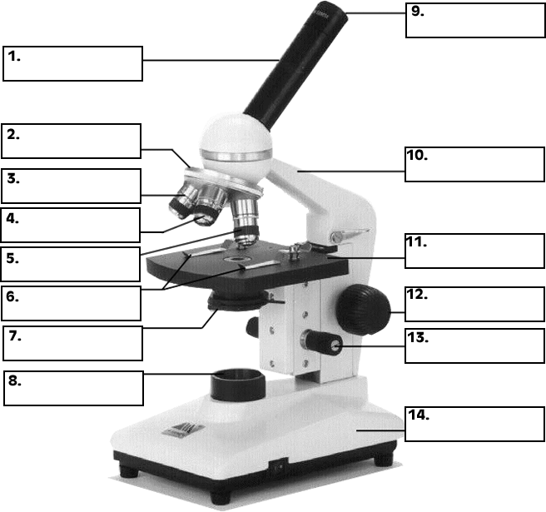
Practice Labeling the Parts

Slide 22
Quiz Over the Microscope
1. When focusing a specimen, you should always start with the ___________________ objective.
2. When using the high power objective, only the ________ ___________ knob should be used.
3. The type of microscope used in most science classes is the _________________ microscope
4. Stains can be drawn under the slide (and over a specimen) by using a _____________________
5. What part of the microscope can adjust the amount of light that hits the slide? ______________________________

Slide 23
6. You should carry the microscope by the ________ and the __________.
7. The objectives are attached to what part of the microscope (it can be rotated to click the lenses into place):
_______________ ________________
8. You should always store you microscope with the ________________ objective in place.
9. A microscope has an ocular objective of 10x and a high power objective of 50x. What is this microscope's total magnification? ____________
10. SEM is an abbreviation for ____________ ____________
_________________

