Slide 1
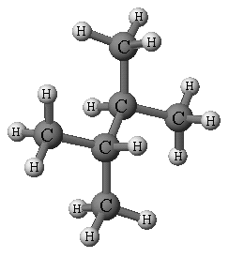
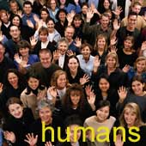
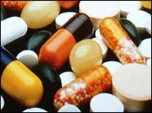
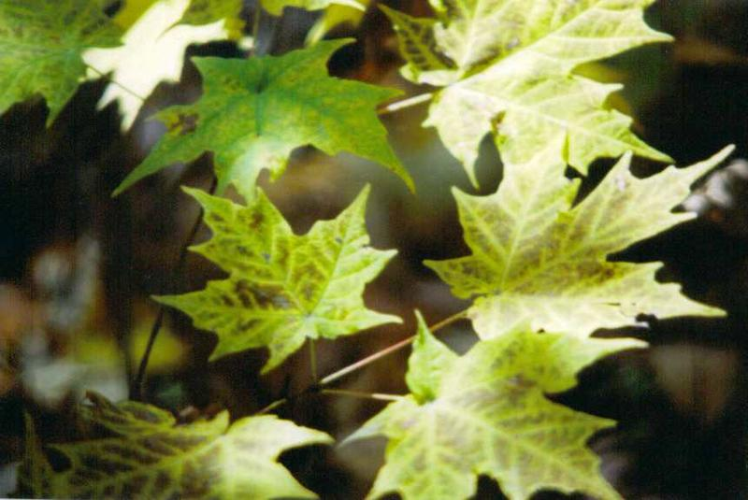
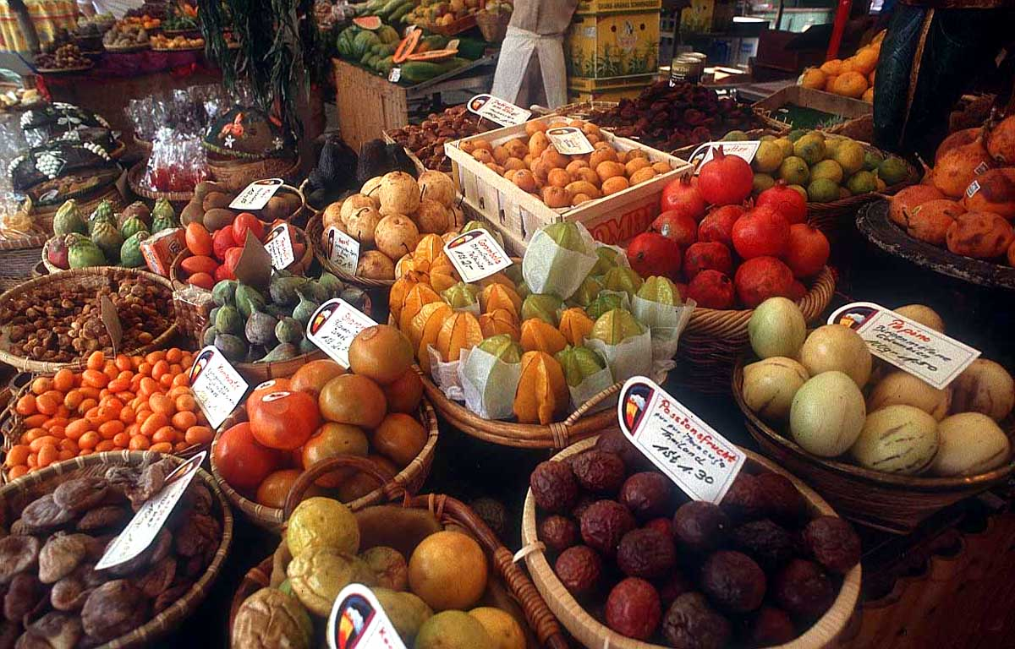
Organic Chemistry #1 Ch. 10 and 11- Part One

Slide 2
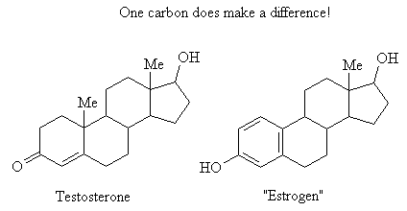
What is Organic chemistry?
What does organic mean to you?
The name organic was given to molecules found in living organisms
Now, organic chemistry refers to the chemistry of carbon compounds
Carbon is important to life because of its ability to form an endless number of molecules
CH₄ – methane gas
Proteins
Cotton, wool, silk
CH₃CH₂OH - Ethanol

Slide 3
Organic Compounds
Typically, organic compounds
Contain carbon (C-C or C-H).
Have covalent bonds.
Have low melting points.
Have low boiling points.
Are flammable.
Are soluble in nonpolar solvents.

Slide 4
Bonding in Organic Compounds
Carbon has 4 valence electrons (lone electrons)
C
This means there are four places for it to bound to other atoms in order for carbon to achieve an octet
C
•
•
•
*Typically, one ‘s’ e- goes to empty ‘p’ orbital
•
1
•
•
•
2
4
•
3

Slide 5
Bonding with Hydrogen
Carbon has 4 lone electrons; hydrogen has 1.
•
• C • H •
•
To achieve an octet, carbon forms four bonds.
H H
• • |
H : C : H H—C—H CH₄ , methane
• • |
H H

Slide 6
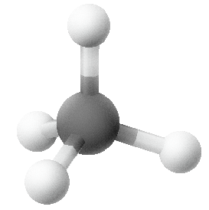
Tetrahedral Nature of Carbon
When carbon forms four bonds to other atoms, the bonds are situated 109.5º apart from each other.
This arrangement is a
tetrahedral arrangement.

Slide 7
Organic Molecules
In organic molecules, valence electrons form covalent bonds between carbon atoms
Molecules consisting of only carbon and hydrogen are call hydrocarbons
H H H H
• • • • | |
H : C : C : H H—C—C—H Ethane,CH₃CH₃
• • • • | |
H H H H

Slide 8
Other Elements
Carbon in organic compounds also commonly forms covalent bonds with N, O, S, and halogens (Cl, Br)

Slide 9
Learning Check
Complete the structure of the organic molecule by adding the correct number of hydrogen atoms.
C—C—C

Slide 10
Learning Check
Complete the structure of the organic molecule by adding the correct number of hydrogen atoms.
H H H
| | |
H—C—C—C—H
| | |
H H H
Notes:
Note- All C have 4 bonds!!!

Slide 11
Functional Groups
Refer to the chart given in class, as well as Ch 10, p. 313- 318 (only gives the 6 most common ones)
Functional groups are important: they are the units by which we divide organic compounds into Families of compounds. Families, with the same functional groups, will undergo the same type of chemical reactions
There will be a Quiz on basic identification of the groups and families this week (see Daily Agenda). Make sure you know the ones identified on the chart given in class (*notecards to study are suggested)

Slide 12
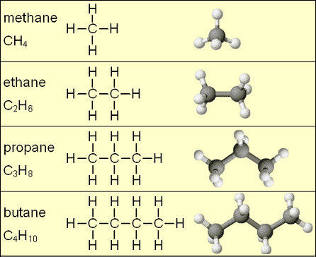
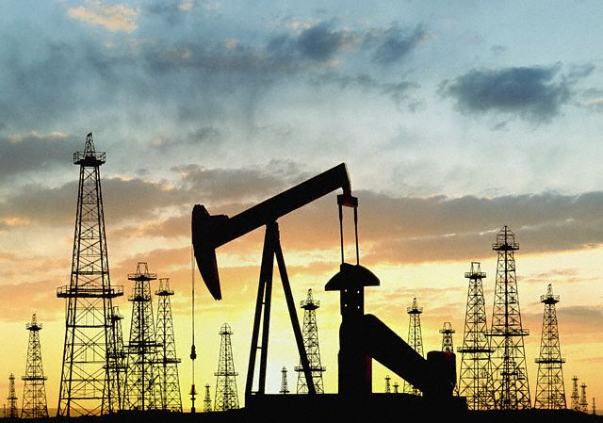
Ch 11- Alkanes
Saturated hydrocarbons (aka- aliphatic, because they resemble hydrocarbons found in lipids) that contain only carbon-carbon single bonds. Major sources: natural gas (Ex- methane), petroleum. HW- How is petroleum formed? Refined?
General formula = C_{n}H_{2n+2}
n = number of carbons

Slide 13
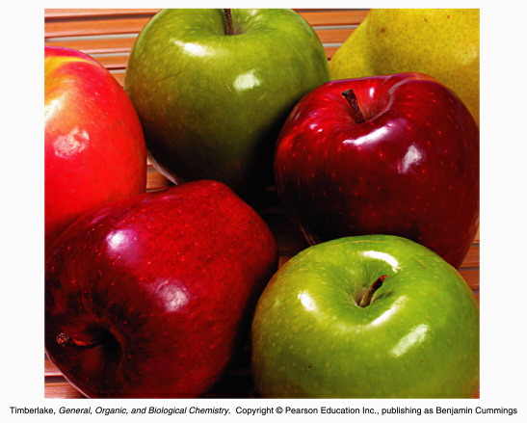
Properties and Uses of Alkanes
Small number of carbons: 1 – 4 carbons
gases
Heating fuels: Ex- propane, butane
5 –12 carbons (pentane, hexane, hept, oct, non, dec, etc)
Gasoline- motor fuels and industrial solvents
12-16: Kerosene
15-20: Oils- Ex: fuel oil; lubricants (Ex- ‘Vaseline’); waxy solids: (Ex- plant wax; paraffin)
20+: asphalt

Slide 14
Properties of Alkanes
Melting points and boiling points of straight chain alkanes increases with molecular size (density).

Slide 15
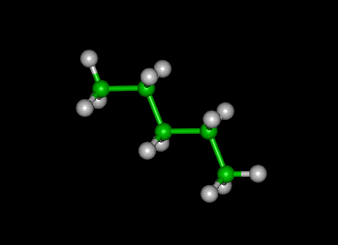
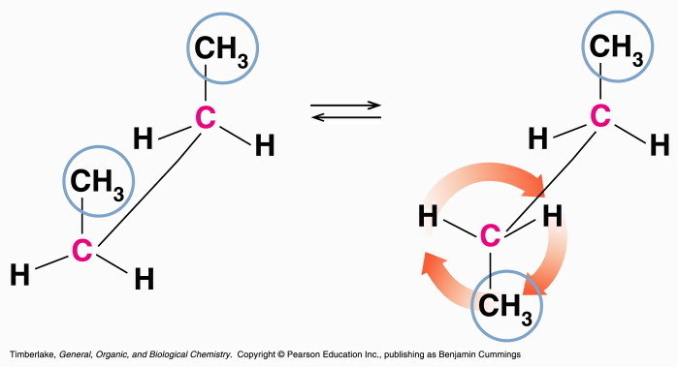
Conformation of Alkanes
Because of the tetrahedral shape of carbon bonds, carbon bonds are in a zigzag pattern
Atoms can rotate around a single carbon-carbon bond
Different arrangements that can occur because of this are called conformations

Slide 16
Expanded and Condensed Formulas
Expanded structural formula = all individual bonds (indicated with dashes) and atoms are drawn (see p. 312)
Condensed structural formula = each carbon atom is grouped with its bonded hydrogen atoms. Subscripts are used to indicate number of H’s and bonds are indicated with dashes (p. 315)
Skeletal Formula = only carbons and bonds(as dashes) are represented- Hydrogens are implied
Notes:
Draw Examples of each

Slide 17
Expanded and Condensed Formulas
Line-angle formulas = lines represent carbon-carbon bonds. No individual atom is indicated. Hydrogens and Carbons are implied. (p. 325)
Molecular Formula= Atoms are represented and subscripts are used to indicate the number of each atom. No bonds are drawn.
Geometric Formula= Similar to line angle formulas, but used for cyclic compounds.

Slide 18
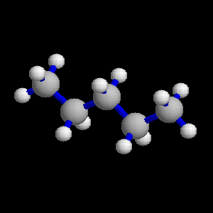
IUPAC
International Union of Pure and Applied Chemistry
Determined protocol for naming organic compounds
Pentane
Prefix states number of carbons
Pent - = five carbons
Suffix shows kind of compound
-ane = alkane, only single carbon bonds

Slide 19
Prefixes (Table 11.2)
Notes:
need to know these!

Slide 20
Cycloalkanes
Hydrocarbons do not need to be in a chain, they can also form circular structures

Slide 21
Cycloalkanes
Cycloalkanes:
Are rings of carbons that can be drawn as geometric figures.
Have a general formula of C_{n}H_{2n} or 2 H less than the alkane.
propane C₃H₈ cyclopropane C₃H₆.
butane C₄H₁₀ cyclobutane C₄H₈.
Are named with the prefix cyclo- in front of the corresponding alkane name.

Slide 22
Table 11.4
LINE BOND FORMULAS FOR SOME CYCLOALKANES
Cyclopropane
Cyclobutane
Cyclopentane
Cyclohexane
C₃H₆
C₄H₈
C₅H₁₀
C₆H₁₂

Slide 23
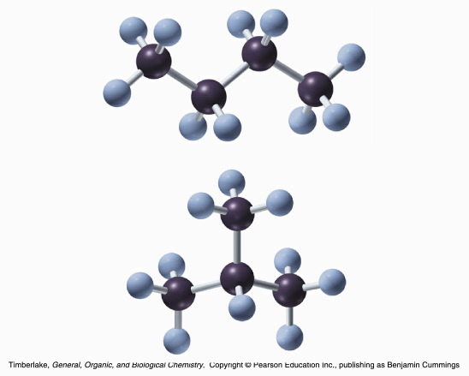
Naming Alkanes
Molecular formulas do not tell us the structure
constitutional isomers
Carbon compounds can be continuous-chain or branched-chained

Slide 24
Substituents
Substituents are groups of atoms that replace a hydrogen on a carbon chain
If the substituent is a hydrocarbon, it is called an alkyl group
The alkyl group is named by replacing the –ane with -yl

Slide 25
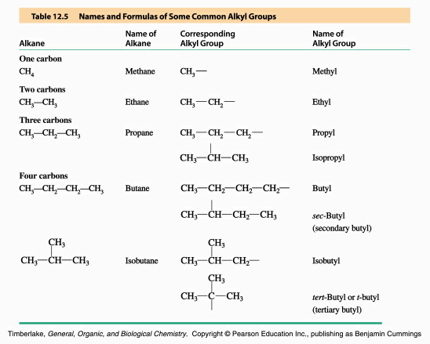
Some of these included in Table 11.5

Slide 26
Steps for naming alkanes: *See handout
1. Name the longest continuous chain of carbons as the main chain
2. Number the carbon atoms in the main chain starting on the end nearest a substituent
-Where there are 2 or more substituents, the main chain should be numbered to give the lowest possible number set

Slide 27
Naming Alkanes Cont.
3. Give the location and name of each alkyl group in front of the name of the main chain
- use prefixes (di-, tri-) if a group appears more than once
4. List the substituents in alphabetical order (note- Prefixes “di, tri, tetra”, etc. are not considered when alphabetizing. HOWEVER, ‘iso’ IS

Slide 28
Naming
1. Name Longest Chain First= hexane
2. Number Carbons from the end with the nearest substituent.

Slide 29
3. Give the location and name of each alkyl group in front of the name of the main chain. Would the name be:
2-methyl-4-ethylhexane?
No…
List substituents in alphabetical order.
So… 4-ethyl-2-methylhexane

Slide 30
Naming
1. Name Longest Chain First= heptane. WHY?
2. Number Carbons from the end with the nearest substituent.

Slide 31
3. Give the location and name of each alkyl group in front of the name of the main chain
2,5-dimethylheptane
List substituents in alphabetical order.
Fine as is!
Notes:
Separate with dashes as seen here

Slide 32
Drawing Structural Formulas
Step 1 – Draw the main chain of carbon atoms
Step 2 – Draw the substituents on the main chain in the positions indicated by the location numbers
Step 3 – Fill in the correct number of hydrogen atoms to give four bonds to each carbon atom

Slide 33
Draw: 2,3-dimethylpentane

Slide 34
Solution: 2,3-dimethylpentane
1. Draw Main Chain of Carbon atoms
C-C-C-C-C
2. Draw the substituents on the main chain in the positions indicated by the location numbers

Slide 35
3. Fill in the correct number of hydrogen atoms to give four bonds to each carbon atom
Notes:
This is condensed structural- They might find regular structural easier to draw at first.

Slide 36
Try a few!
2,3,5-trimethylhexane
3-ethylpentane
4-isopropyloctane

Slide 37
Isomers- *See handout for naming isomers
Molecules with the same molecular formula but different structural formula
Example: C₅H₁₂

Slide 38
Constitutional Isomers
Most organic compounds have structural isomers and their number increases as the number of atoms increases

Slide 39
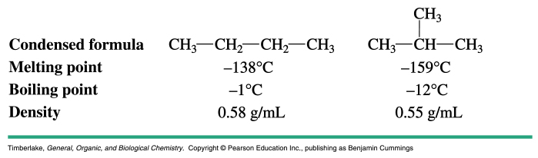
Physical Properties of Constitutional Isomers
Different structural arrangement can result in very different physical properties

Slide 40
Drawing Isomers
Step 1 – Draw the longest continuous chain
Step 2 – Remove one carbon from the chain and attach it as a methyl group in as many locations as possible
Step 3 – Remove another carbon atom from the main chain and attach as another alkyl group

Slide 41
Try this one…then do “Isomers Model Lab”
Draw isomers for C₄H₁₀
Practice Naming!!
Notes:
Butane and 2-methylpropane

