Slide 1
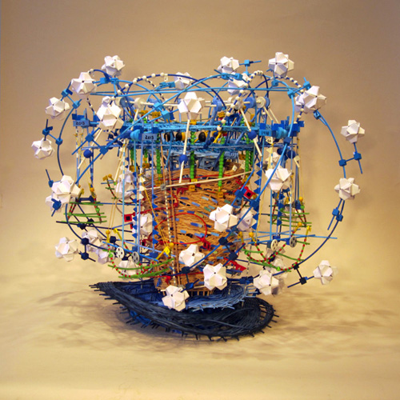
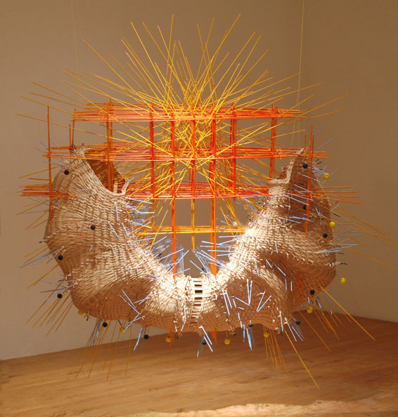
Data Visualization
AKA: Art Data

Slide 2
TED TALK
https://www.ted.com/talks/david_mccandless_the_beauty_of_data_visualization

Slide 3
Why do we need to visualize data? -to REDUCE: simplify for understanding -to REVEAL: show things we have never seen before -Create the “OOH, AHH”! -Data Artist, Jer Thorp, Office for Creative Research

Slide 4
How can we get data to change human action? Use the arts to start the conversation, promote thinking and drive change.

Slide 5
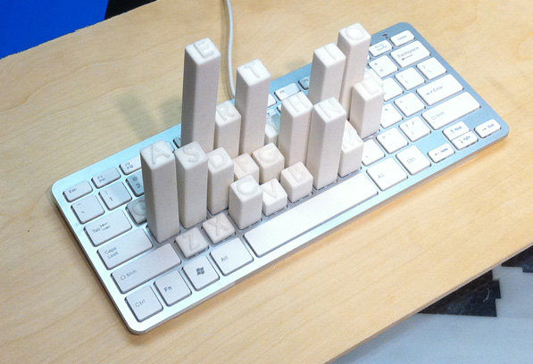
l

Slide 6
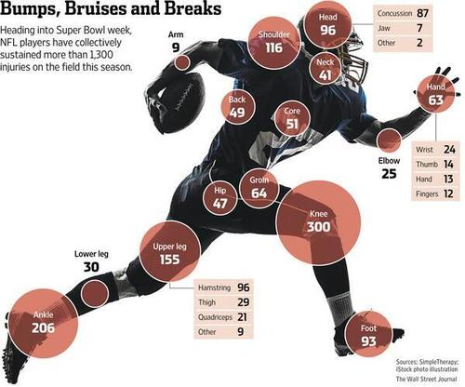

Slide 7
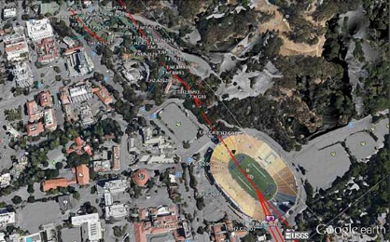
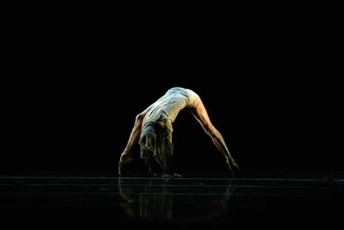
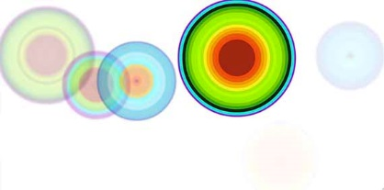
Ken Goldberg
Seismic Activity

Slide 8
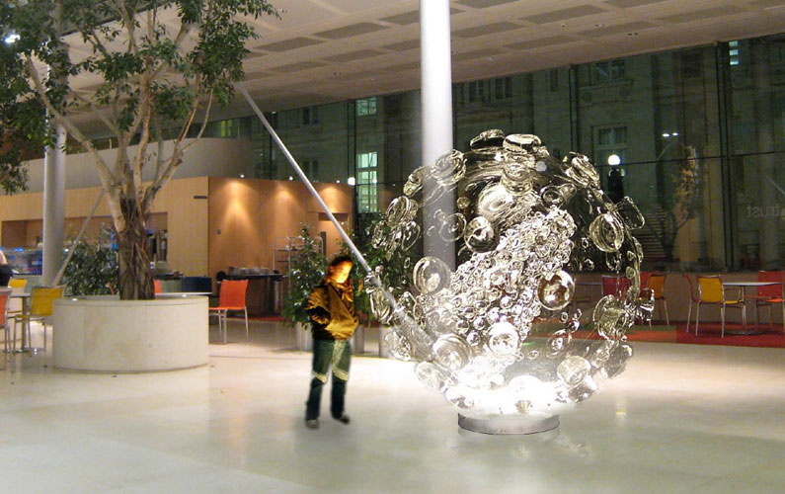
Luke Jerram, Glass Microbiology

Slide 9
Stef Lewandowski, “Data Necklace”

Slide 10
Samuel Granados, “Lego Cartography”

Slide 11
Dear Data
Dear Data is a year-long, analog data drawing project by Giorgia Lupi and Stefanie Posavec, two award-winning information designers living on different sides of the Atlantic.
By collecting and hand drawing their personal data and sending it to each other in the form of postcards, they became friends.

Slide 13
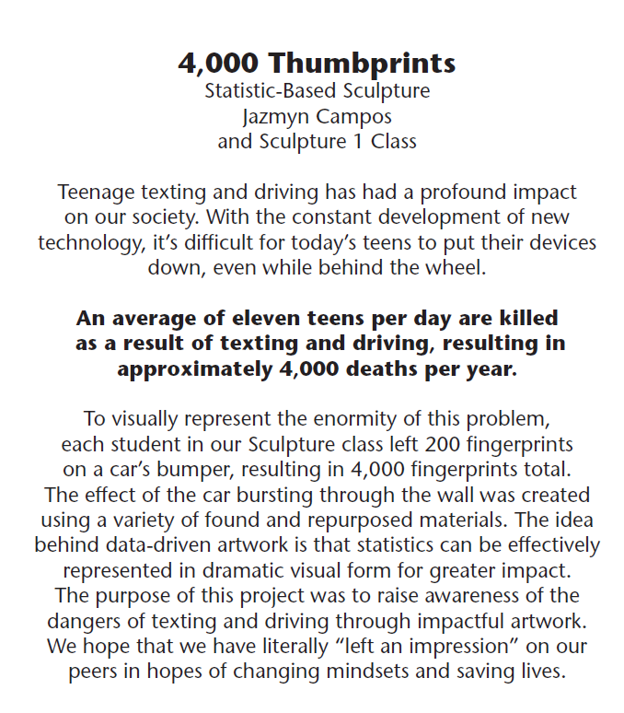
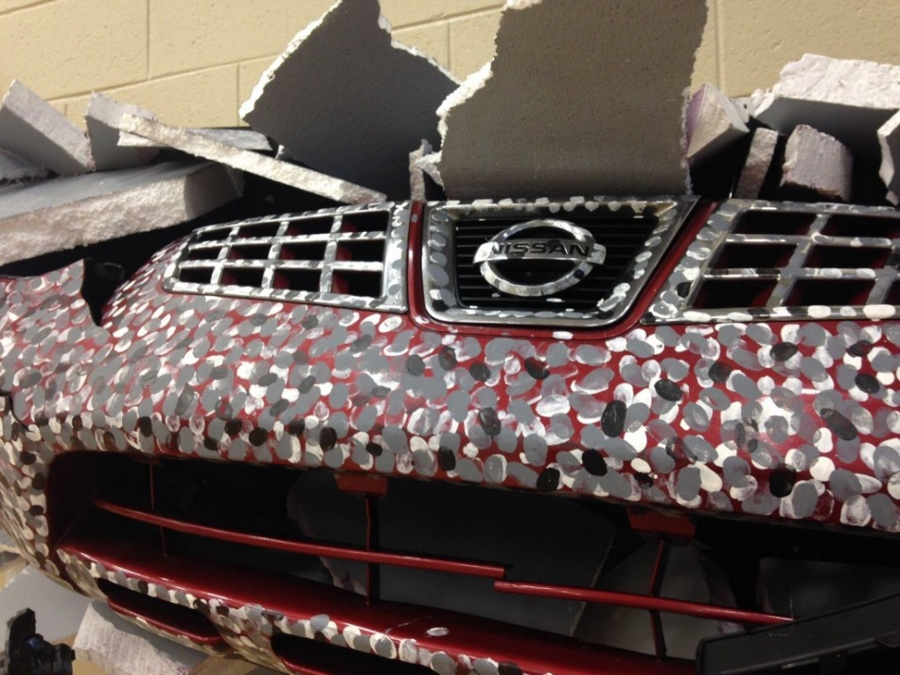

Slide 14
Why do we need to visualize data? -to REDUCE: simplify for understanding -to REVEAL: show things we have never seen before -Create the “OOH, AHH”! -TO CHANGE HUMAN ACTION/BEHAVIOR -Data Artist, Jer Thorp, Office for Creative Research

Slide 15
Now it is your turn…
Use your data set to create “data art”!
Goals:
REDUCE data to simplify understanding
Create a balance of the “OOH” and the “AHH”.

