Slide 1
Equilibrium
Honors Chem- 2018

Slide 2
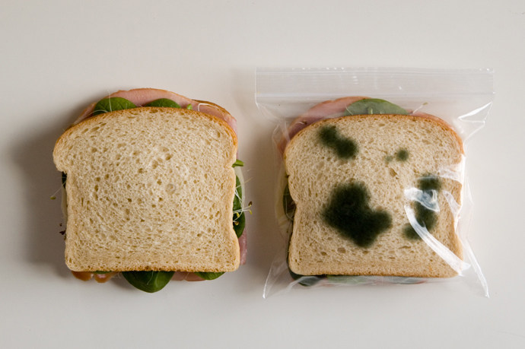
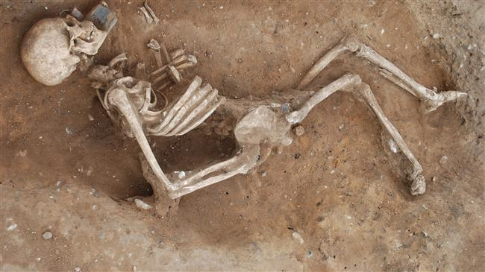
Why is chemical equilibrium important?
At room temperature, the equilibrium of reactions in foods is shifted causing them to spoil
Reactions in your body are kept away from equilibrium by adding reactants and removing products; otherwise, you die!

Slide 3
Bailing Demonstration
https://www.youtube.com/watch?v=CMs2WhGY3NE
Round 1: Same size cup
Discussion: What happened as they both moved the water? Why?
Round 2: One side has a bigger cup
Discussion: What happened as they both moved the water? Why?
Notes:
https://www.youtube.com/watch?v=CMs2WhGY3NE

Slide 4
Reversible Reactions
Most reactions continue until all the reactants are used up; however some reactions appear to stop after a certain period of time
This is because these reactions can proceed in both directions:
Forward: N₂ + 3H₂ → 2NH₃
Reverse: N₂ + 3H₂ ← 2NH₃

Slide 5
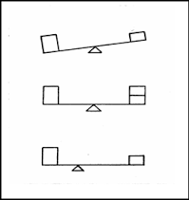
What is chemical equilibrium?
Equilibrium is a “balance of forces”
State in which reactants and products are present in concentrations that will not change
The forward and reverse reactions proceed at the same rate
When the rate of the forward reaction equals the rate of the reverse reaction, the reaction is said to be in chemical equilibrium
In other words, as soon as some product is formed it reacts to produce more reactant

Slide 6
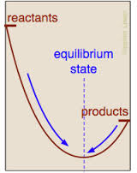
Why do reactions go toward equilibrium?
At equilibrium, energy is in the bonds of stable molecules
Reactions change in the direction that brings it closest to equilibrium

Slide 7
Chemical Equilibrium
Even though the rates of the forward and reverse are equal, the concentrations of components on both sides may not be equal
An equilibrium position may be shown:
A B or A B
1% 99% 99% 1%
Note the emphasis of the arrow’s direction
It depends on which side is favored; almost all reactions are reversible to some extent

Slide 8
Comparison of Rates
Let’s look at the reversible reaction of Hydrogen and Iodine to form Hydrogen iodide
H₂ + I₂ 2HI

Slide 9
Forward Reaction Rate
The rate of the forward reaction decreases over time, because the concentration of the reactants decreases
H₂ + I₂ →2HI
Reaction Rate
Time

Slide 10
Reverse Reaction Rate
The rate of the reverse reaction increases over time, because the concentration of the products increases
Reaction Rate
2HI → H₂ + I₂
Time

Slide 11
Rate Comparison
The rates of opposing reactions equalize at equilibrium
H₂(g) + I₂(g) ↔ 2HI(g)
H₂ + I₂ →2HI
Reaction Rate
2HI → H₂ + I₂
equilibrium
Time

Slide 12
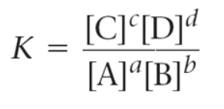
Measuring Equilibrium
Law of Chemical Equilibrium – defines direction of a reaction by relating the concentrations of the reactants and the products
Equilibrium Constant (K)
K > 1 → Favors the products
K < 1 → Favors the reactants

Slide 13
Calculating Keq
Write and balance the equation including states of matter
Set up the equation for K using any gases
NOTE: Concentrations of any solid or pure liquid is left out because the concentration remains constant

Slide 14
Example – Calculating K_{eq}
Write the equilibrium expression for the following reaction:
N_{2 (g)} + 3 H₂ _{(g)} ←→ 2 NH_{3 (g)}
Calculate K_{eq} if the following is true for the reaction:
[N₂] = 0.885, [H₂] = 0.665, [NH₃] = 1.230
Does this reaction favor the products or the reactants?

Slide 15
Practice – Calculating K_{eq}
Write the equilibrium expression for the following reaction:
CO (g) + 3 H₂ (g) ←→ CH₄ (g) + H₂O (g)
Calculate K_{eq} if the following is true for the reaction:
[CO] = 0.613, [H₂] = 1.839,
[CH₄] = 0.387, [H₂O] = 0.387
Does this reaction favor the products or the reactants?
Notes:
.0393

Slide 16
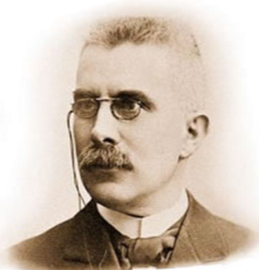
What is LeChatelier’s Principle?
If a change is imposed on a system at equilibrium, the equilibrium shifts to reduce the effect of that change

Slide 17
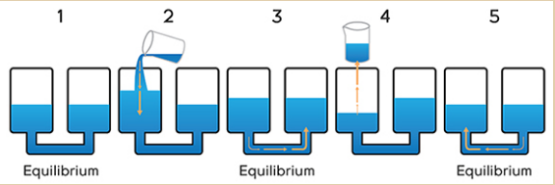
What is LeChatelier’s Principle?
Changes in concentration, volume & temperature may cause a shift in the equilibrium of a reaction
Reactions shift AWAY from anything added
Reactions shift TOWARDS anything removed

Slide 18
Le Châtelier’s Principle
In order to visualize the impact of changing the concentration of a reactant or product, consider how adding or removing weight from one side of a balanced teeter totter impacts the balance.
Balanced:
At “equilibrium”

Slide 19
Le Châtelier’s Principle
If you remove two blocks from the right side of the teeter totter, what happens?
What do you have to do to re-balance the teeter totter (re-establish the equilibrium)?

Slide 20
Le Châtelier’s Principle
To re-balance the teeter totter (re-establish the equilibrium), you must move one of the blocks from the left side over to the right side.

Slide 21
Le Châtelier’s Principle
What happens if you add 2 blocks to the right side of the original teeter totter?
What do you have to do to re-balance (re-establish the equilibrium) the teeter totter?

Slide 22
Le Châtelier’s Principle
To re-balance the teeter totter (re-establish the equilibrium), you must move one of the blocks from the right side to the left side.

Slide 23
Stress: Change Concentration
Ex: Co(H₂O)₆²⁺ + 4 Cl⁻ ↔ CoCl₄²⁻ + 6 H₂O
(pink) (blue)
Stress Result
Add Cl-
Forward reaction favored
Shifts right to reduce extra Cl⁻
More CoCl₄²⁻ will form
Remove Cl-
Reverse reaction favored
Shifts left to replace Cl⁻
More Co(H₂O)₆²⁺ will form

Slide 24
Effect of Temperature on Equilibrium
Consider two different types of reactions:
Exothermic & Endothermic
Exothermic: Heat can be considered a product
Endothermic: Heat can be considered a reactant
Endothermic: Increase in T shifts reaction to the right
Exothermic: Increase in T shifts reaction to the left

Slide 25
Stress: Change Temperature
Ex: heat + Co(H₂O)₆²⁺ + 4 Cl¹⁻ ↔ CoCl₄²⁻ + 6 H₂O
(pink) (blue)
This reaction is endothermic. For Le Chatelier’s principle, consider “heat” as a chemical.
Stress Result
Increase T
Forward reaction favored;
shifts right to reduce extra heat
More CoCl₄²⁻ will form
Decrease T
Reverse reaction favored;
shifts left to replace “lost” heat
More Co(H₂O)₆²⁺ will form

Slide 26
Stress: Change Volume
Ex: 1 N₂ (g) + 3 H₂(g) ↔ 2 NH₃(g)
(1 + 3 = 4 moles of gas) ↔ (2 moles of gas)
Stress Result
Forward rxn favored;
shifts right to side with fewer moles of gas
(reduces # of mc’s packed into this smaller volume)
Decrease V
Increase V
Reverse rxn favored;
shifts left to side with more moles of gas
(to fill the larger volume with more mc’s)

Slide 27
Catalysts & Equilibrium
MnO₂
2 H₂O₂ (aq) ↔ 2 H₂O (l) + O₂ (g)
Since a catalyst increases the forward and reverse rates equally, it will not shift the equilibrium.

Slide 28
LeChatelier’s Principle
N₂ + 3 H₂ 2 NH₃ + heat
…favors the endothermic reaction (the reverse
reaction) in which the rise in temperature is
counteracted by the absorption of heat.
Raising the temperature…
Decreasing the concentration
of NH₃…
…favors the forward reaction in order to
replace the NH₃ that has been removed.
Dorin, Demmin, Gabel, Chemistry The Study of Matter 3rd Edition, page 532

Slide 29
LeChatelier’s Principle Practice
Some sulfur trioxide is sealed in a container and allowed to equilibrate at a particular temperature. The reaction is endothermic.
SO₃ (g) + Heat → SO₂ (g) + ½ O₂ (g)
In which direction will the reaction proceed if the following occur:
More SO₃ is added to the system
Oxygen is removed from the system
SO₂ is added to the system
The temperature is increased
The temperature is decreased

Slide 30
More Practice- Do Now
Consider the reaction below for each of the questions:
CH₄ (g) + 2 H₂S (g) + heat ←→ CS₂ (g) + 4 H₂ (g)
How will removing hydrogen gas affect the system?
a) Shift to right b) Shift to the left c) No effect
How will increasing the temperature affect the system?
a) Shift to right b) Shift to the left c) No effect
If K_{eq} is calculated to be 5.81, what does that mean about the reaction?
The forward reaction (products) is favored
The reverse reaction (reactants) is favored
There is not enough information to know

Slide 31
Answers
Consider the reaction below for each of the questions:
CH₄ (g) + 2 H₂S (g) + heat ←→ CS₂ (g) + 4 H₂ (g)
How will removing hydrogen gas affect the system?
a) Shift to right b) Shift to the left c) No effect
How will increasing the temperature affect the system?
a) Shift to right b) Shift to the left c) No effect
If K_{eq} is calculated to be 5.81, what does that mean about the reaction?
The forward reaction (products) is favored
The reverse reaction (reactants) is favored
There is not enough information to know

Slide 32
Do Now – More Practice
Consider the reaction below for the following questions:
N_{2 (g)} + 3 H_{2 (g)} → 2 NH_{3 (g)} + Heat
Determine if the concentration of H₂ will increase or decrease when equilibrium is reestablished after the stresses are applied
NH₃ is added
N₂ is removed
Temperature is increased
What is the equilibrium expression for the reaction?
Notes:
a) increase b) increase c) increase
K = [NH3]2 / [N2][H2]3

Slide 33
Le Châtelier’s Principle SUMMARY
Changes in Concentration
Remove
Remove
Add
Add
aA + bB cC + dD
Change
Shifts the Equilibrium
Increase concentration of product(s)
left
Decrease concentration of product(s)
right
Increase concentration of reactant(s)
right
Decrease concentration of reactant(s)
left

Slide 34
Le Châtelier’s Principle SUMMARY
Changes in Volume and Pressure
(Only a factor with gases)
A (g) + B (g) C (g)
Change
Shifts the Equilibrium
Increase pressure
Side with fewer moles of gas
Decrease pressure
Side with most moles of gas
Increase volume
Side with most moles of gas
Decrease volume
Side with fewer moles of gas

Slide 35
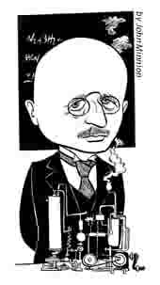
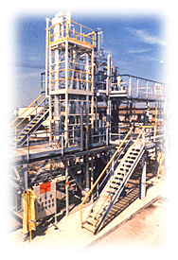
Le Chatelier’s Principle Recap
Le Chatelier’s principle:
When a system at equilibrium is disturbed, it shifts to a
new equilibrium that counteracts the disturbance.
N₂(g) + 3 H₂(g) 2 NH₃(g)
Disturbance Equilibrium Shift
Add more N₂…………………..
“ “ H₂…………………..
“ “ NH₃…………………
Remove NH₃…………………..
Add a catalyst…………………
no shift
Decrease volume……………..
Fritz Haber
Notes:
The Nobel Prize in Chemistry 1918
Presentation Speech
Presentation Speech by Doctor Å.G. Ekstrand, President of the Royal Swedish Academy of Sciences, on June 1, 1920*
Ladies and Gentlemen.** The Royal Swedish Academy of Sciences has decided to confer the Nobel Prize in Chemistry for 1918 upon the Director of the Kaiser Wilhelm Institute at Dahlem near Berlin, Geheimrat Professor Dr. Fritz Haber, for his method of synthesizing ammonia from its elements, nitrogen and hydrogen. In accordance with Nature's plan of economy, soil fertility under normal circumstances is maintained at an even level if the waste products from the crop are returned to the soil; if, however, substantially increased productivity is required from the soil, then additional fertilizer must be used. Since meanwhile a large proportion of the annual harvest is consumed by the yearly increasing population of towns, and since the towns' waste products are returned to land under cultivation only to a very incomplete extent, the inevitable consequence is that the soil becomes exhausted and the harvest yield diminishes. This has, in turn, led to the manufacture of artificial fertilizers which has also increased year by year in importance to such an extent that, at least in Europe, hardly a country exists which can do entirely without them. Among these substances nitrogenous compounds occupy an important position, since usually the soil does not possess a large store of these to be released to suit the plants' needs by weathering as in the case of phosphoric acid and potash; added to which there is the fact that part of the effective nitrogen turns into inactive atmospheric nitrogen during the cyclic process. Admittedly a part of this loss is compensated by rainfall and through the activity of bacteria, but so far experience has shown that intensive cultivation cannot be maintained without artificial nitrogenous fertilizers. This applies, above all, to one of today's most important crops, sugar-beet. For many years only two artificial nitrogenous compounds existed, namely potassium nitrate and ammonium chloride. The older methods by which these were made, however, ceased to play a part, at least in Europe and America, when Chile saltpetre (sodium nitrate) came into the picture and use was made of the by-products from dry distillation of mineral coal for this purpose. The consumption of Chile saltpetre, calculated in terms of nitrogen, amounts to about 500,000 or more tons per annum. Under normal circumstances the vast majority of this saltpetre is used for fertilizer purposes. The burning question, therefore, has long been: how long will the saltpetre deposits in Chile last? The Chilean authorities give very widely varying estimates, and experts in Europe are of the opinion that at current production rates the deposits will be exhausted within the foreseeable future. Be that as it may. The protracted World War has sufficiently demonstrated to every country the need of organizing, wherever possible, production of essential commodities within its own borders in sufficient quantities to meet its own needs. Now, since saltpetre is among the most important of these substances, particularly in those countries which possess neither large mineral coal deposits nor cheap hydro-electric power, the artificial production of ammonia and nitric acid has reached an unprecedented degree of importance. A substance on the borderline between natural and artificial products is the ammonia obtained by dry distillation of bituminous and brown coal. This ammonia comes from the nitrogen content of these minerals, amounting to approximately 1.3 % by weight, of which however the largest portion (around 85%) remains behind in the coke or is liberated as nitrogen during distillation. During the first ten years of this century several methods were published, based on binding the nitrogen from the air, but few of these survived the trial stage. The first of these was Frank-Caro's cyanamide method. Indeed it appears that calcium cyanamide did not come fully up to expectations as a fertilizer, but since its nitrogen content can be converted to ammonia relatively easily, this has not so far proved to be an obstacle to the application of the method to an ever-increasing extent. Using the main principles of thermodynamics every quantitative condition with regard to the combustion of atmospheric nitrogen to produce nitric oxide can be calculated. Birkeland and Eyde were, of course, the first to apply this technically with successful results. Until 1904 nobody had been able to bring about a direct combination of nitrogen and hydrogen to form ammonia without the help of dark electrical discharge, although the experiments of Berthelot and Thomson proved that the combination occurred exothermically. With the experience we now have we can easily see that this negative result was due to the slowness of the reaction at low temperatures, and unfavourable equilibrium conditions at high temperatures. Admittedly, in 1884 Ramsay and Young had conducted some experiments on this, using iron fillings as a catalyst, but these yielded only uncertain results. In 1904 Haber and van Oordt began a methodical study of this relevant field, based on modern physico-chemical methods, after a single previous experiment had given Haber a hope of finding a technical solution to the problem. They worked at a temperature of about 1,000° C and normal pressure, using iron as a catalyst. From these experiments it emerged that from red heat onwards, and also at higher pressures, only traces of ammonia could be formed. During this work it was also shown experimentally for the first time that a real state of equilibrium existed in the system N2+ 3H2 D2NH3, which is in fact the real basis for the synthesis of ammonia. In the "Zeitschrift für Elektrochemie" of 1913 can be found the treatment of this question, by Haber and Le Rossignol which has the most important practical meaning: "Über die technische Darstellung von Ammoniak aus Elementen" (On the technical production of ammonia from the elements). This treatise provided the groundwork for the development of the method on a factory scale at the "Badische Anilin- und Sodafabrik" in Ludwigshafen, the main development occurring under the guidance of Dr. C. Bosch. Earlier experiments had shown the pointlessness of exceeding dark red heat, i.e. about 600° C. On the other hand, the reaction formula showed that combination occurs with a contraction of from 4 to 2 volumes. From the law of equilibrium it follows that the higher the pressure is the more the equilibrium must shift to the ammonia side. This provided the basic principles. A temperature of about 500° C had to be used at the highest possible pressure, which in practice meant at about 150-200 atmospheres. It could also be assumed that this high pressure speeded up the reaction. But work with a flow of gas in a circulation system at such high pressure and at a temperature approaching red heat posed very severe difficulties and up to then had never been tried. It was, however, completely successful. The treatise in question contains detailed drawings of the equipment used with which, using iron as a catalyst, about 250 grams of ammonia were produced per hour and per litre of contact volume; with uranium or osmium as a catalyst considerably more was produced. The heating is done electrically. Since however the heat escaping from the equipment is largely regenerated in the entrant gases the required temperature can largely be maintained by the regenerated heat and by the heat liberated during the formation of ammonia. A very important point in Haber's observations is that the gases can be given a greater flow rate during the reaction which of course substantially increases the amount of ammonia produced per unit of time. Haber found the best catalyst to be osmium, followed by uranium or uranium carbide. According to tests conducted mostly at the factories of the "Badische", the activity of the catalyst may be increased by oxides or certain salts of alkalis and alkaline earth metals, just as it may be decreased by catalytic poisons. Gradually more active catalysts have been discovered, and by this means it has been found possible to reduce substantially the pressure in the chamber. In 1910 construction work was begun on the first large factory near Oppau in the neighbourhood of Frankfurt am Main, with an estimated annual output of 30,000 tons of ammonia. The basic materials, nitrogen and hydrogen, are produced by standard methods. Power consumption in the ammonia process is very low, amounting to no more than 0.5 kilowatt-hours per kilogram of ammonia. Per kilowattyear, therefore, no less than 10,000 kilograms of nitrogen are bound. Since the position of the equilibrium of the reaction depends, among other things, upon the heat of formation of ammonia and its specific heat, Haber in a series of seven articles in the "Zeitschrift für Elektrochemie" of 1914-1915, has extensively described experiments carried out to confirm these figures with the greatest possible accuracy. As, according to Ostwald's modified method, ammonia can be converted into nitric acid and the latter into calcium nitrate, the ratio between the overall costs of producing calcium nitrate is, according to the available calculations, approximately as follows: Norwegian Hydro: 100 Haber: 103 Frank-Caro: 117 in other words, they are the same for the first two methods but approximately 15% higher for the last. Since, however, of the three existing nitrogen methods, Haber's is the only one capable of operating independently of any available source of cheap hydroelectric power it can in future be applied in all countries; since furthermore it can be utilized on any convenient scale and because it can produce ammonia very much more cheaply and nitrate equally as cheaply as any other method, as explained above, it is of universal significance for the improvement of human nutrition and so of the greatest benefit to mankind. German Haber factories, especially the recently built Leuna Works near Merseburg, are also in full production, providing the vast majority of all nitrogenous fertilizers obtainable in Germany. Moreover, the method has already been extensively applied in the United States of America.
Geheimrat Professor Haber. This country's Academy of Sciences has awarded you the 1918 Nobel Prize for Chemistry in recognition of your great services in the solution of the problem of directly combining atmospheric nitrogen with hydrogen. A solution to this problem has been repeatedly attempted before, but you were the first to provide the industrial solution and thus to create an exceedingly important means of improving the standards of agriculture and the well-being of mankind. We congratulate you on this triumph in the service of your country and the whole of humanity. Please, accept now your prize from the President of the Nobel Foundation.
* The Nobel Prize in Chemistry 1918 was announced on November 13, 1919.
** Owing to the death of the crown-princess Margaret, no member of the Royal family was present at the Prize ceremony, which for special reasons had been postponed to early in June, 1920.
From Nobel Lectures, Chemistry 1901-1921, Elsevier Publishing Company, Amsterdam, 1966
Copyright © The Nobel Foundation 1918
Printer Friendly
Comments & Questions
Tell a Friend
The 1918 Prize in:
Prev. year
Next year
The Nobel Prize in Chemistry 1918
Presentation Speech
Fritz Haber
Biography
Nobel Lecture
Other Resources
Articles - A glimpse into their world
Listen to Chemistry Laureates
Sign up for News from Nobelprize.org
The Official Web Site of the Nobel Foundation
Copyright © Nobel Web AB 2007

Slide 36
HW Practice
Complete the worksheet using your notes and periodic table as necessary

