Slide 1
EOC Review
Feedback Control

Slide 2
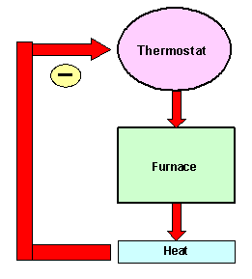
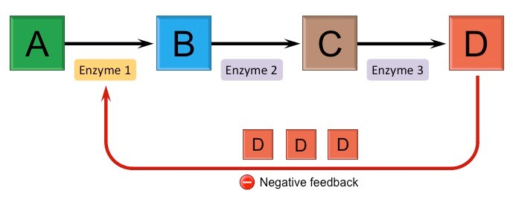
Feedback Control: General
Example: Negative
Example: Negative
(*Good site- Bioninja)

Slide 3
Feedback Control Source: www.albert.io
Positive: Ex #1
Positive: Ex #2

Slide 4
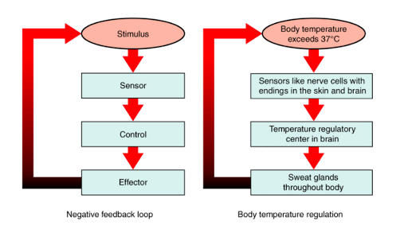
Feedback Control: General question (homeostasis)

Slide 5
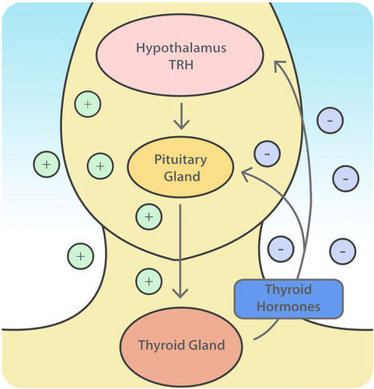
Sum this diagram up in words

Slide 6
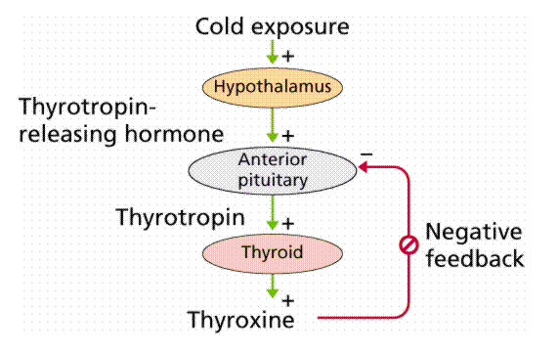
Feedback Control: Endocrine System
http://www2.estrellamountain.edu/faculty/farabee/biobk/biobookendocr.html
You don’t have to understand what these even are to see that this is neg feedback control (inhibition

