Slide 1
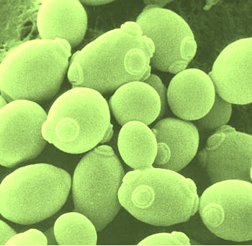
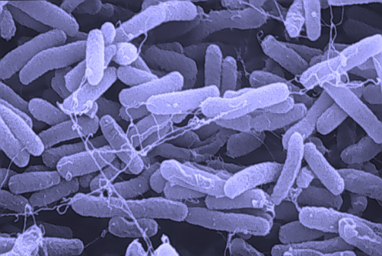
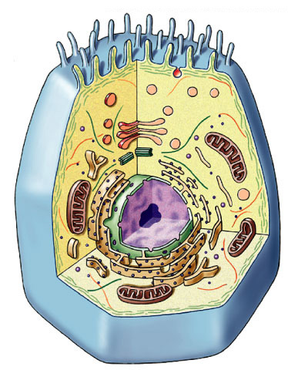
Cellular Respiration
Stage 1:
Glycolysis

Slide 2
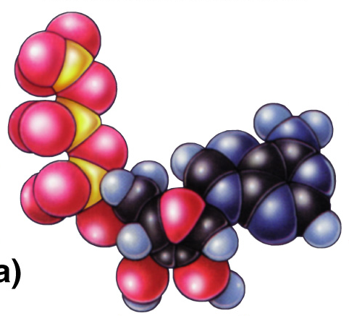
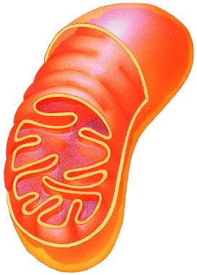
What’s the
point?
The point
is to make
ATP!
ATP

Slide 3

Glycolysis
Breaking down glucose
  “glyco – lysis” (splitting sugar)
  ancient pathway which harvests energy
    where energy transfer first evolved
    transfer energy from organic molecules to ATP
    still is starting point for ALL cellular respiration
  but it’s inefficient
    generate only 2 ATP for every 1 glucose
  occurs in cytosol
In the
cytosol?
Why does
that make
evolutionary
sense?
glucose → → → → → pyruvate
6C
2x
3C
That’s not enough
ATP for me!
Notes:
Why does it make sense that this happens in the cytosol?
Who evolved first?

Slide 4
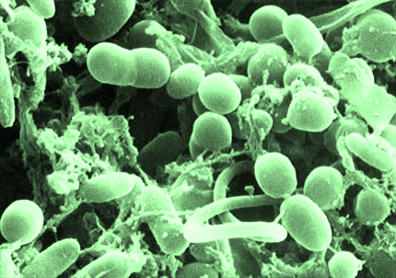
Evolutionary perspective
Enzymes
of glycolysis are
“well-conserved”
Prokaryotes
  first cells had no organelles
Anaerobic atmosphere
  life on Earth first evolved without free oxygen (O₂) in atmosphere
  energy had to be captured from organic molecules in absence of O₂
Prokaryotes that evolved glycolysis are ancestors of all modern life
  ALL cells of ALL organisms still utilize glycolysis
You mean
we’re related?
Do I have to invite
them over for
the holidays?
Notes:
The enzymes of glycolysis are very similar among all organisms. The genes that code for them are highly conserved.
They are a good measure for evolutionary studies. Compare eukaryotes, bacteria & archaea using glycolysis enzymes.
Bacteria = 3.5 billion years ago
glycolysis in cytosol = doesn’t require a membrane-bound organelle
O₂ = 2.7 billion years ago
photosynthetic bacteria / proto-blue-green algae
Eukaryotes = 1.5 billion years ago
membrane-bound organelles!
Processes that all life/organisms share:
Protein synthesis
Glycolysis
DNA replication

Slide 5
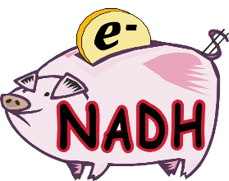
Overview
glucose
C-C-C-C-C-C
ATP
2
10 reactions! Don’t worry- you only have to know what’s written below:
  convert
  glucose (6C) to
  2 pyruvate (3C)
  produces:
  4 ATP & 2 NADH
  consumes:
  2 ATP
  FYI:
  net yield:
  2 ATP & 2 NADH
enzyme
2
enzyme
ADP
fructose-1,6bP
P-C-C-C-C-C-C-P
enzyme
enzyme
DHAP
P-C-C-C
enzyme
G3P
C-C-C-P
2
2H
NAD⁺
2P_{i}
enzyme
2
enzyme
4
2P_{i}
ADP
enzyme
ATP
4
pyruvate
C-C-C
DHAP = dihydroxyacetone phosphate
G3P = glyceraldehyde-3-phosphate
Notes:
1st ATP used is like a match to light a fire…
initiation energy / activation energy.
Destabilizes glucose enough to split it in two

Slide 6
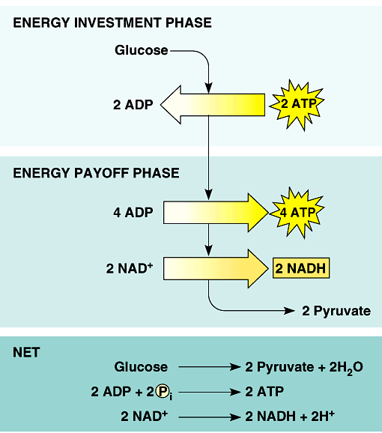
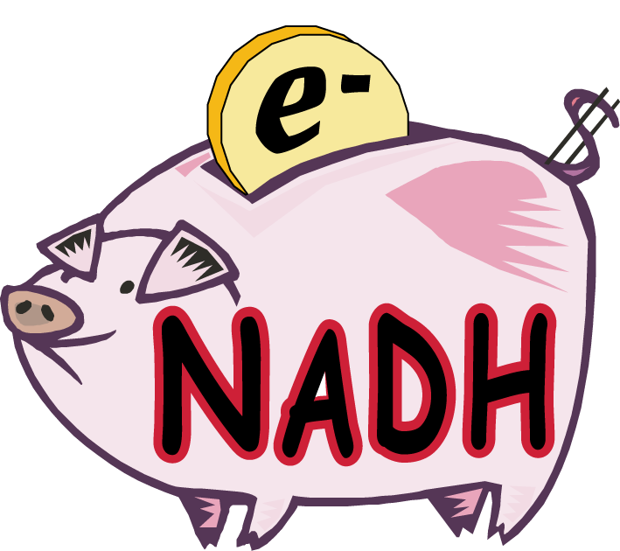
Glycolysis summary
endergonic
invest some ATP
ENERGY INVESTMENT
-2 ATP
G3P
C-C-C-P
exergonic
harvest a little
ATP & a little NADH
ENERGY PAYOFF
4 ATP
like $$
in the
bank
net yield
2 ATP
2 NADH
NET YIELD
Notes:
Glucose is a stable molecule it needs an activation energy
to break it apart.
phosphorylate it = Pi comes from ATP.
make NADH & put it in the bank for later.

Slide 7
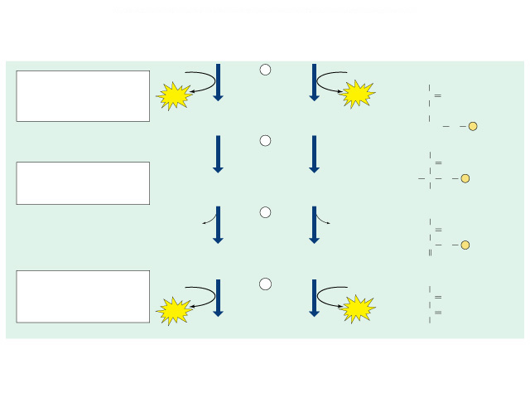
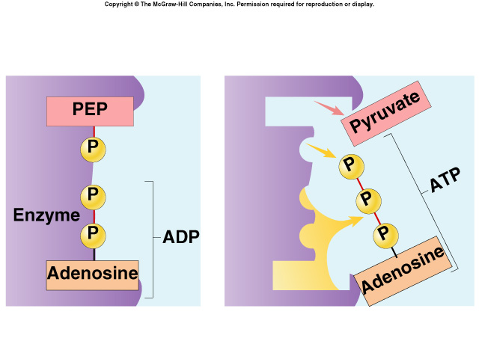
Substrate-level Phosphorylation
In the last steps of glycolysis, where did the P come from to make ATP?
  the sugar substrate (PEP)
9
O⁻
H₂O
enolase
H₂O
C
O
P is transferred from PEP to ADP
  kinase enzyme
  ADP → ATP
C
O
P
Phosphoenolpyruvate
(PEP)
Phosphoenolpyruvate
(PEP)
CH₂
10
O⁻
ADP
ADP
C
O
pyruvate kinase
ATP
ATP
C
O
ATP
Pyruvate
Pyruvate
CH₃
I get it!
The P_{i} came
directly from
the substrate!

Slide 8
Energy accounting of glycolysis
2 ATP
2 ADP
glucose → → → → → pyruvate
6C
2x
3C
ATP
All that work!
And that’s all
I get?
4 ADP
4
2 NAD⁺
2
But
glucose has
so much more
to give!
Net gain = 2 ATP + 2 NADH
  some energy investment (-2 ATP)
  small energy return (4 ATP + 2 NADH)
1 6C sugar → 2 3C sugars
Notes:
And that’s how life subsisted for a billion years.
Until a certain bacteria ”learned” how to metabolize O₂; which was previously a poison.
But now pyruvate is not the end of the process
Pyruvate still has a lot of energy in it that has not been captured.
It still has 3 carbons bonded together!
There is still energy stored in those bonds.
It can still be oxidized further.

Slide 9
Is that all there is?
Not a lot of energy…
  for 1 billon years⁺ this is how life on Earth survived
    no O₂ = slow growth, slow reproduction
    only harvest 3.5% of energy stored in glucose
      more carbons to strip off = more energy to harvest
O₂
glucose → → → → pyruvate
O₂
6C
2x
3C
O₂
Hard way
to make
a living!
O₂
O₂
Notes:
So why does glycolysis still take place?

Slide 10
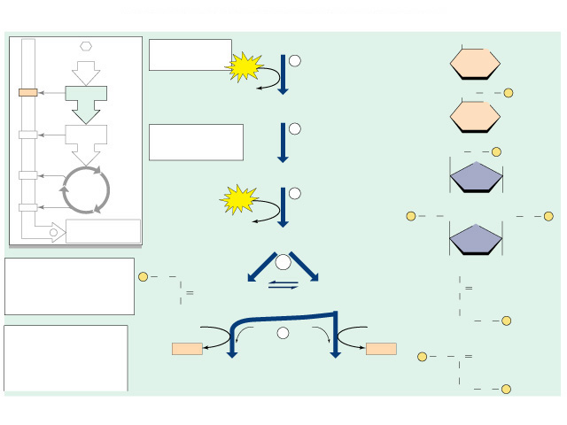
But can’t stop there!
DHAP
G3P
NAD⁺
P_{i}
P_{i}
NAD⁺
raw materials → products
NADH
P_{i}
NADH
NAD⁺
P_{i}
6
NAD⁺
NADH
1,3-BPG
1,3-BPG
NADH
ADP
7
ADP
Glycolysis
glucose + 2ADP + 2P_{i} + 2 NAD⁺ → 2 pyruvate + 2ATP + 2NADH
ATP
ATP
3-Phosphoglycerate
(3PG)
3-Phosphoglycerate
(3PG)
8
2-Phosphoglycerate
(2PG)
2-Phosphoglycerate
(2PG)
Going to run out of NAD⁺
  without regenerating NAD⁺,
  energy production would stop!
  another molecule must accept H
  from NADH
    so NAD⁺ is freed up for another round
9
H₂O
H₂O
Phosphoenolpyruvate
(PEP)
Phosphoenolpyruvate
(PEP)
ADP
10
ADP
ATP
ATP
Pyruvate
Pyruvate

Slide 11
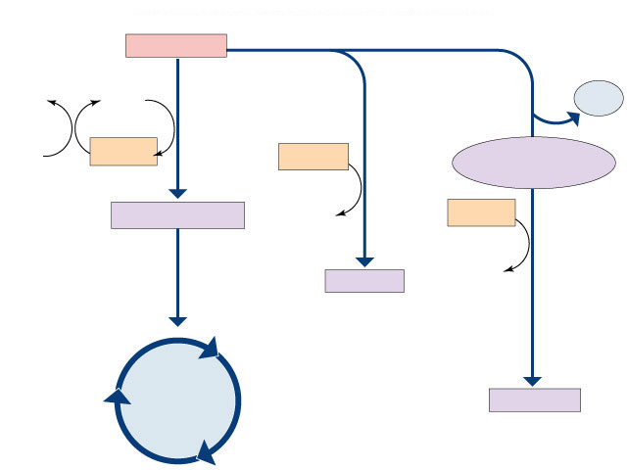
How is NADH recycled to NAD⁺?
Another molecule must accept H from NADH
with oxygen
aerobic respiration
without oxygen
anaerobic respiration
“fermentation”
pyruvate
H₂O
NAD⁺
CO²
O₂
NADH
NADH
acetaldehyde
recycle
NADH
acetyl-CoA
NADH
NAD⁺
lactate
NAD⁺
lactic acid
fermentation
which path you use depends on who you are…
Krebs
cycle
ethanol
alcohol
fermentation

Slide 12
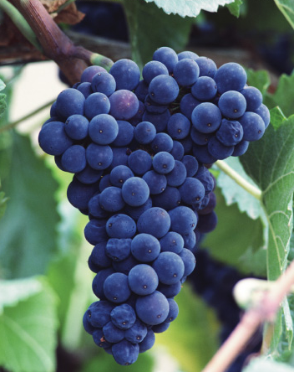
Fermentation (anaerobic)
Bacteria, yeast
pyruvate → ethanol + CO₂
3C
2C
1C
NADH
NAD⁺
back to glycolysis→→
    beer, wine, bread
Animals, some fungi
pyruvate → lactic acid
3C
3C
NADH
NAD⁺
back to glycolysis→→
    cheese, anaerobic exercise (no O₂)
Notes:
Count the carbons!!
Lactic acid is not a dead end like ethanol. Once you have O₂ again, lactate is converted back to pyruvate by the liver and fed to the Kreb’s cycle.

Slide 13
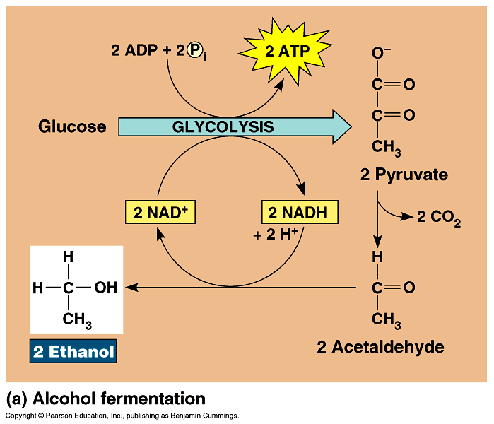
Alcohol Fermentation
bacteria yeast
recycle
NADH
pyruvate → ethanol + CO₂
3C
2C
1C
NADH
NAD⁺
back to glycolysis→→
Dead end process
  at ~12% ethanol, kills yeast
  can’t reverse the reaction
Count the
carbons!

Slide 14
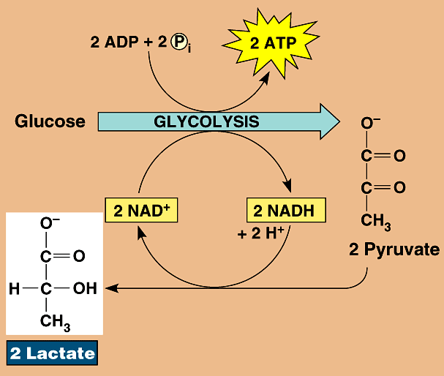
Lactic Acid Fermentation
animals
some fungi
recycle
NADH
pyruvate → lactic acid
O₂
→
3C
3C
NADH
NAD⁺
back to glycolysis→→
Reversible process
  once O₂ is available, lactate is converted back to pyruvate by the liver
Count the
carbons!

Slide 15
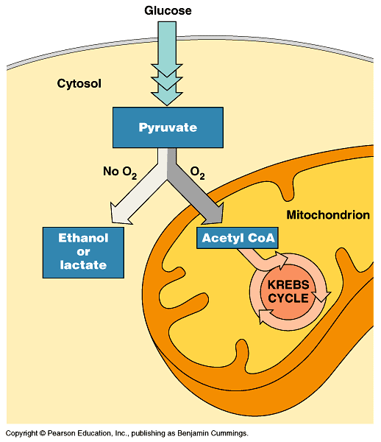
Pyruvate is a branching point
Pyruvate
O₂
O₂
fermentation
anaerobic
respiration
mitochondria
Krebs cycle
aerobic respiration

Slide 16
What’s the
point?
The point
is to make
ATP!
ATP

Slide 17
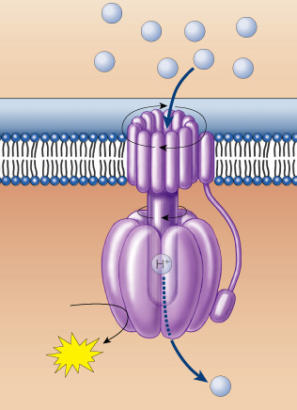
And how do we do that?
H⁺
H⁺
H⁺
H⁺
H⁺
H⁺
H⁺
H⁺
ATP synthase
  set up a H⁺ gradient
  allow H⁺ to flow
  through ATP synthase
  powers bonding
  of P_{i} to ADP
ADP + P_{i} → ATP
ADP
+
P
ATP
H⁺
But… Have we done that yet?

Slide 18
NO!
There’s still more to my story!
Any Questions?

Slide 19
Maybe an Amoeba Sisters Video Will Help
http://www.youtube.com/watch?v=4Eo7JtRA7lg&list=UUb2GCoLSBXjmI_Qj1vk-44g

Slide 20
Quiz 4
The formula CO₂ + H₂O --- C₆H₁₂O₆ + O₂ is the formula for ? a. photosynthesis b. respiration
___ is the process which breaks down food molecules to release energy and takes place in the mitochondria.
a. photosynthesis b. digestion c. respiration
___ is formed when ATP releases a phosphate.
a. ADP b. AMP c. APP
Fermentation is a form of ___ respiration which occurs without the presence of oxygen.
a. aerobic b. anaerobic c. antioxidant
The green pigment which is present in plant cells and allows them to go through photosynthesis is ___.
a. chlorophyll b. chloroplast c. chlorosis

Slide 21
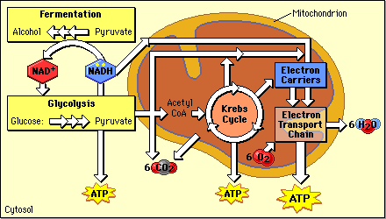
Where does Glycolysis take place?
Glycolysis

Slide 22
What does Glycolysis require?

Slide 23
What are the final products??
Glycolysis

Slide 24
Special Note:
Glycolysis can produce thousands of ATP molecules in milliseconds.
But quickly fills all available NAD+ (electron carriers) with electrons and the process stops, so it’s only good for short-term energy.

Slide 25

Cellular Respiration
2
36

