Slide 1
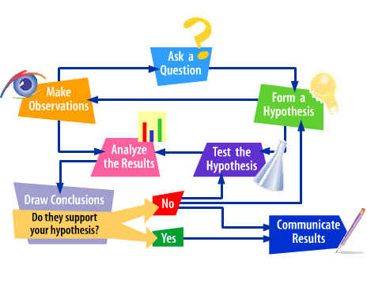
Scientific Method

Slide 2
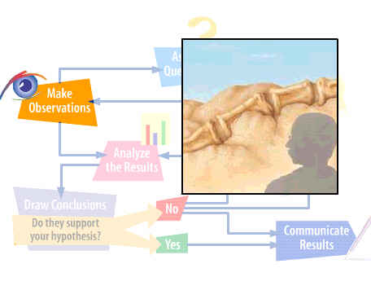
Observation – STEP 1
Employing your five senses to perceive objects or events

Slide 3
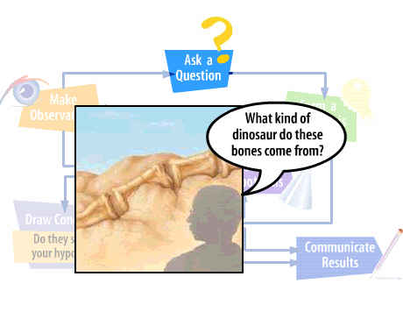
Asking a Question
Based on observations; one or more questions are generated

Slide 4
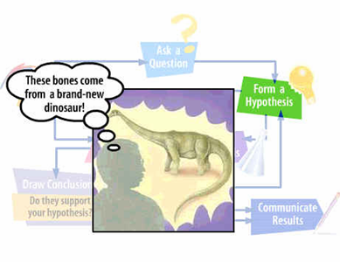
Forming a Hypothesis – STEP 2
A statement is testable if evidence can be collected that either does or doesn’t support it. Must be testable to be valid.
It can never be proven beyond doubt
Often must be refined and revised or discarded

Slide 5
The Hypothesis ---
Is a statement made in advance that states the results that will be obtained from testing the hypothesis
Often written in the form of an “if-then” statement (and often called a prediction)

Slide 6
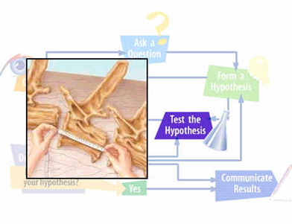
Experimenting – STEP 3
Testing a hypothesis or prediction by gathering data under controlled conditions – conducting a controlled experiment
Based on a comparison of a control group with an experimental group

Slide 7
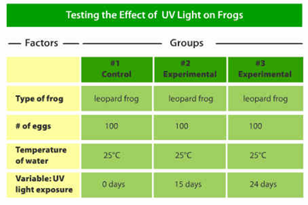
Both groups are identical except for one factor (independent variable)
Observations and measurements are taken for a particular factor (dependent variable) in both groups
Driven by or results from independent variable

Slide 8
Measuring
Involves quantitative data that can be measured in numbers &/or qualitative data information that isn’t numbers
Sampling
Technique of using a sample – a small part – to represent the entire population

Slide 9
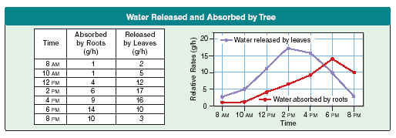
Organizing Data – STEP 4
Involves placing observations and measurement (data) in order
Graphs, charts, tables, or maps

Slide 10
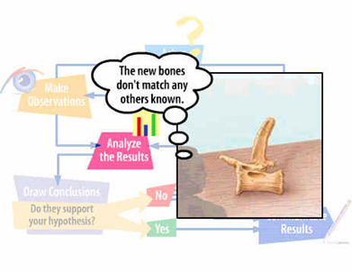
Analyzing Data – STEP 4 cont)
Collected and organized data must be analyzed
Process of determining whether data are reliable or whether they support or do not support a hypothesis or prediction

Slide 11
Conclusion – STEP 5
Conclusions are made on the basis of facts, not observations
Often drawn from data gathered from a study or experiment
Should support the hypothesis
Should be re-testable

Slide 12
Communication – STEP 6
Scientists must share the results of their studies with other scientists (peers)
Publish findings in journals
Present their findings at scientific meetings
Scientists must be unbiased
Should not tamper with their data
Only publish & report tested & proven ideas

Slide 13
Communication
Sharing of information is essential to scientific process
Subject to examination and verification by other scientists
Allows scientists to build on the work of others

Slide 14
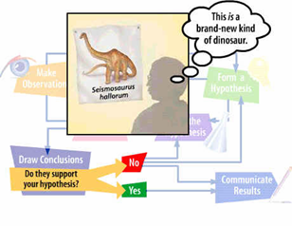
Theories
A theory may be formed after many related hypotheses have been tested and supported with experimental evidence
A broad and comprehensive statement of what is thought to be true
Supported by considerable evidence
Ties together related hypotheses

Slide 15
Laws
A Statement of fact that concisely explains an action or group of actions e.g. Law of Gravity
Accepted to be true
Universal
May be expressed as a math equation e.g. E=mc²

