Slide 1
Water Transport- Plants
Video: https://www.youtube.com/watch?v=UTgilJAitII (dfaulkes)

Slide 2
Key Points

Slide 4
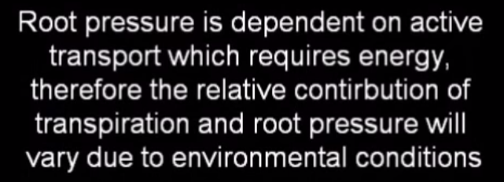
Why can’t water simply move into the xylem by osmosis?
Hint: Water moves from high water potential to low WP. Where is WP higher…the endodermis or the xylem?

Slide 5
Active Transport
1- Salts must be actively transported into the xylem in order for water to move from high to low
2- How does active transport also apply to the opening and closing of stomata?

